Slide 1
Agricultural Knowledge & Information Systems
Farming Systems Research
Technology Transfer
Ongoing
Evolution
Agricultural Innovation Systems
Greater embedding of social & environmental concerns; with
innovations seen as niche activities?
Growing interest in the influence
of system’s wider structural
elements on innovation capacity
2000’s
Increasingly open participation with
focus on knowledge triangle of
research, education & extension
1990’s
Rising levels of concern with respect to disconnect between science & practice prompted turn to participatory approaches
1970’s
Top-down, linear or pipeline model with science dominant providers of knowledge and farmers & growers passive recipients
1960’s

Slide 2
1.
Introduction
2.
Theoretical
Perspective
4.
Context
6. Heifer Rearing
7. Water Use Efficiency
5. Primary Innovation Programme
8.
Discussion
9.
Conclusions
3. Method-ology

Slide 3
Co-ordinated:
working together
across the value chain at multiple-levels
(micro, meso & macro) towards a shared vision
Complementary: seeking alignment of
technological, network & institutional
dimensions with a view to creating conditions conducive to change
Collaborative:
a coming together, over time, of an evolving group of stakeholders with diverse skills, knowledge & resources, open to mutual learning
Context:
a 4th ‘co’?
Innovation
driven
value
creation
Co-innovation approach
Shared
Problem

Slide 4
Group
dynamics
Respect value of knowledge in all its forms
Be open to learning &
reflect on contribution to project
Include all needed to fully understand problem & to develop solutions
Allow relationships to evolve over time
Be honest &
open to encourage trust
Take time to understand the problem
Be
prepared to be
uncomfortable at times
Maintain awareness of wider, changing context
Keep shared
vision in sight & under review
Co-innovation
space
Context
Self
reflection
Problem
focus

Slide 5
Ever-present &
constantly changing
layers
Anticipatory
co-ordination
Shifting
and Dynamic
Landscape
emerging
novelty…
innovation pathway or journey
…configuration
that works
Patchwork
of Evolving
Regimes
Niches or
Protected
Spaces
Time

Slide 6
Technological
Anchoring
Institutional
Anchoring
Network
Anchoring
Context
Develop inspiring approach in
response to identified need
Provide
an
exemplar
Encourage
partial
take-up
Develop & sustain
supportive network
across the value chain
Create space for
experimentation
Strategic
Tactical

Slide 7
Outward looking perspective maintained
Group dynamics evolving over time
Shared vision developed & reviewed
Context
Co-innovation
space
Co-ordinated
Spirit of openness & sharing of resources
Address tensions & reflect on learnings
Complementary
Mutual learning via knowledge exchange
Inclusive, with all knowledge respected
Collaborative
Rounded perspective of the problem
Detailed under-standing of problem

Slide 8
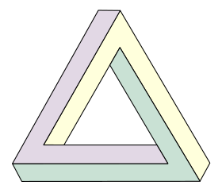
Dimensions of Scale
Temporal
+/-
Institutional
Spatial
… Long Term --->
<--- Conforming …
+/-
<--- Global …
… Reforming --->
… Short Term --->
<--- Local …
Potential tension(s) between
contrasting perspectives
of each dimension with
associated opportunities(+)/challenges(-)
+/-
Penrose Triangle for Powerpoint from http://upload.wikimedia.org/wikipedia/commons/thumb/f/f4/Penrose_triangle.svg/280px-Penrose_triangle.svg.png

Slide 9
Research design/strategy of inquiry
Quantitative | e.g. experimental and non-experimental
Qualitative | e.g. narrative; grounded theory; ethnography; phenomenological; and case study
Mixed Methods | e.g. convergent; explanatory and exploratory
Philosophical worldview or paradigm: postpositivist; constructivist;
pragmatist or transformative
Research
approach:
quantitative,
qualitative or
mixed methods
Research methods:
questions; data collection, analysis, interpretation and validation

Slide 10
Primary Innovation Programme (PIP)
Stream 1:
ex-post
analysis of
3 x projects
Stream 2:
ex-ante
analysis of
5 x projects
Stream 3: engagement with wider Community for Change (CfC)
InCalf
Apple Futures
LEP Toolkit
Heifer Rearing (HR)
Tomato Potato Psyllid (TPP)
Timber Segregation (TS)
Water Use Efficiency (WUE)
Nutrient Management (NM)
Approximately
50 x stakeholders
in some 20 varied
organisations

Slide 11
Context
Respondent’s understanding of project and its objectives
Length of time involved
Rationale for / starting point of involvement
Respondent’s role in project
Expectations of involvement / what’s in it for them
Previous experience relevant to project
Institutional (Geels, 2004)
Rules, incentive structures, governance and protocols
Perceived rights, duties and responsibilities
Respondent’s priorities & problem agendas
Economic
Normative
Interpretative
How
co-innovation
anticipates scaling
Technological (Rogers, 1995)
Has respondent contributed to development of innovation
Perceived benefits of innovation / benefits for respondent
Perceived risks associated with uptake / trial of innovation
Perceived compatibility with existing systems
Perceived complexity of innovation
Has the innovation been trialled by the respondent? Tried by contacts?
Terminology associated with innovation / used by respondent
Network
Primary points of contact within project
Awareness of / contact with others involved at the same level / at different hierarchies
Nature of contact: influenced by / influencing
Frequency of contact
Intensity of contact
Perceived value of contact with respect to respondent’s objectives; with respect to project’s objectives
Critical contact points
How have these contacts evolved over time
Perceived contact gaps

Slide 12
Analysis
Writing
Analysis
Analysis
Reading & re-reading to become familiar with data
Reporting:
compelling narrative supported by selected extracts
Coding across the data set
Thematic Analysis
Refining themes through ongoing analysis
Collating codes to develop broad themes
Reviewing themes by moving back & forth with wider data
Theoretical Perspective

Slide 13
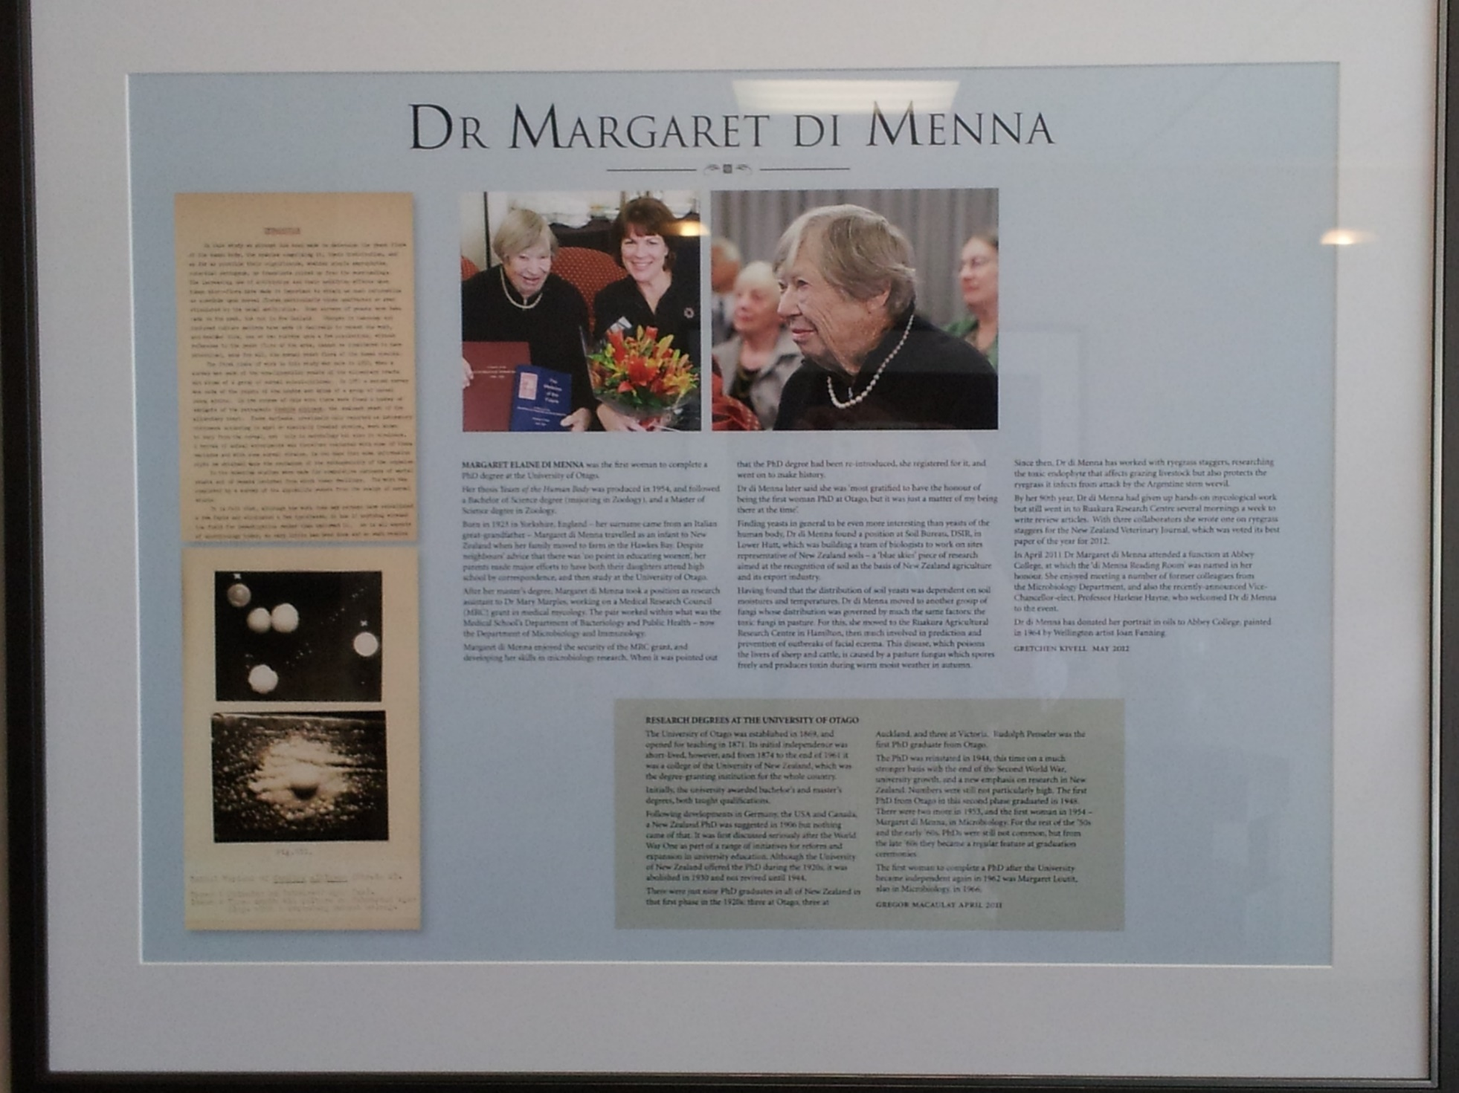

Slide 14
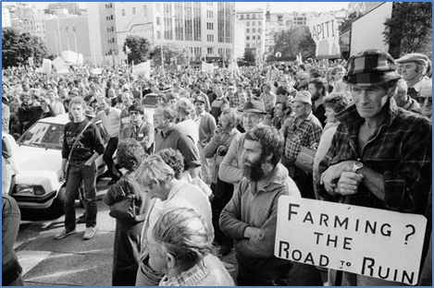

Slide 15
* Farmgate price was NZ53cents below calculated price to reflect global market shifts
** Forecast (as at August 2018)
Source: https://www.fonterra.com/nz/en/investors/farmgate-milk-prices.html (accessed 31/08/2018)

Slide 16
REFLEXIVITY
Stream 1:
Theoretical
Framing
Primary
Innovation
Programme
(PIP)
Stream 3:
Stakeholder
Engagement
Stream 2:
In-field
Application
LEARNING

Slide 17
Nutrient
Management
Water Use Efficiency
More Contested
Timber Segregation
Tomato Potato Psyllid
Knowledge
Less Contested
Heifer
Rearing
Less Complex
More Complex
Change Mechanisms

Slide 18
Water Use Efficiency
Nutrient Management
Heifer
Rearing
Timber Segregation
Tomato Potato Psyllid
Commenced in
October 2013
Commenced in
October 2012
Additional funding secured from October 2013
Oct 2012
Sept 2013
Oct 2013
June 2014

Slide 19
Later-stage vision
2015/16
Mid-stage reflections
2014/15
A diverse range of under-standings
Target activities around key attractors
Early-stage experience
2013/14
Confusion with respect to concept of systemic failures
Use ex-ante projects to bring concepts to life
Fragmented, silo-thinking, competitive rather than cohesive
An appetite for change
Little engagement with function of the system
Target activities towards key influencers
System
Concern that pushed too far, too fast
Encourage stakeholders to own the process
Reactive rather than proactive
Interest & curiosity in a coinnovation approach
Individual
Time
Barrier
Opportunity

Slide 20
Industry Leadership Group (ILG):
i) Leadership; ii) Relationship Management;
iii) Economics; and iv) Knowledge
Industry Advisory
Group (IAG)
Year 4:
Review & reflection
Year 3:
Knowledge sharing
Year 2: Knowledge
development
4-year Heifer Rearing Project under the Primary Innovation Programme
Year 1:
Problem scoping & information gathering
2016/17
2015/16
2014/15
2013/14
Heifer Rearing component of InCalf forms basis of co-innovation
project under umbrella of Primary Innovation Programme
InCalf programme launched under licence for use in New Zealand
InCalf
Initiative
Comprehensive dairy herd fertility studies in Australia &
New Zealand
2008 to date
Herd Fertility Studies
Downward pressure on milk prices prompts DairyNZ to launch
‘Tactics for Tight Times’ campaign
1996-2000
2014/16
Indicative timeline of activities involved in the Heifer Rearing project

Slide 21
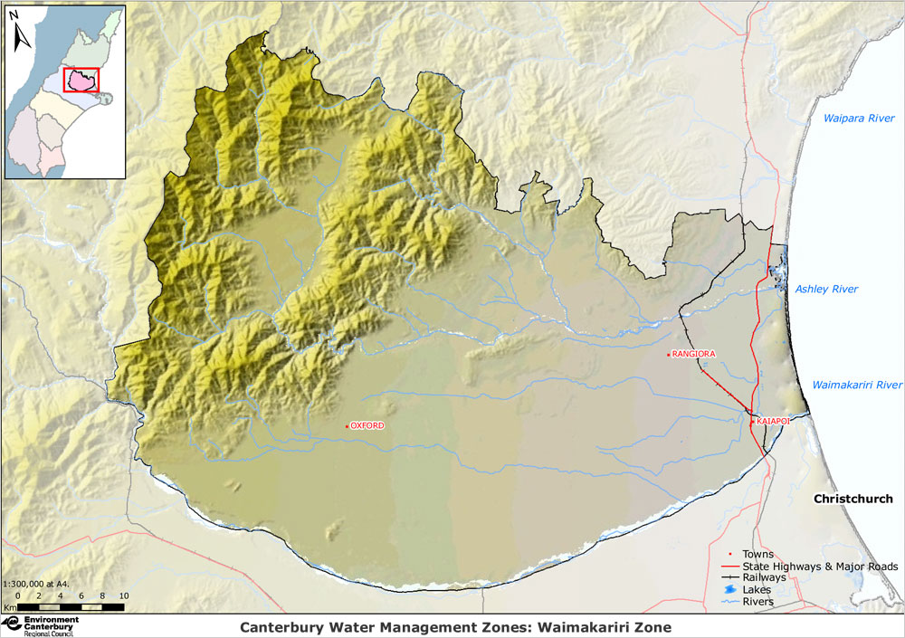
Base map: braid.org.nz, extracted from
Environment Canterbury (accessed 01/02/2016)
Canterbury Water Management Zones
1
2
6
3
4
7
5
9
8
10
Southern Alps
Outline of Zones
in the
Canterbury Region
(key below)
Ashley River
Cust River
Eyre River
Waimakariri River
Key to Zones: 1-Kaikora; 2-Hurunui-Waiau; 3-Waimakariri; 4-Christchurch-WestMelton; 5-Banks Peninsula; 6-Selwyn-Waihora; 7-Ashburton; 8-Opihi-Orari-Pareora; 9-UpperWaitaki; 10-LowerWaitaki.

Slide 22
Development & application of WUE concepts
Irrigation Insight:
continued application of
co-innovation principles in stand-alone NIWA-led MBIE-funded follow-on to
pilot WUE concept in the Cust District
Application of co-innovation approach
Farm Weather Briefing:
application of co-innovation under Primary Innovation Programme to explore use of high resolution NIWA weather forecast & soil moisture data in on-farm irrigation decision-making; working with Waimakariri Irrigation Ltd, farmers & stakeholders
New commercial partnership between
Waimakariri Irrigation Ltd & Regen for
provision of novel data-driven app to
inform on-farm irrigation decisions to
ensure users are operating according to
Good Management Practice by 2020
Field trials
of Regen technologies with Waimakariri
Irrigation Ltd
…
2012
2013
2014
2015
2016
2017
2018
2019
2020
2021
…
Indicative timeline of WUE activities in the Waimakariri and Cust Districts of Canterbury

Slide 23
 | Main Irrigation Season |  | Shoulder Season |  | Off Season |  |  |  | Shoulder Season |  | Main Irrigation Season
 | Jan | Feb | Mar | Apr | May | Jun | Jul | Aug | Sept | Oct | Nov | Dec
2017 |  |  |  |  | X
2016 |  |  |  |  | X |  |  |  | !
2015 |  |  |  |  | X
2014 |  |  |  |  | X
2013 |  | ! |  |  | X
2012
Key to phases
Phase 5 | Project Legacy; n = 28
Phase 4 | Extended Outreach; n = 25
Phase 3 | Knowledge Synthesis; n = 22
Phase 2 | Trust Building; n = 15
Phase 1 | Concept Development; n = 9
FEP
Target date for
introduction of FEPs
in Waimakariri Zone
Annual
end of season
stakeholder
workshop
FEP
FEP Template
operative in
neighbouring zone

Slide 24
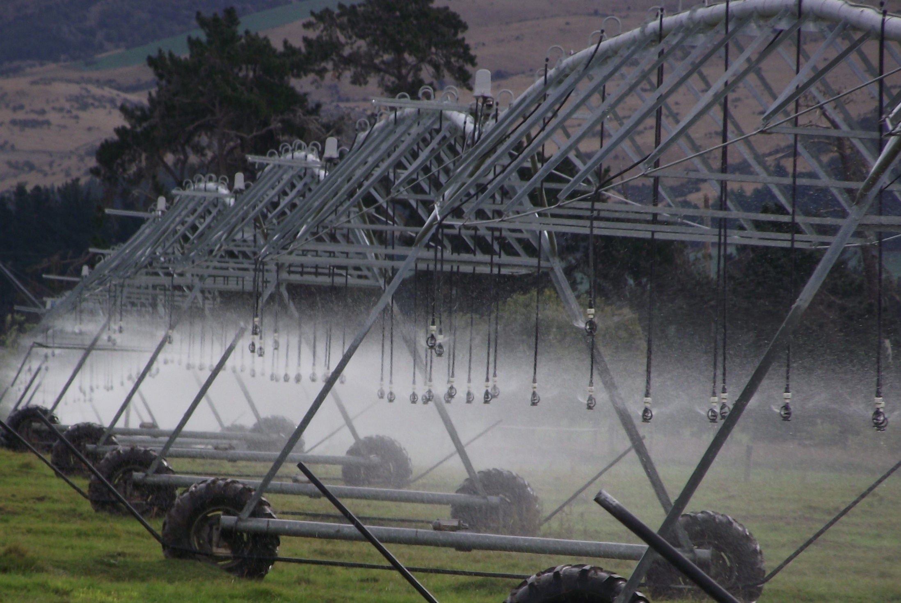

Slide 25
Ever-present
layers of
niches, regimes
& landscape
in flux
Anticipatory
co-ordination
(up-scaling?)
Shifting
Landscape
emerging
local
novelty…
innovation pathway (out-scaling?)
…some
configuration
that works
Patchwork
of Evolving
Regimes
Dynamic
Niches or
Protected
Spaces
Time

Slide 26
Jointly held co-innovation space
Boundary functions
tending towards
mediating & stabilising
Hybrid-forum functions
tending towards
translation & adaptation
… Innovation pathway over time …

Slide 27
Co-innovation inspired
response to a shared problem
A joint
commitment
to hold space
Innovation-driven
value creation
Network
(Software)
Who?
Public Sector, Research Institutes, Private Sector, NGOs, Farmers
What do they bring?
Resources
Knowledge
Skills
Collaborative:
a coming together
over time of diverse
stakeholders alert to the
need to address a shared
problem to create value
-> multi-actor
Institutional:
cultivate an enabling environment
c
o
n
t
e
x
t
s
c
a
l
i
n
g
Techno-institutional:
encourage part uptake
& learn-by-doing
Co-ordinated:
working in a spirit of
openness to encourage
development of trust
& mutual learnings with
an awareness that tensions
are part of the process
-> multi-dimensional
Technological:
create & communicate an inspiring response
to a shared problem
Technological
(Hardware)
Novel technology
or practice
co-innovation
space
Techno-network:
provide an exemplar
to put a
stake-in-the-ground
Institutional (Orgware)
Hard: e.g. governance, regulations & laws
Soft: e.g. accepted norms & behaviours
Complementary:
outward looking,
responsive to context
& seeking to create
conditions for change
-> multi-level
Network:
develop & sustain a supportive & evolving
community of
stakeholders
AIS thinking
Understanding
Operationalising
Anchoring

