Slide 1
Jisc update
Paul Feldman
CEO Jisc
REPO Fringe 2/8/2016

Slide 2
Some highlights of what we are doing today

Slide 3
Jisc Strategy
Our Vision
For the UK to be the most digitally advanced Higher and Further education and research nation in the world
Our Aim
To achieve this vision, each day we will continue both to power UK’s Higher and Further education’s teaching, learning and research and inspire its digital transformation

Slide 4
Our Strategy 2016-19
Continue to develop the Janet Network, the foremost national research and education network in the world.
Focus our products on the areas that make the most difference to learners, teachers and researchers and offer solutions tailored to the unique challenges of the education and research sectors.
  Build on our strong reputation in HE, especially with senior leadership teams, by adding indispensable value.
  Become a recognised and valued partner to FE through our world-class infrastructure and our expertise in technology-assisted learning.
  Strengthen our position as a partner and key enabler of UK research through our network, research infrastructure, curation and discovery.
  Grow our offering internationally so it is a significant source of income, efficiencies and benefits our members.
Make membership meaningful through an authentic two-way relationship with individual members and the HE and FES sectors, by listening, collaborating and fully integrating our plans with their own requirements and thinking.
Continue to build a strong, financially sustainable, position
Operating to high standards of efficiency and effectiveness, be recognised as the leading sector agency in the UK and internationally with motivated, passionate staff and satisfied members.

Slide 5
Network now
Glasgow
Global Transit & Peering
Peering
Manchester
Leeds
Birmingham
Nottingham
Bristol
London
Telehouse West
London
Telecity Powergate
100Gbit/s
London
Telecity HX
200Gbit/s
London
Telehouse North
400Gbit/s
Global Transit & Peering
600Gbit/s

Slide 6
Janet external connectivity
100Gbit/s
Google
Akamai
BTnet
Total external connectivity > 1.2 Tbit/s
Netflix
AQL 3G
IXLeeds
10Gbit/s
BBC
Bogons
1Gbit/s
Init7
BBC (Pacific Quay)
Globelynx
Microsoft EU (via TN)
inTechnology
Microsoft EU (via TW)
Simplecall
SWAN
(Glasgow)
Limelight
Updata
Glasgow
&
Edinburgh
Logicalis UK
BBC (HD 4K pilots)
Telehouse
North & West
Pipex / GXN
Leeds
RM for Schools
INUK
SWAN
(Edinburgh)
Voicenet
VM for LGfL
Virgin Radio
Global Transit
Tata
LINX multicast
AQL 3G
LINX
IXManchester
HEAnet
Google
Global Transit
Level3
Akamai
Telecity Harbour Exch.
GÉANT
NHS N3
Microsoft EU
Google
Gamma
Manchester
VM for LGfL
Synetrix
VM for LGfL
RM for Schools
GÉANT+
inTechnology
One Connect
Akamai
Gamma
Redstone
Exa Networks
BBC (HD 4Kpilots)
Limelight
Amazon
Voicenet
Datahop
~ 500 peerings to…
~ 300 organisations
Global Transit
Level3
Simplecall
China Unicom
NHS N3
China Telecom
Telekom Malaysia

Slide 7
Teaching & learning growth drivers
Redesigning learning and library spaces incorporating the use of technology
Student experience - BYOMD
Proliferation of open educational resources
Uptake of cloud services
Growth of satellite campuses both nationally and internationally
Media rich creation and delivery of course work
Use of
off-site datacentres
Increasing cross-institution collaboration
Focus on personalised learning, driving the gathering and analysis of large amounts of data
Streaming and video capture of lectures, and increased online interaction between students and teaching staff both on and off campus
Increasing university & business collaboration

Slide 8






Research growth drivers

Slide 9
Upgrade 15/16
Glasgow
Global Transit & Peering
Peering
Manchester
Leeds
Birmingham
Nottingham
Bristol
London
Telehouse West
London
Telecity Powergate
100Gbit/s
London
Telecity HX
200Gbit/s
London
Telehouse North
400Gbit/s
Global Transit & Peering
600Gbit/s

Slide 10
Upgrade 16/17
Glasgow
Global Transit & Peering
Peering
Manchester
Leeds
Birmingham
Nottingham
Bristol
London
Telehouse West
London
Telecity Powergate
100Gbit/s
London
Telecity HX
200Gbit/s
London
Telehouse North
400Gbit/s
Global Transit & Peering
600Gbit/s

Slide 11
Upgrade 17/18
Glasgow
Global Transit & Peering
Peering
Manchester
Leeds
Birmingham
Nottingham
Bristol
London
Telehouse West
London
Telecity Powergate
100Gbit/s
London
Telecity HX
200Gbit/s
London
Telehouse North
400Gbit/s
Global Transit & Peering
600Gbit/s

Slide 12
Jisc and Open Educational Resources
Closure of Jorum
Decision based on platform not being fit for purpose; not about the content
  Resources hard to find
  Resources not pre-viewable
  Resources had no ownership
  No way for users to share their experiences
Some content retired – consultation with the community, and opportunities for decision to be revisited
Development of Content/App Store
Focus on providing functionality required by teaching staff to source and curate learning resources (dealing with barriers described)
Content from Jorum being taken forward on new platform, circa 7000 rich open resources
Open Content mixed with Paid for content – user decides what suits their needs
Curation – user playlists; shareable
Ranking – user feedback, quality ID’d
Re-useable – can be re-mixed and re-shared

Slide 13
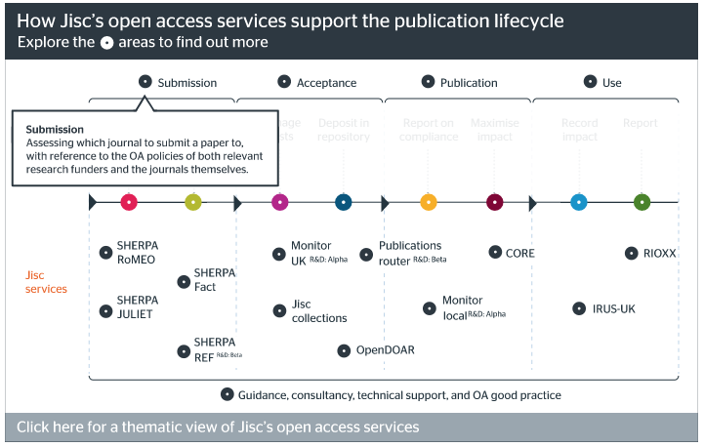
Product Update
Open Access
Working towards global open access, in partnership with information professionals and researchers, we enable the UK's academic research community to realise the rewards of open access.
Particularly relevant with the Research Excellence Framework and REF OA policy
3 new services coming soon:
  Jisc Publications Router – notification service to help institutional repositories comply with the REF OA policy
  Jisc Monitor UK – national service giving cost and compliance information for OA
  Jisc Monitor Local – cloud-hosted application for HEIs to collate and use information about research outputs being published OA
Neil Jacobs, Cluster Owner
https://www.jisc.ac.uk/content/open-access/our-role

Slide 14
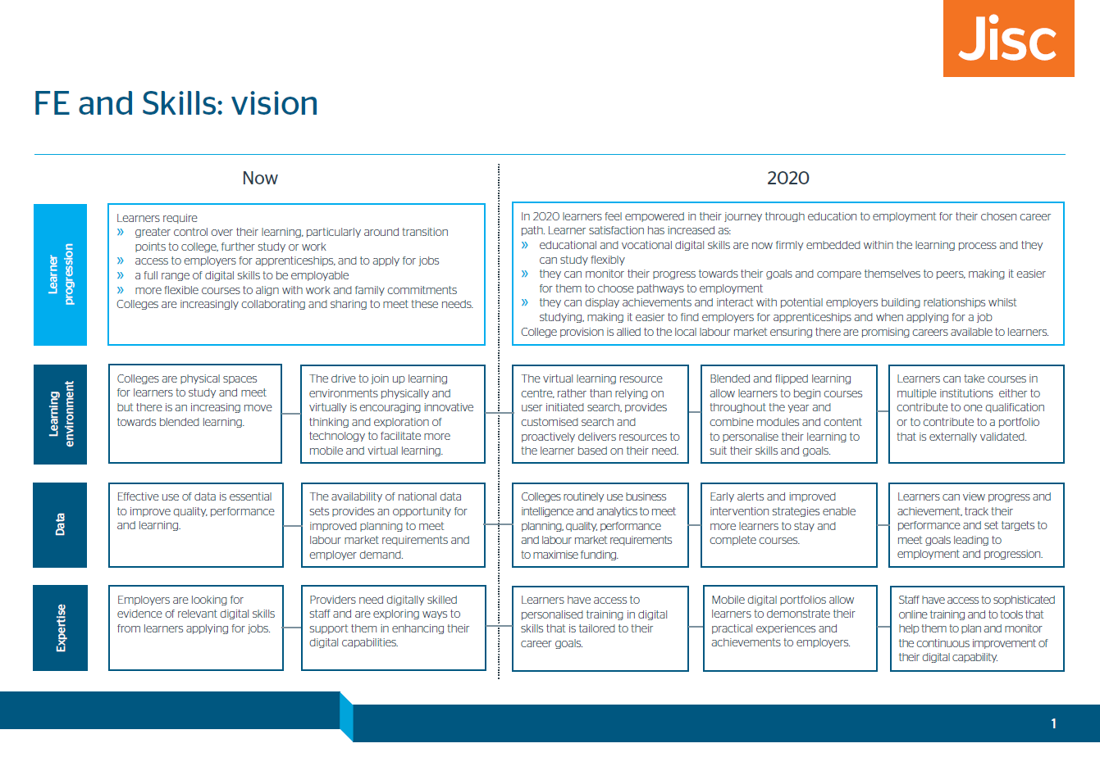
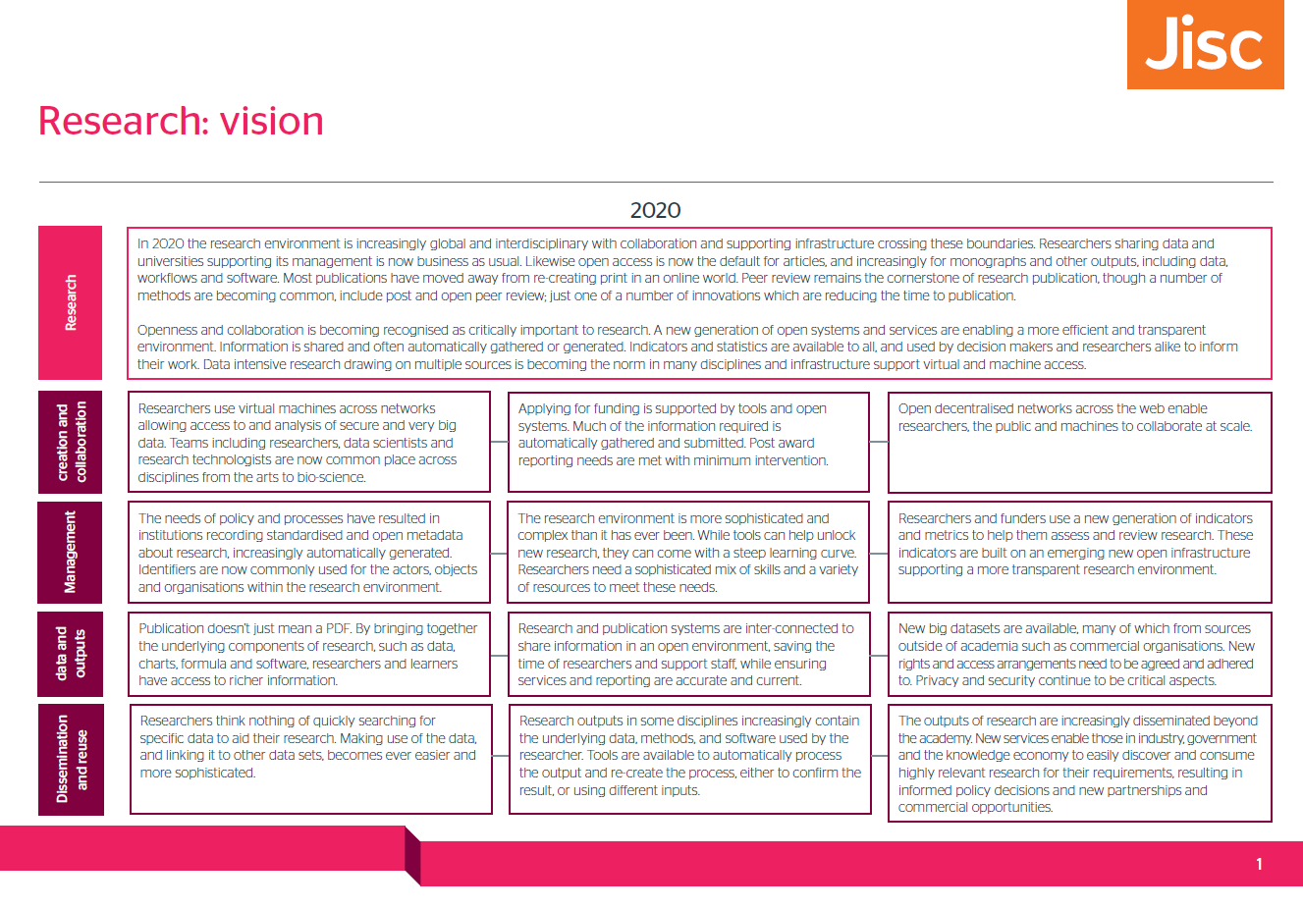
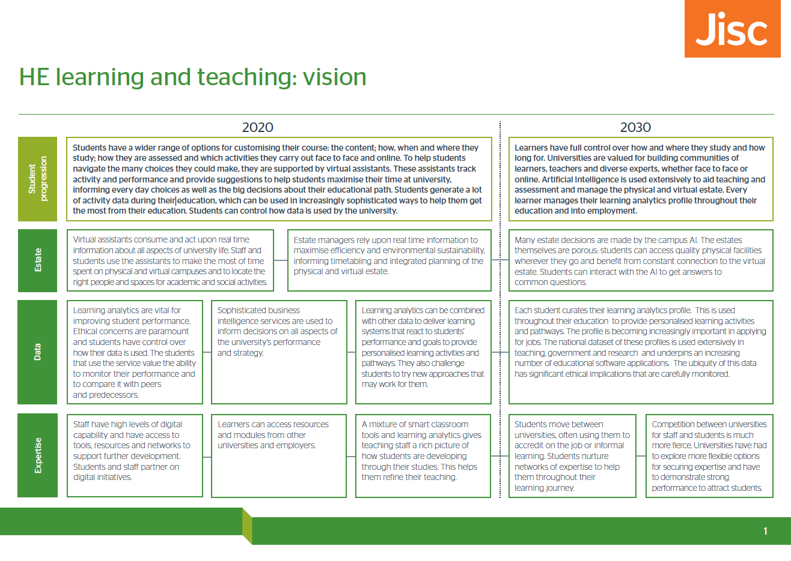
Co-design visions set the long-term direction
jisc.ac.uk/rd/how-we-innovate/co-design

Slide 15
The futures portfolio consists of three big areas
Digital
capability
Learning analytics
Research data shared service
App
and
content
store
Digital
leadership
Digital
launchpad
Analytics
academy
Research data
discovery
Analytics
labs
Research
data
usage
metrics
Apprentice
workforce
development
Qualification
verification
Equipment
data
Summer of
student
innovation
?
Playlists
Store services
Curation and remix
Diagnostic tool builder
Learner
Analytics Services
Repository and
preservation platform

Slide 16
Research data
shared service

Slide 17
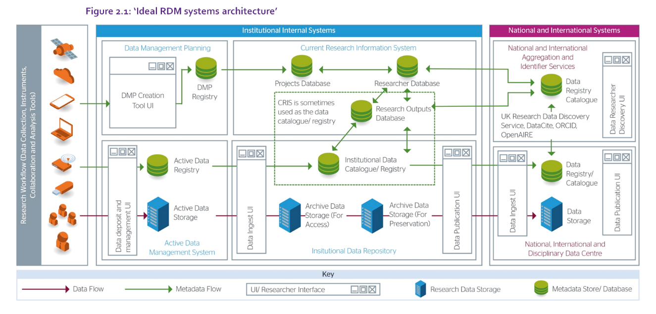
Research data shared service
A shared service to help universities manage their research data in compliance with mandates from research funders. Researchers will use the service to easily deposit data for publication, discovery, safe storage, long term archiving and preservation.
We are working with 16 HEIs to develop requirements and have procured suppliers to deliver parts of the service.
Alpha
Sep
2016
Service development
Dec 2017

Slide 18
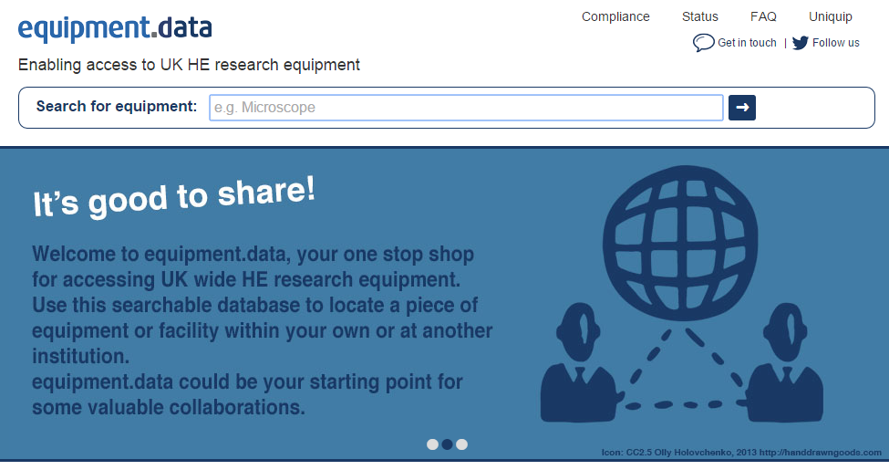
Equipment data
An infrastructure that enables institutions to share their expensive research equipment, leading to cost savings in the sector and excellence in research. Our primary focus is equipment.data, which is backed by RCUK and currently includes records of research equipment from 43 UK universities, aligned with supportive services such as Kit Catalogue and the Brunswick and HPC agreements.
Service development
Jul 2016

Slide 19
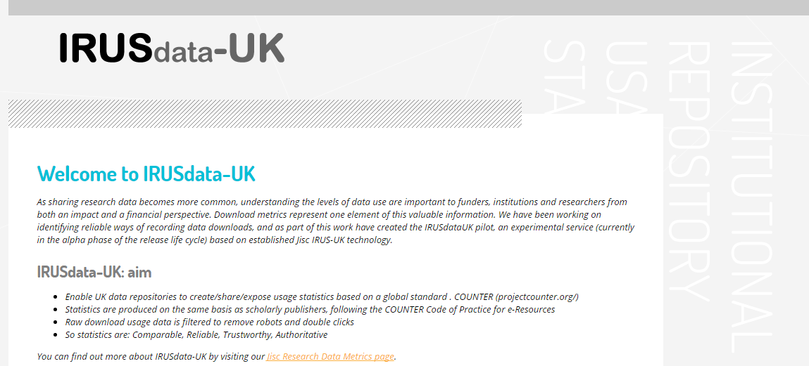
Research data usage and metrics
A prototype service for tracking usage measures and other metrics to help assess research data impact and use. Initially we will run an instance of the current repository usage statistics service (IRUS-UK) across research data repositories.
Beta
Summer
2016
Service development
Early 2017

Slide 20
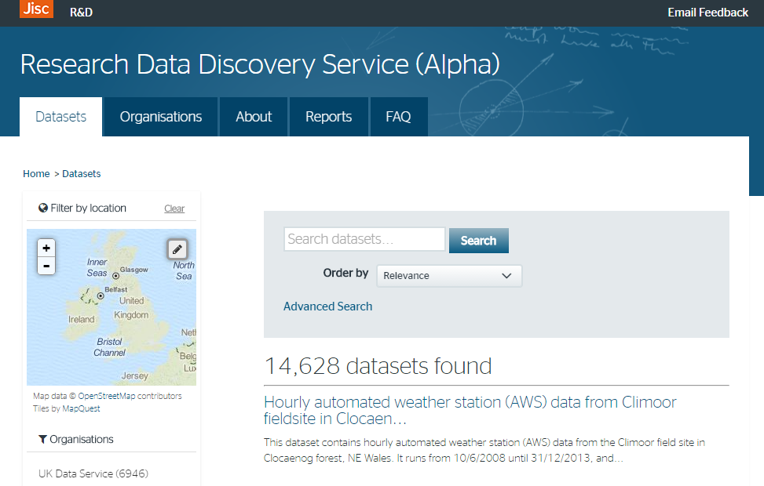
Research data discovery UK
A search tool to help researchers find research data across all UK repositories and data portals. This will encourage reuse of research data, particularly in interdisciplinary research as well as making data citation easier.
The alpha version of the service is available now, with >14k datasets aggregated.
http://ckan.data.alpha.jisc.ac.uk/dataset
Beta
Summer
2016
Service development
Early 2017

Slide 21
App and
content store

Slide 22
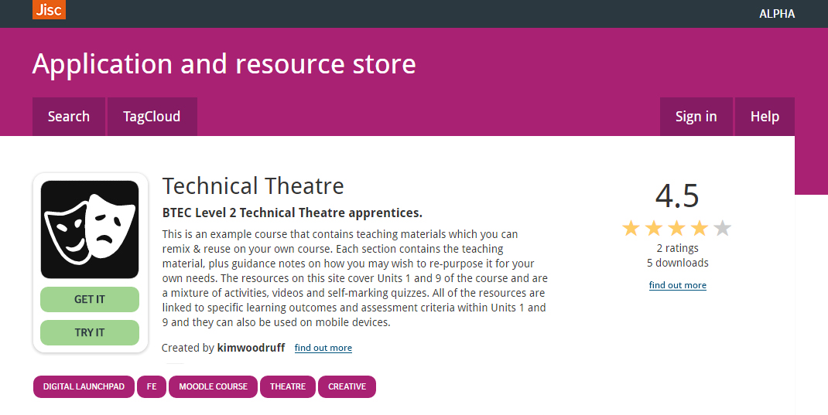
Store
An application and resource store that will help Jisc members find tools and content relevant to research and education from Jisc and from third parties who have tools or content that meet Jisc’s quality standards.
We have a working alpha that we are starting to populate with content
Contact: Justin Haylock
HE
FE
Skills
Beta
Summer
2016
Service development
Early 2017

Slide 23
Horizon scan

Slide 24


