Slide 1
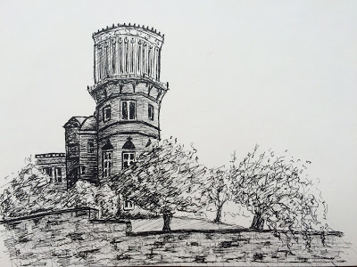

Restoring Gig Workers to Power
The Collective Potential of Personal Data Portability
Cailean Gallagher
STUC 2019
cgallagher@stuc.org.uk

Slide 2



Slide 3
History
Data-Driven Work Discipline

Slide 4
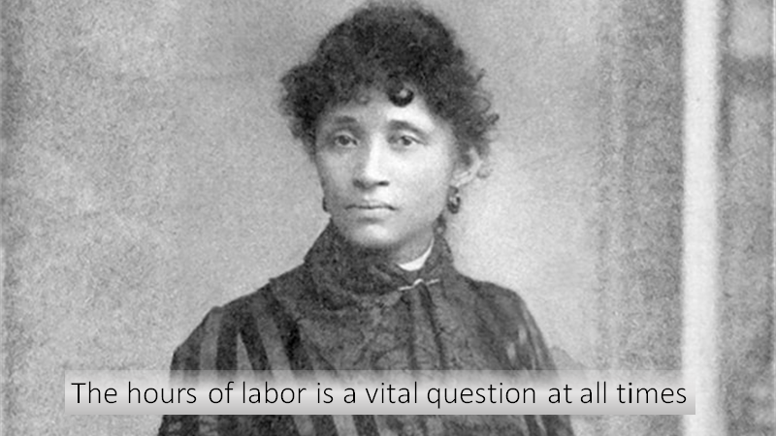

Slide 5



Slide 6
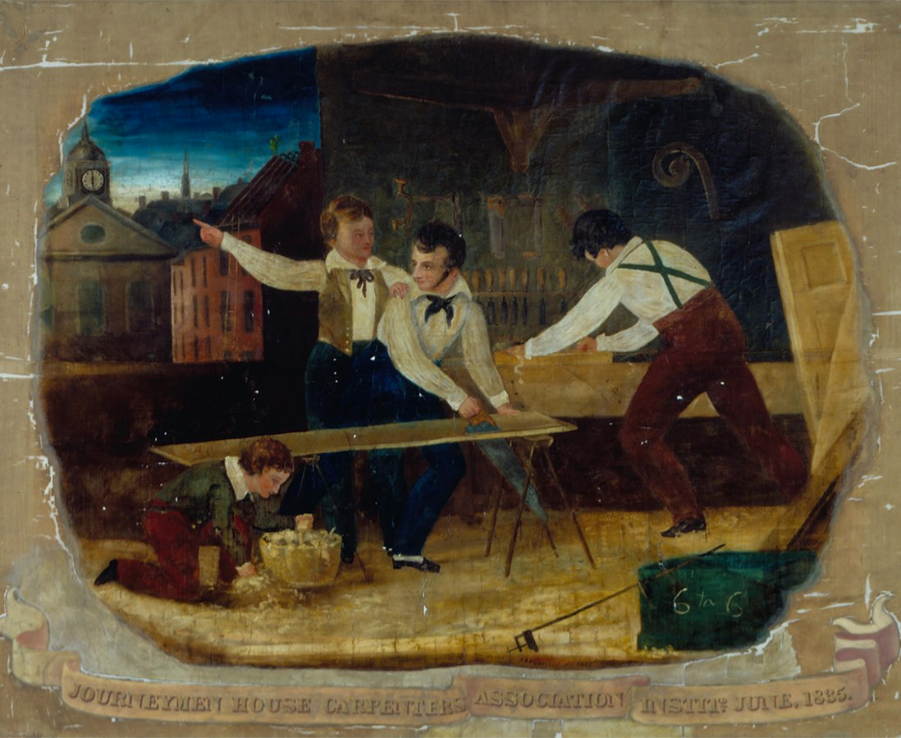

Slide 7
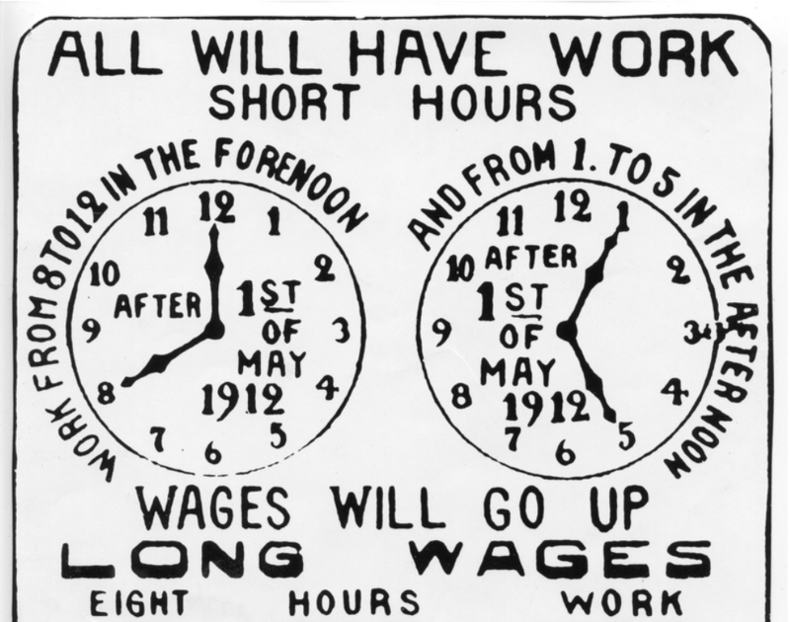

Slide 8
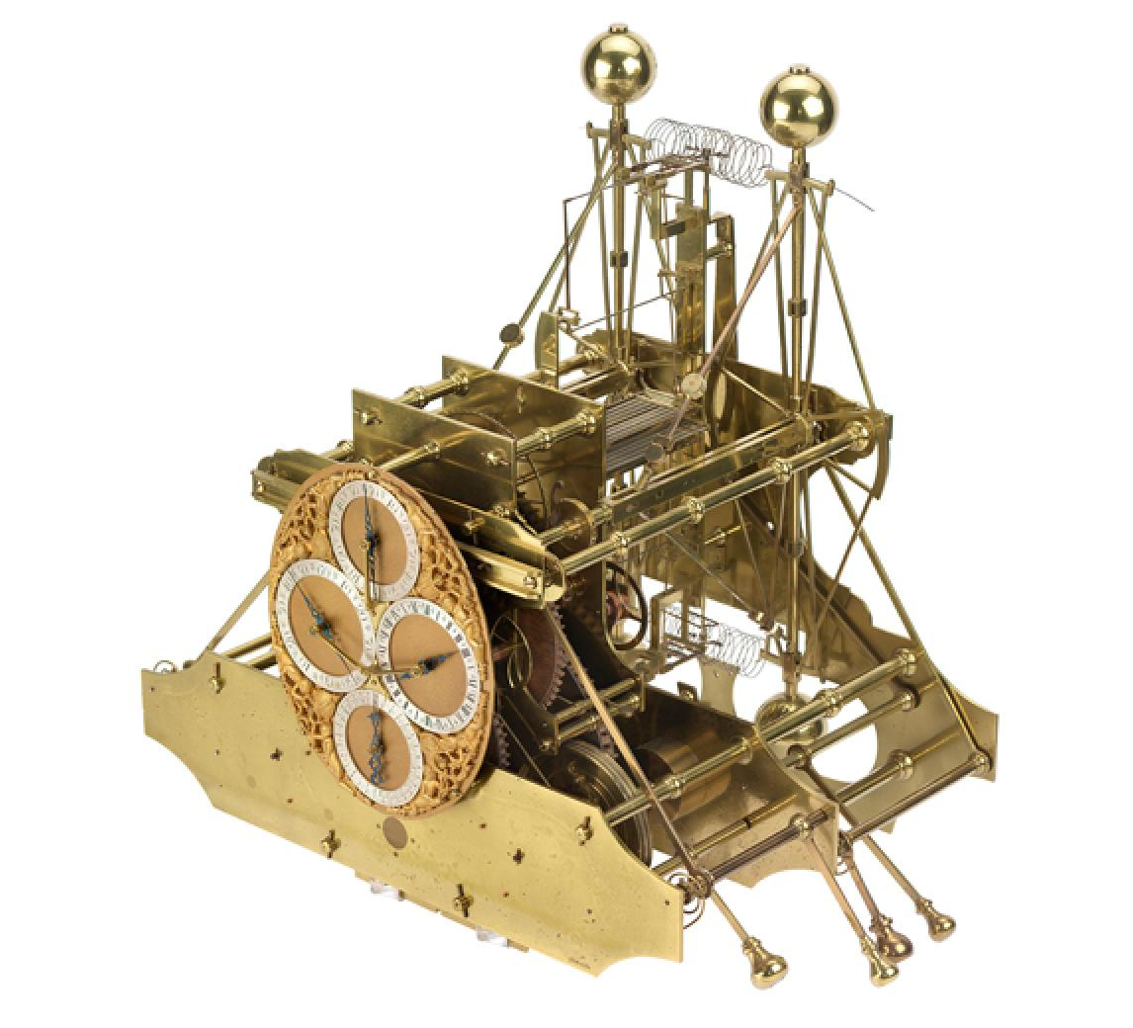


Slide 9
Sociology
Show Us The Algorithm
Karen Gregory

Slide 10
Karen Gregory, (2019) “My Life is More Valuable Than This”: Understanding Risk Among On-Demand Food Couriers in Edinburgh
Just transparency. What do you expect? What do you want exactly? We know it's not great but at least be honest and tell us, yes, this, that's how this works. Yes, we would like that. One of the thing I was hoping with this courier network is we could be big enough to be able to negotiate things with Deliveroo, especially about what do you mean by work, and exactly what do you want, exactly?
– Taylor, Deliveroo Rider (Edinburgh 2018)
BODILY RISK - FINANCIAL RISK - MOBILITY RISKS - EXISTENTIAL RISKS

Slide 11
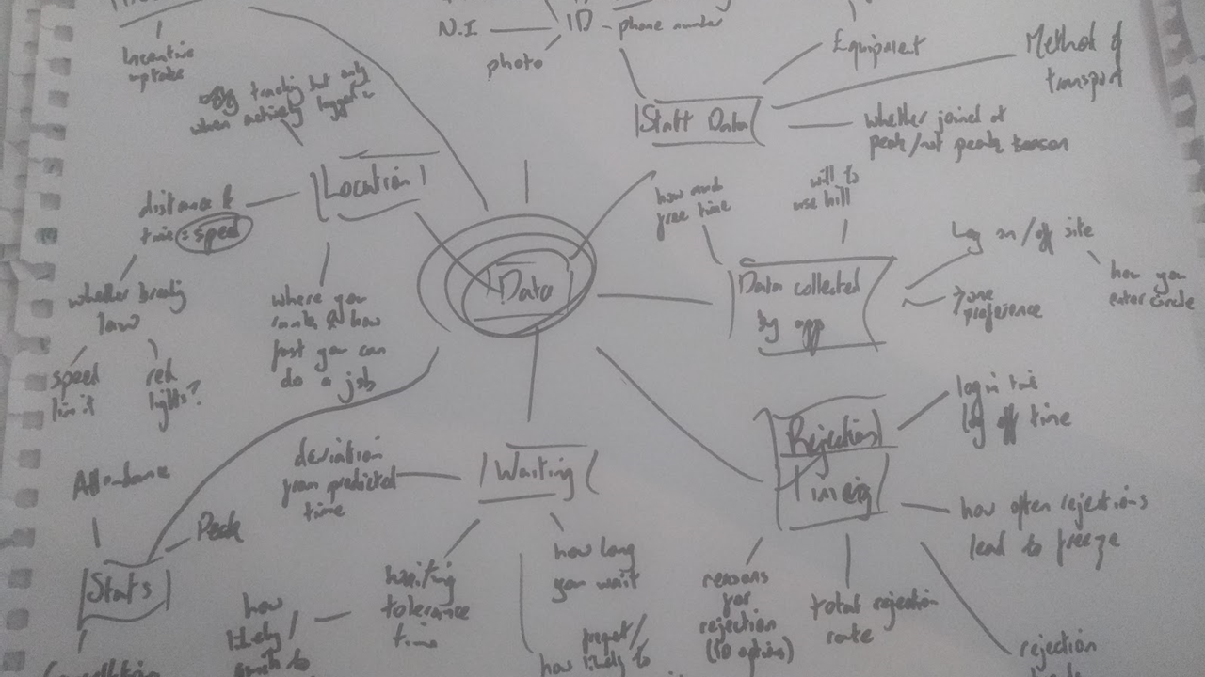

Slide 12
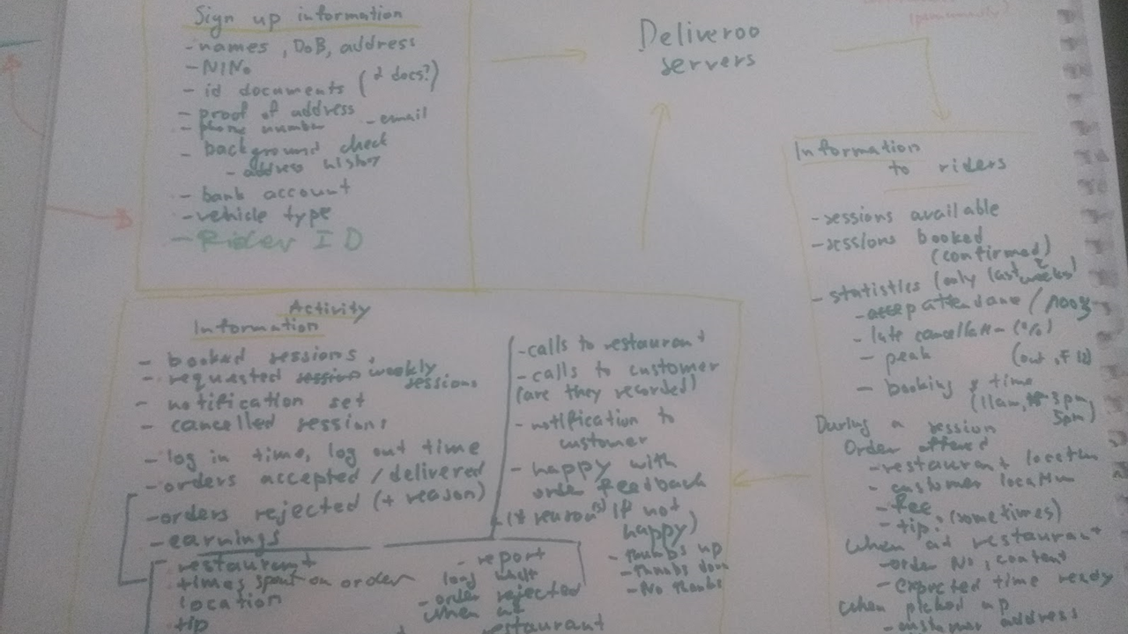

Slide 13
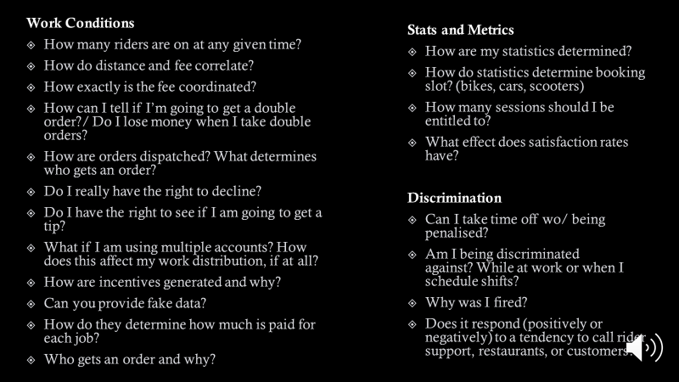

Slide 14
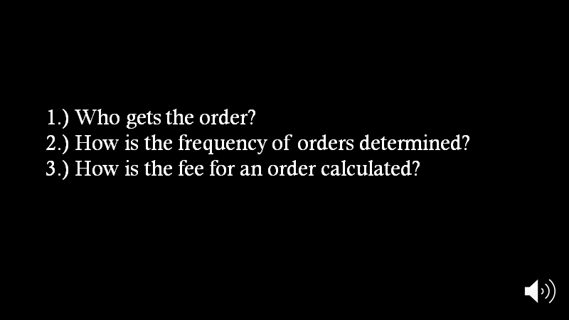

Slide 15
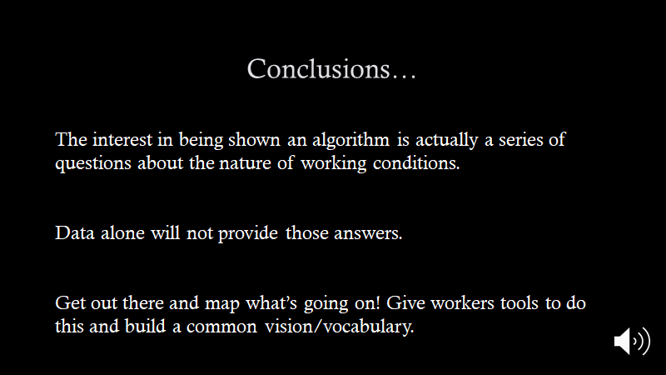

Slide 16
Law
Data Portability and GDPR
Wenlong Li

Slide 17
Three Options - No Silver Bullet
Article 20 - data provided by the subject to be provided in reusable format
Digital Content Directive (DCD)
Free Flow of Non-Personal Data (FFNDP)
What’s the subject: Worker, Consumer, Trader?

Slide 18
Date | Day | Time in | Time Out | Hours | Orders Delivered
9 November 2019 | Saturday | 18:06 | 21:07 | 3.1 | 7
13 November 2019 | Wednesday | 13:02 | 15:00 | 2 | 3
Total |  |  |  | 5.1 | 10
Service Hours - 18 September 2019 - 1 October 2019
Summary
Hourly Pay: £_______
Order Commission: £_______
Tips: £_______
Total: £_______
Table 3 Example of invoice data

Slide 19
Data Science
Data Trusts and Worker Science

Slide 20
Workers’ Data Trust
Quis Custodiet:
Government
University
Non-profit
Trade Unions

Slide 21
Worker Science
Try out data rights and tools
Know and predict hours and wages
Develop collective data and demands
Collectively challenge and correct decisions

Slide 22
Workers’ Observatory
Who would do the work?
Would workers be trained?
Could professionals and scientists facilitate?
What is the research potential?

Slide 23
Summit and Network Details:
email cgallagher@stuc.org
THANKS
Cailean Gallagher
cgallagher@stuc.org.uk

