Slide 1

Where data and journal content collide what does it mean to ‘publish your data’?
Peter Burnhill, Muriel Mewissen & Adam Rusbridge
EDINA, Information Services
University of Edinburgh
09:40 – 10:00

Slide 2
Bio-Informatics of a time-served data person at U of E
Scottish Education Data Archive, 1979 - mid ‘80s
  Survey statistician: school leavers, YTS & 16-19 cohort surveys
    In Centre for Educational Sociology
Edinburgh University Data Library,1984 & on
  Manager: set-up and development
  President of IASSIST, 2000 – 2004 : social science data professionals
Graduate School, Faculty of Social Science, 1987 – 1997
  Senior Lecturer, teaching quantitative/survey methods
    In Research Centre for Social Sciences
ESRC Regional Research Laboratory for Scotland, 1986/90
  Co-director: early days of Geographical Information Systems (GIS)
    With University’s Department of Geography
EDINA, 1995/6 to present - main focus as day job
  Director: set-up and continuous development
  Jisc-designated centre for service delivery & digital expertise
Digital Curation Centre, 2004/05
  Director for set-up & definition of ‘data curation + digital preservation’
    With University’s School of Informatics

Slide 3
Overview
Time-served data person reverts to researcher, having to ask:
  Why should we publish our data?
  What data should be shared, when and how?
  Are data part of that research statement?
  What payback is there in sharing?
& what about the new Web-resident research statements?

Slide 4
Focus on two ‘case studies’
  Project funded by Andrew Mellon Foundation
    No mandate on data deposit but encourage OA for tools/application developed as part of the project
  ‘Unfunded’ (indirectly-funded) statistical statement: data from two Jisc services
    with no direct mandate (& could have passed undetected)
Both case studies have findings about threats to the integrity of the scholarly record.

Slide 5

 | Reference Rot | E-Journal Archiving
Study | Exploratory investigation into status of references to the web-at-large in scholarly statement (eg e-theses)
Project | Hiberlink Andrew Mellon Foundation EDINA & Language Technology Group, School of Informatics (Claire Grover & colleagues ) jointly with the Research Library, Los Alamos National Laboratory (Herbert Van de Sompel & colleagues).
 | hiberlink.org

Slide 6
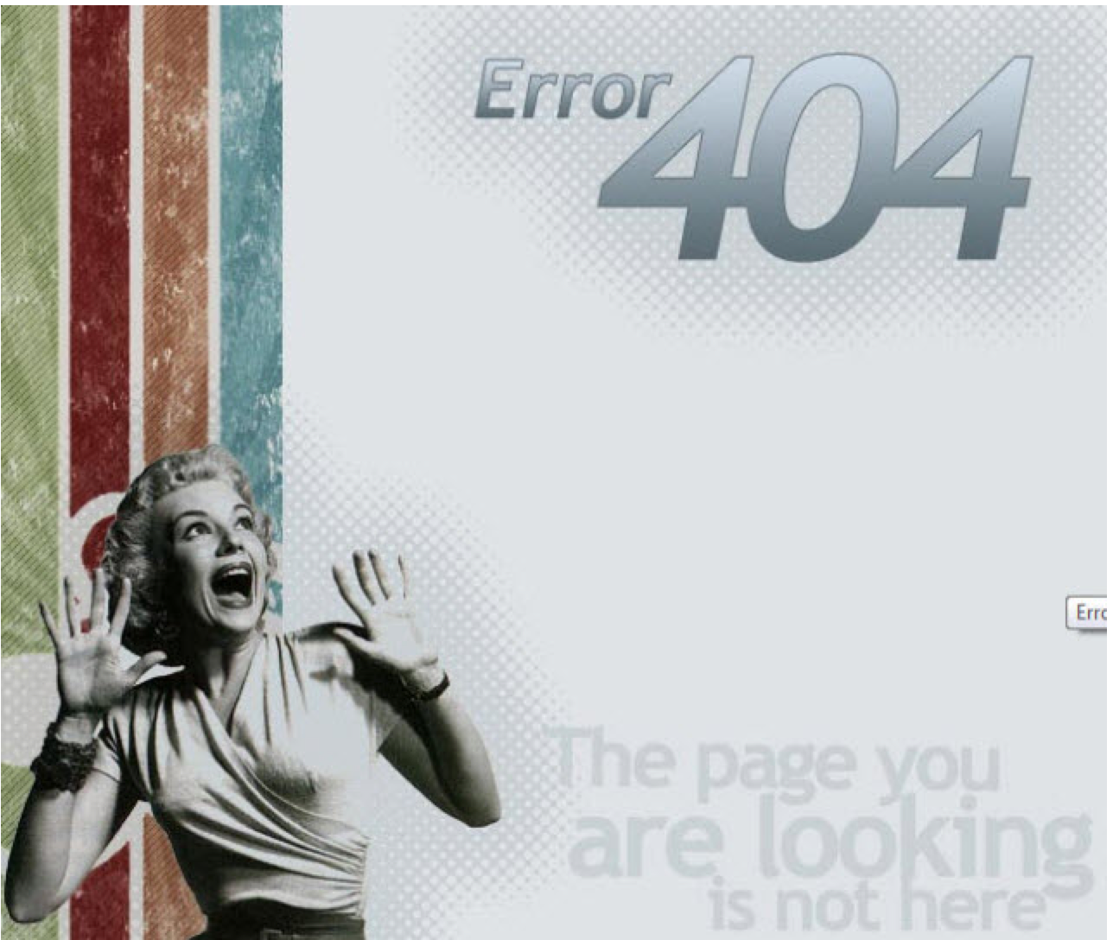
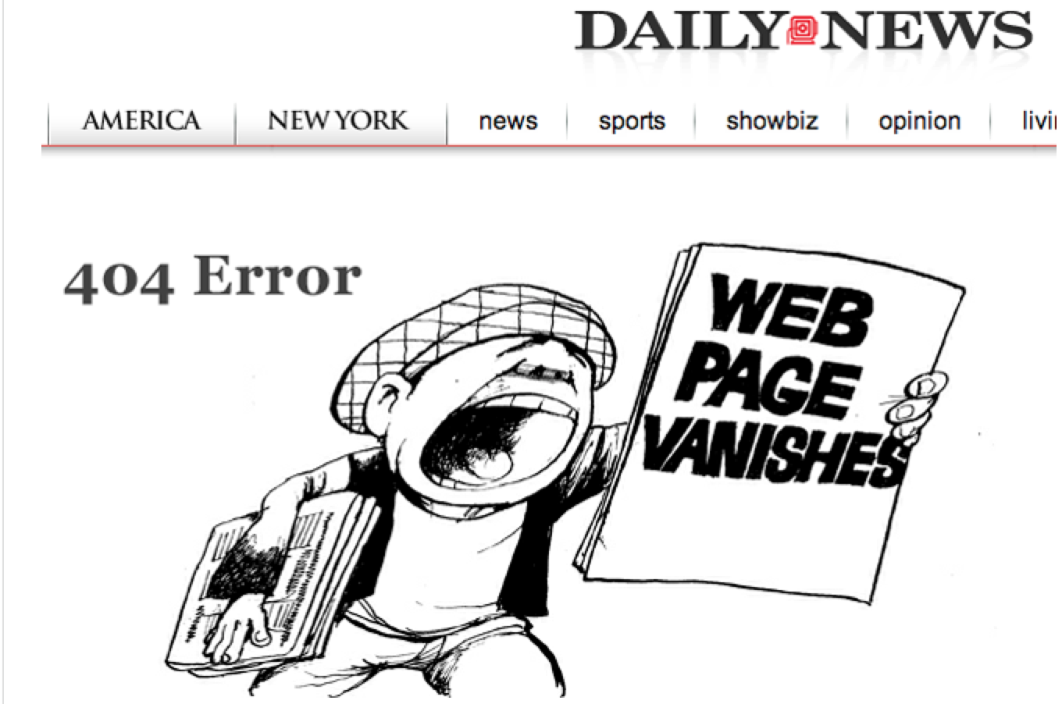
Link Rot
‘Link Rot’

Slide 7
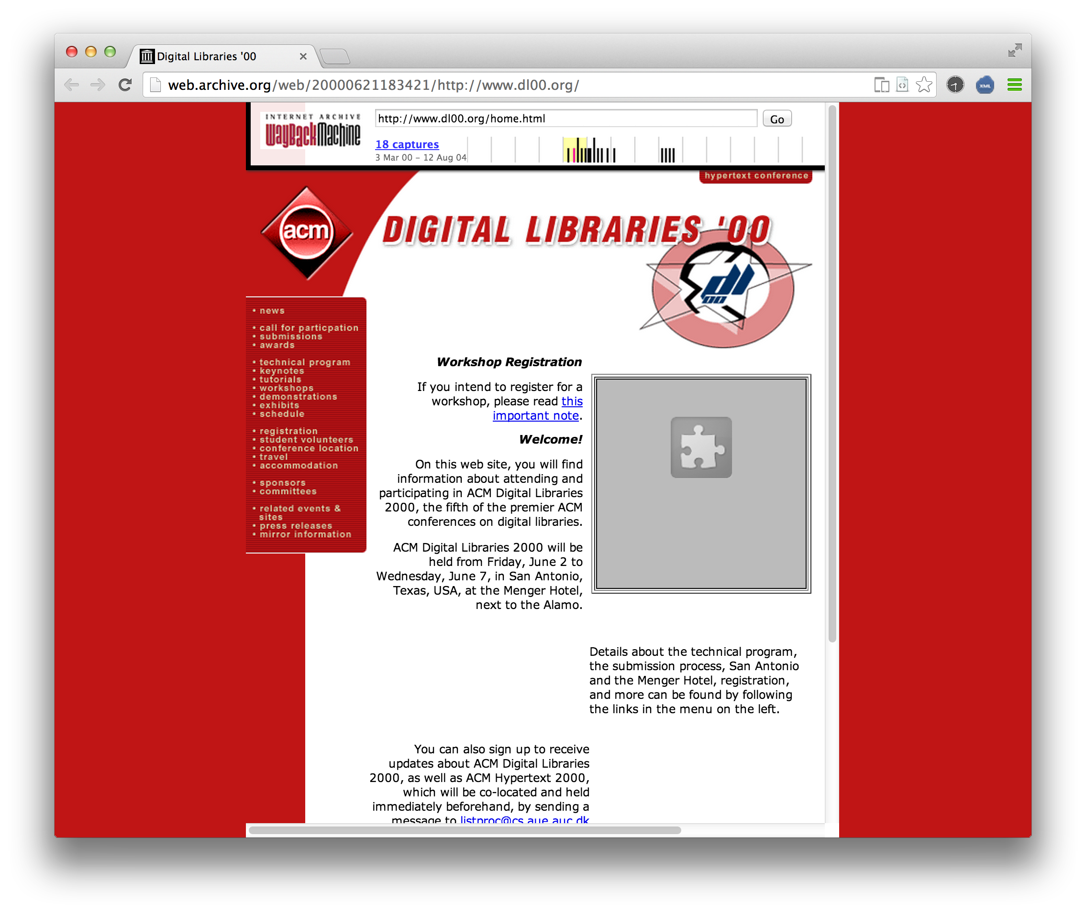
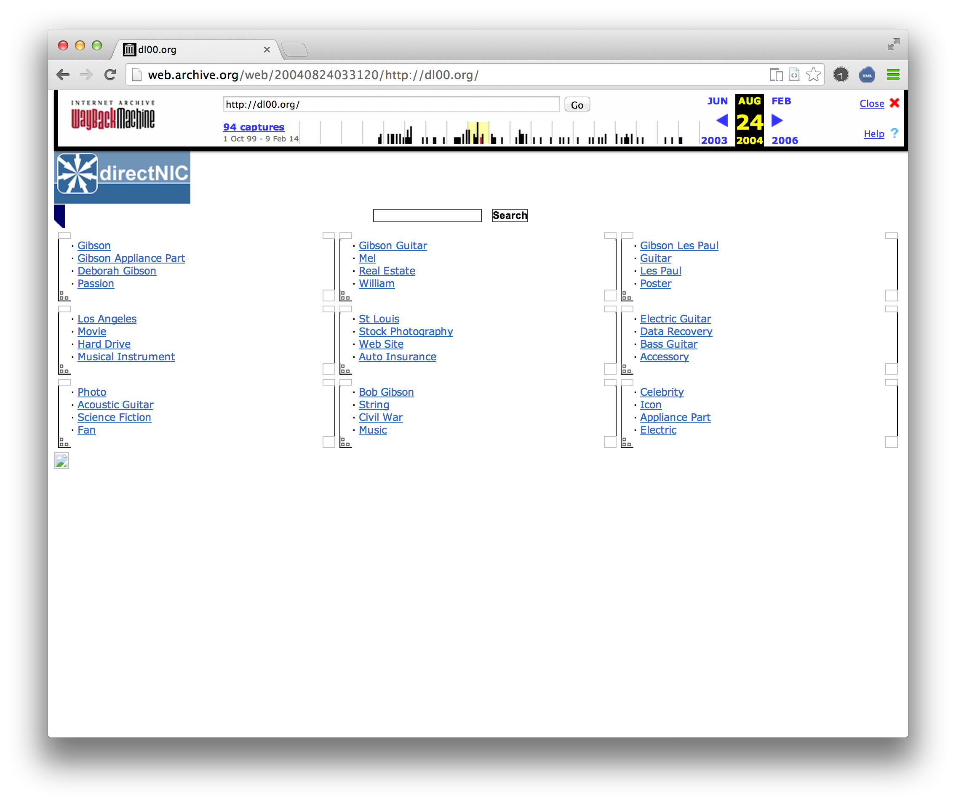
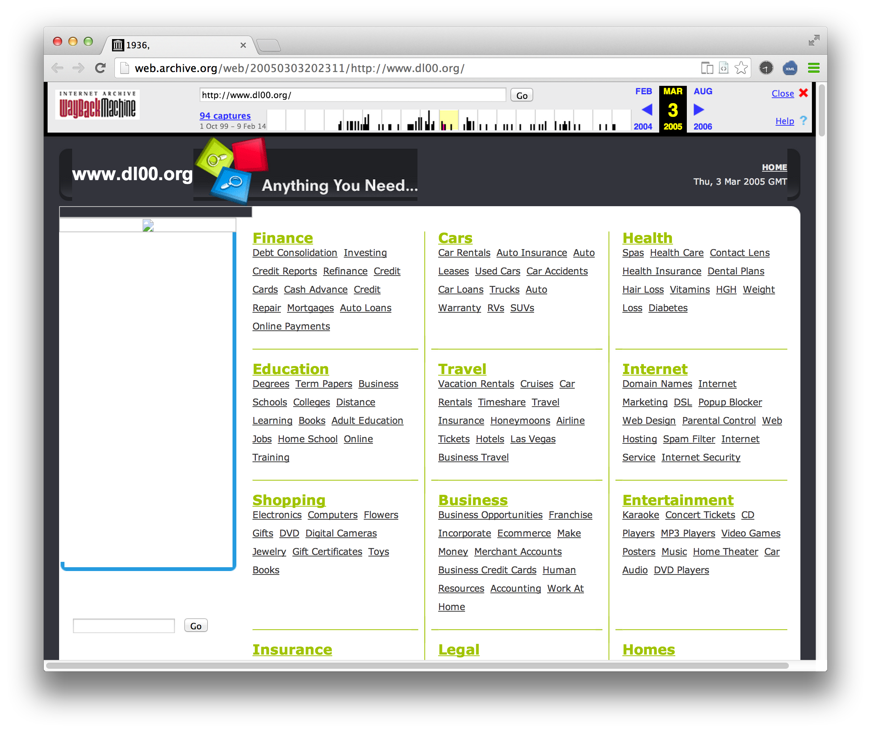
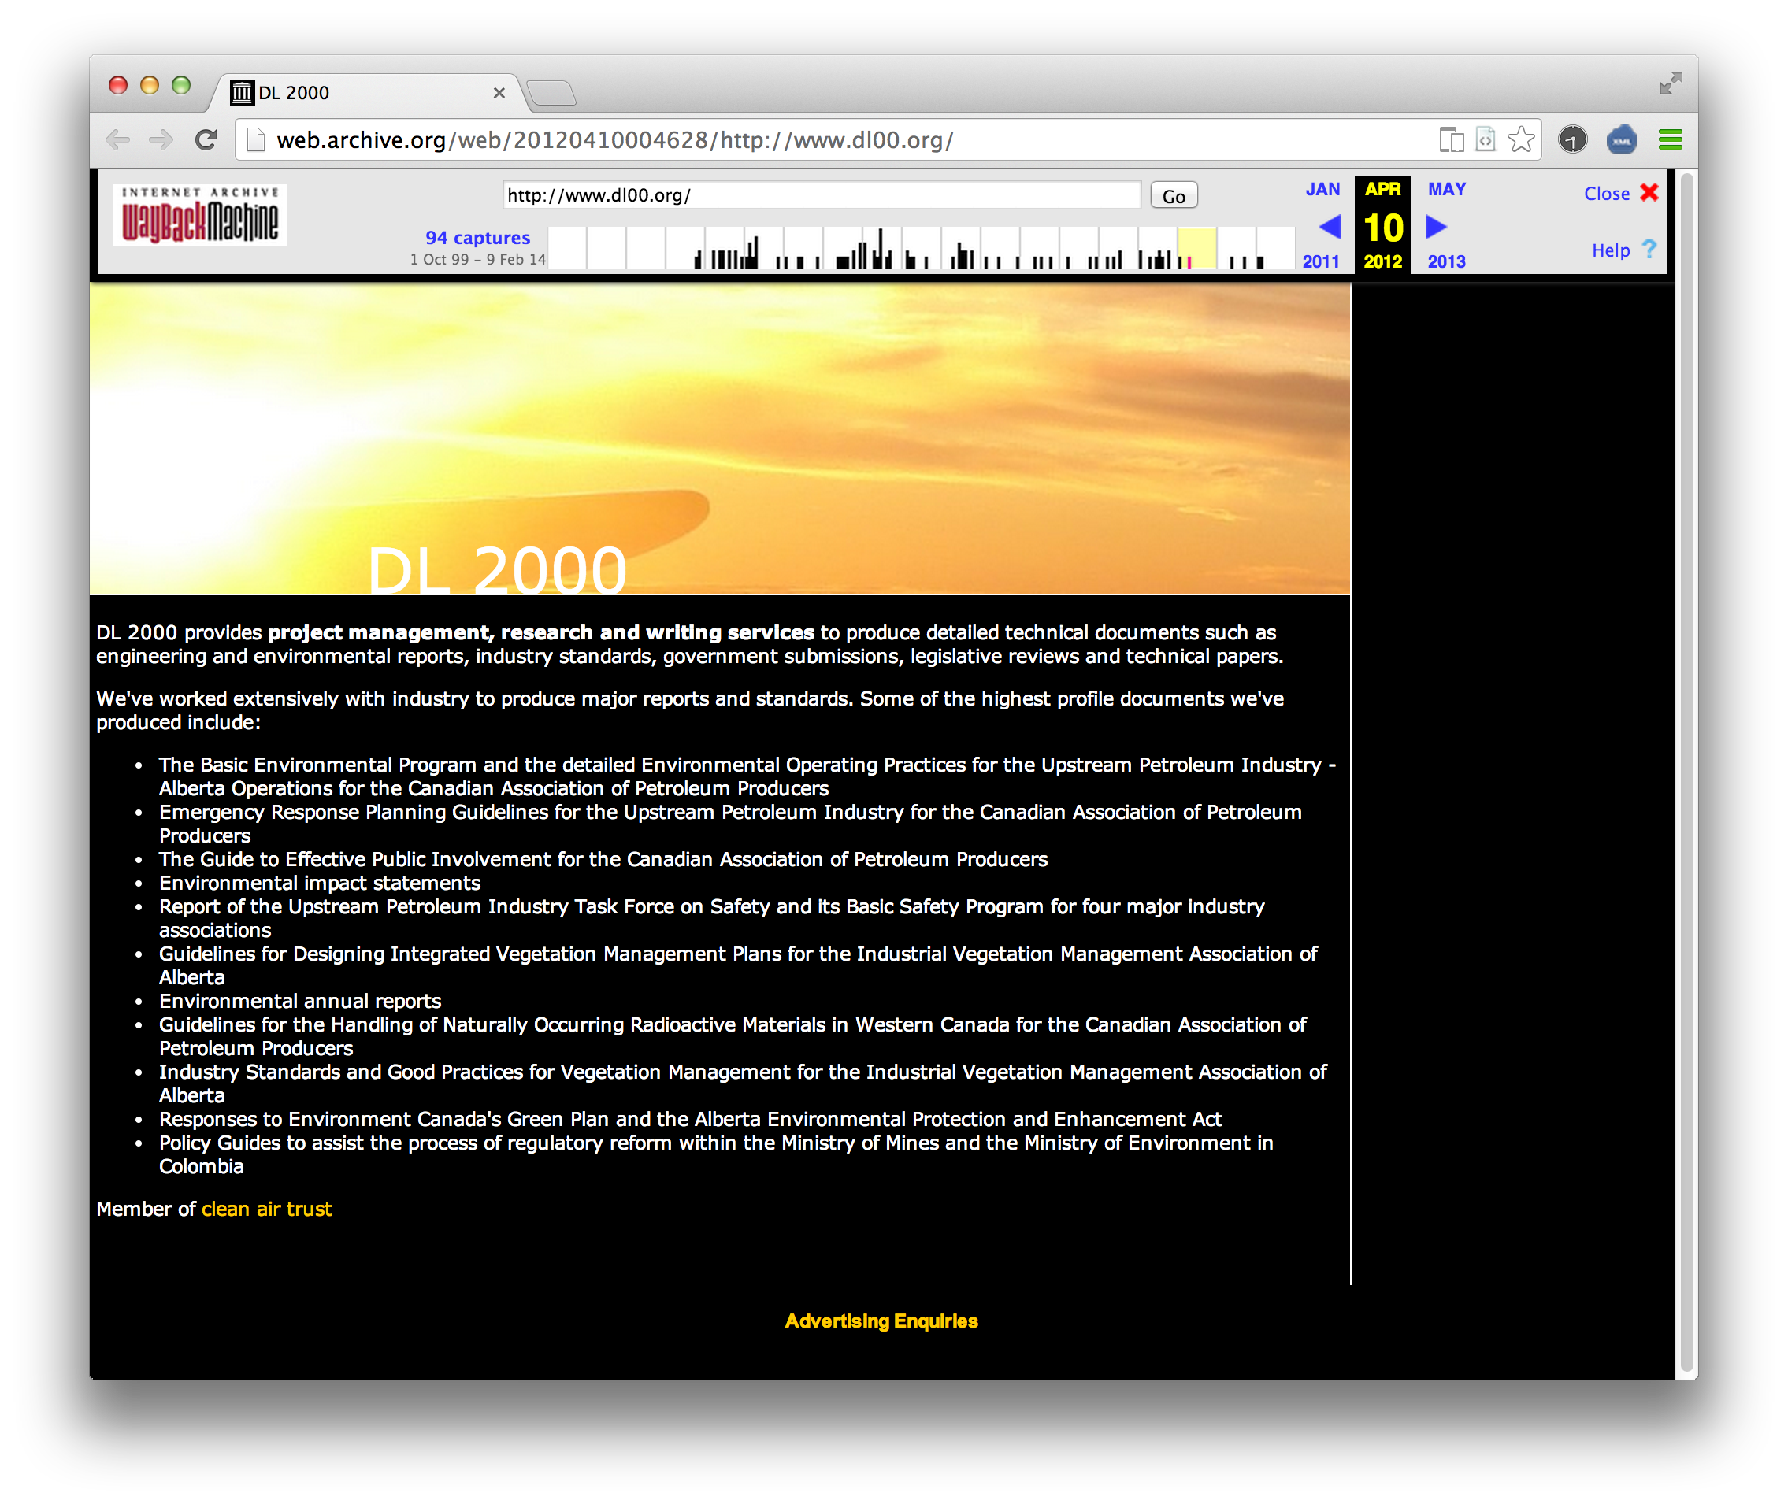
+ Content Drift: What is at end of URI has changed, or gone!
http://dl00.org
2000
(a) Dynamic content
as values on webpage changes over time
http://dl00.org
2004
http://dl00.org
2005
http://dl00.org
2008
(b) Static content
but very different (often unrelated) web pages

Slide 8
 | Reference Rot | E-Journal Archiving
Study | status of references to the web-at-large (in e-theses)
Project | Hiberlink
Findings Empirical statements Made as: i) WORK-IN-PROGRESS in preparation for ii) PUBLICATION | Reference Rot occurs in over 36% of the URIs; affects 1/3rds of e-theses Routine web archiving delivers less than a 50:50 chance that content is being kept safe circa 1 in 5 of referenced content is probably lost for ever => devising tools to enable authors / researchers to archive pro-actively what was read/used and cited (in articles & e-theses) ‘transactional archiving’ ** increasingly what is referenced on the web via URI is a data resource **

Slide 9
 | Reference Rot | E-Journal Archiving
Study |  | Extent to which scholarly record is at risk of loss: who is looking after your e-journal content?
Project] |  | Keepers+ ‘Unfunded’ (Jisc / UoEd) EDINA in collaboration internationally with archiving organisations & research libraries
 |  | thekeepers.org
 |  | http://thekeepers.blogs.edina.ac.uk

Slide 10
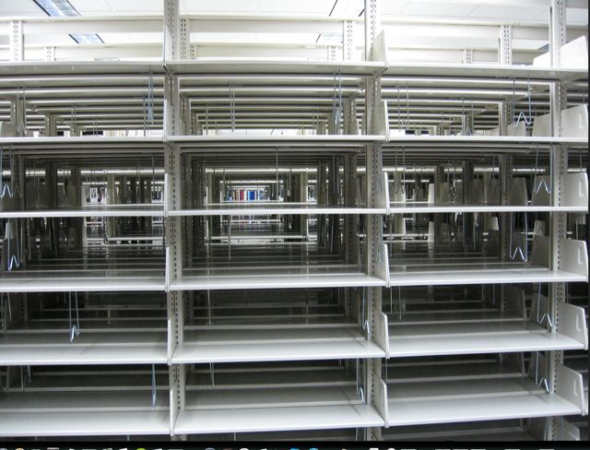
That Article in the Scholarly Record is not in the custody of Libraries, nor yet on their digital shelves.
Picture credit: http://somanybooksblog.com/2009/03/27/library-tour/
Notes:
What was once on shelf, is no more.
This is not news, but it is cause for concern
Libraries speak of e-collections but increasingly they have only e-connections
an emptiness inside
Brought on by a simple twist of fate.

Slide 11
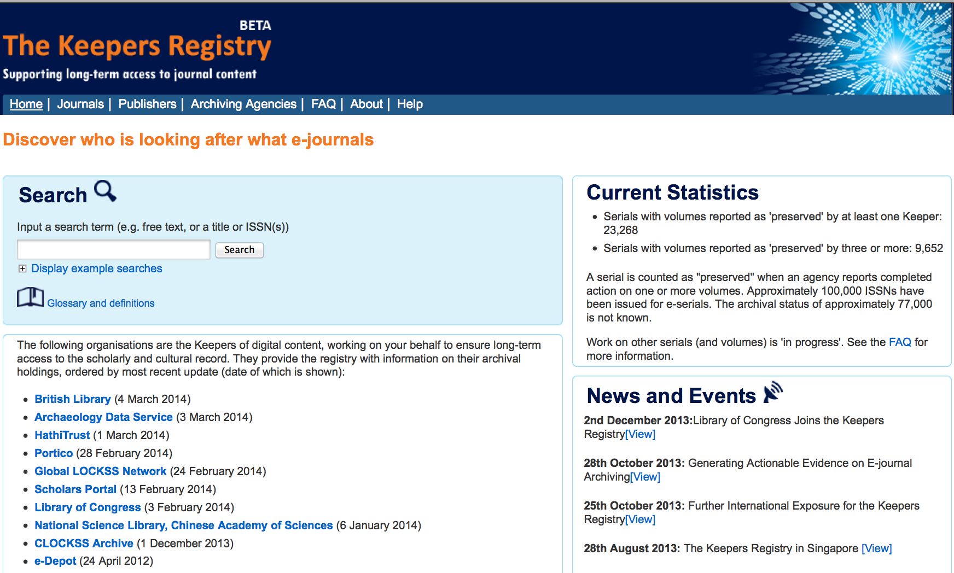
thekeepers.org as Global Monitor
… to discover who is looking after what
Notes:
But how do we know who is looking after what?
More good news, you have The Keepers Registry at thekeepers Dot Org
Enter title or ISSN
& you search across metadata reported by
the world’s 10 leading archiving organisations

Slide 12
 | Reference Rot | E-Journal Archiving
Study | status of references to the web-at-large in e-theses. | scholarly record at risk of loss: who is looking after e-journal content?
Project | Hiberlink | Keepers+
Key Findings Empirical statements Made as: i) WORK-IN-PROGRESS in preparation for ii) PUBLICATION |  | Two thirds (68%) of what was consulted online (108 UK universities) in 2012 is at risk of loss. Missing Volumes & Issues Only 22% to 28% of Title Lists of 3 US research libraries (Columbia, Cornell & Duke) were being archived when checked in 2011/12 We need to update these findings annually Libraries don’t have e-collections of serials (only e-connections) So we all need to know that scholarly content is being kept safe somewhere! (SafeNet Project just statted)

Slide 13
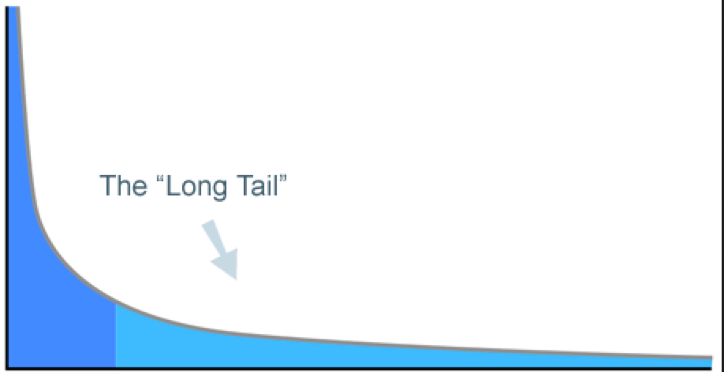
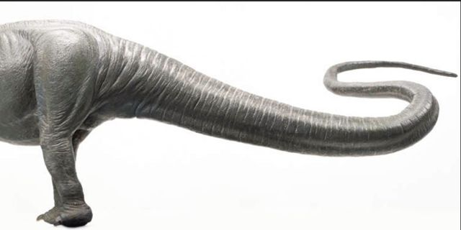
    BIG
    publishers
    act early but incompletely
    Priority:
    find economic way to archive content from …
    very many ‘at risk’ e-journals from many small publishers
Notes:
This is largely a long tail problem
The big publishers in the room - those dinosaurs that aim to evolve into birds
They have been active with CLOCKSS & Portico and have signed agreements to archive their content for the long term
But as we all realise, once we start to think about it, it’s the content from the very many small publishers that is at risk
They matter to you because they are cited in your journals and because libraries wont go e-only until that is fixed

Slide 14
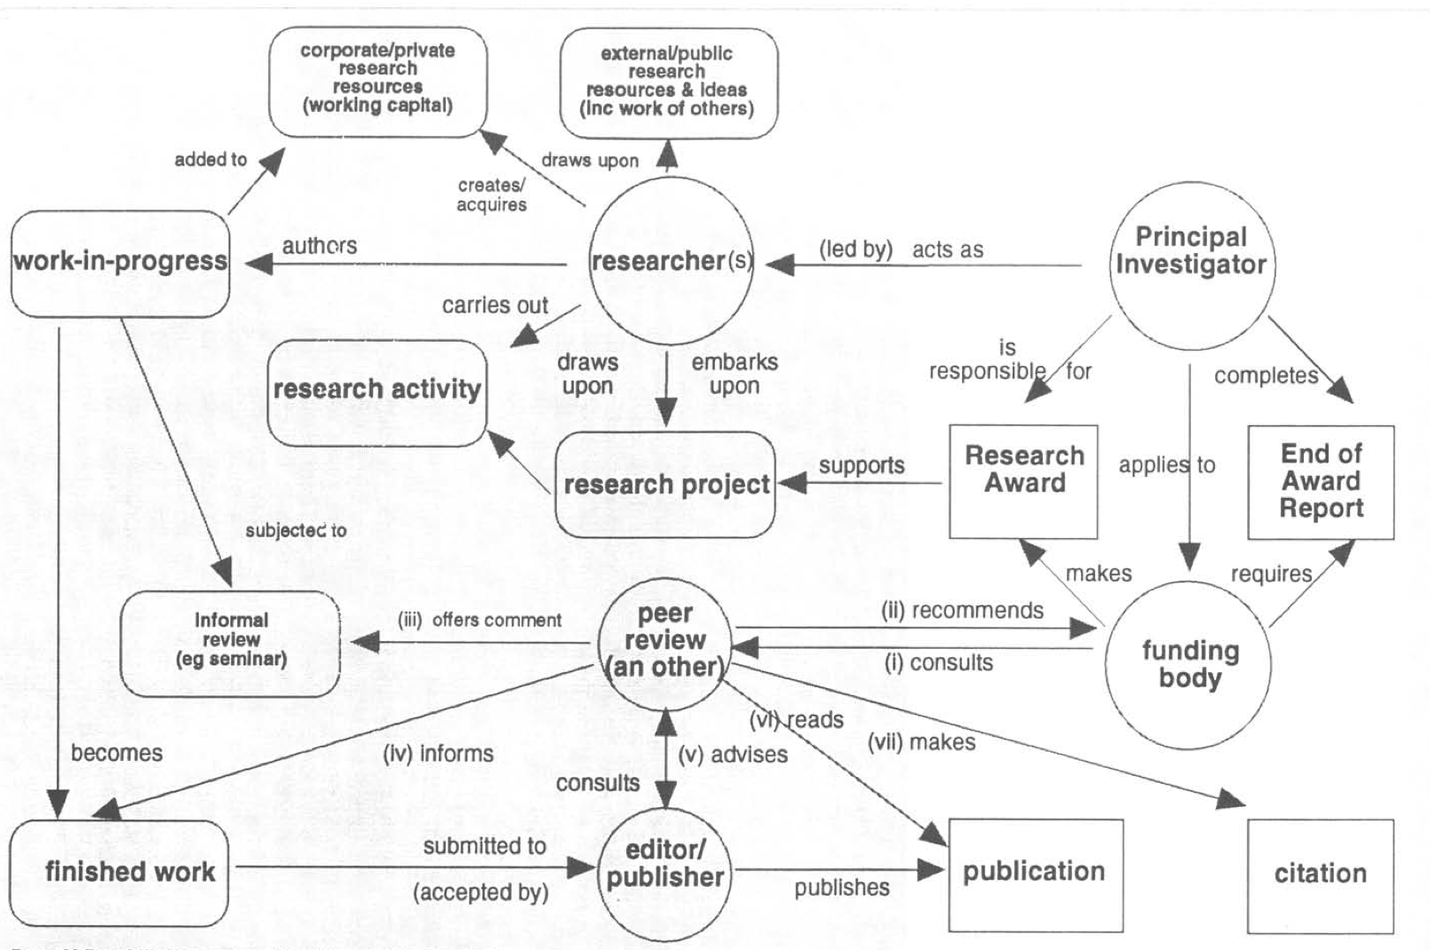
Cannot ignore the focus on Publication
re-visiting an article now being cited again:
On measuring the relation between social science research activity and research publication.
Research Evaluation 4.3 130-152
doi: 10.1093/rev/4.3.130
P. Burnhill & M. Tubby-Hille (1994)
& What the Funder sees

Slide 15
DATA, other working capital
& references to work of others
FINDINGS
STUDY
Taken from: Figure 1 in P. Burnhill & M. Tubby-Hille (1994)
On measuring the relation between social science research activity and research publication.
Research Evaluation 4.3 130-152. doi: 10.1093/rev/4.3.130

Slide 16
Study / Project / Data / Findings / Publication
STUDY/ Activity [Purpose] | Large-scale experiment / Exploratory investigation
PROJECT [Grant] | FunderRef ; GrantID
Databases consulted / used Source / Origination | Using extant databases (Generating new data)
Dataset(s) Assembled & Analysed | Extracted data ; derived variables; multiple versions
FINDINGS i) Work-in-progress ii) PUBLICATION | Empirical Statement(s) Presentations etc Formal report of the results of research
DATA as
working capital
DATA as results
to be shared?
Notes:
Type A: if its part of the published work then should we look to the preservation agencies, the national deposit libraries and CLOCKSS, LOCKSS and Portico, for access over the longer term? And do publishers see these as costly files to maintain in the short to medium term? Or do publishers want to hand the responsibility to subject and institutional data repositories?
Type B: and with knowledge of UKDA, ADS but also the (growing but problematic ??) call for data to be held in institutional repositories, some recommendations on what is the 'right thing' to do, and how that can be done with ease - a Repository Junction task!
For Type C, I intend to propose what editors should require by way of citation and URL link. I am on the hunt for such editorial practice.

Slide 17
Study / Project / Data / Findings / Publication
Study | Large-scale experiment / Exploratory investigation
Project
Data Source / Origination ‘database(s)’ | Using extant databases (Generating new data) | Who has custody of new data?
‘Assembled datasets’ ’Dataset(s)’ Analysed | Extracted data; derived variables; multiple versions
‘Data behind the graph’ | Supplementary data which enhance the publication of the results reported. | Do publishers want to hand responsibility to subject & institutional repositories?
Key Findings i) Work-in-progress ii) Publication | Empirical Statement(s)
DataType A
What Data
should be
shared?
DataType B
DataType C
Notes:
Type A: if its part of the published work then should we look to the preservation agencies, the national deposit libraries and CLOCKSS, LOCKSS and Portico, for access over the longer term? And do publishers see these as costly files to maintain in the short to medium term? Or do publishers want to hand the responsibility to subject and institutional data repositories?
Type B: and with knowledge of UKDA, ADS but also the (growing but problematic ??) call for data to be held in institutional repositories, some recommendations on what is the 'right thing' to do, and how that can be done with ease - a Repository Junction task!
For Type C, I intend to propose what editors should require by way of citation and URL link. I am on the hunt for such editorial practice.

Slide 18
Study / Project / Data / Findings / Publication
Study
Project
Data Source / Origination ‘database(s)’ External to Project | Generating new data | Using extant databases
Assembled Datasets ’Dataset(s)’ Analysed Product of Project | multiple versions
‘Data behind the graph’ | Supplementary data
Key Findings i) Work-in-progress ii) Publication | Empirical Statement(s)
DataType A: These sources should be cited
But when are preservation & ‘continuity of access’ proper tasks for the University?
DataType B: Choices: which of these exactly?
For your future use? For others? Required for reproducibility?
DataType C: Should be made available & preserved as multi- part work
But do publishers want the responsibility; role of subject & institutional repositories?
Notes:
Type A: if its part of the published work then should we look to the preservation agencies, the national deposit libraries and CLOCKSS, LOCKSS and Portico, for access over the longer term? And do publishers see these as costly files to maintain in the short to medium term? Or do publishers want to hand the responsibility to subject and institutional data repositories?
Type B: and with knowledge of UKDA, ADS but also the (growing but problematic ??) call for data to be held in institutional repositories, some recommendations on what is the 'right thing' to do, and how that can be done with ease - a Repository Junction task!
For Type C, I intend to propose what editors should require by way of citation and URL link. I am on the hunt for such editorial practice.
Which data to be considered for curation & stewardship by the University
DataType A: Supplementary data (the data behind the graph) which enhance the publication of the results reported in scholarly statement
multimedia files: part of the published article that presents research argument and conclusions
more than linear text, limited tabular and graphical display
enhances user experience with various multimedia objects
DataType B: Research dataset(s) upon which conclusions based
check analysis of those data to support statements made
for reproducibility (exposure to refutation) and new work
via alternative analysis and updates to the database(s)
DataType C: Database(s) from which datasets were assembled
also for reproducibility and new work via updates to the database(s)

Slide 19
Study / Project / Data / Findings / Publication
 | Reference Rot Study | E-Journal Archiving
Study | status of references to the web-at-large [in e-theses] | scholarly record at risk of loss: who is looking after e-journal content?
Project | Hiberlink | Keepers+
‘database(s)’ Data Source / Origination DataType A External to Project | Full text of c.7,500 doctoral theses, as downloaded from 5 university repositories Networked Digital Library of Theses and Dissertations metadata | Logs of requests from UK universities (c.10m pa) via Jisc OpenURL Router Aggregation of archival actions’ for online serials via the Keepers Registry
‘Assembled datasets’ ’Dataset(s)’ Analysed
‘Data behind the graph’

Slide 20
Study / Project / Data = Findings / Publication
 | Reference Rot Study | E-Journal Archiving
Study | status of references to the web-at-large (in e-theses) | scholarly record at risk of loss: who is looking after e-journal content?
Project | Hiberlink | Keepers+
‘database(s)’ Data Source / Origination DataType A | Full text of c.7,500 doctoral theses, as downloaded from 5 university repositories Networked Digital Library of Theses and Dissertations metadata | Logs of requests from UK universities (c.10m pa) via Jisc OpenURL Router Aggregation of archival actions’ for online serials via the Keepers Registry
Datasets Assembled Dataset(s) Analysed DataType B Product of Project | c.46,000 URIs extracted & tested for status, recording live/not, archived/not & other attributes * The findings are strong, we might now just publish | c.53,000 online serial titles cross checked against the reports in Keepers Registry * This could be the first of a regular (annual) series of datasets recording what is being archived and what is not

Slide 21
Let’s look for some answers …
why should we publish our data?
what data should be shared, when and how?
& what about the new Web-resident research statements?

Slide 22
Data as scholarship: a cultural shift?
“You are not finished until you have done the research, published the results, and published the data, receiving formal credit for everything.”
Preserve or Perish
Mark A. Parsons (2006)
International Polar Year
“A scholar’s positive contribution is measured by the sum of the original data that he contributes. Hypotheses come and go but data remain.”
in Advice to a Young Investigator (1897) Santiago Ramón y Cajal
(Nobel Prize winner, 1906)

Slide 23
A more practical set of questions?
why should we publish our data?
what data should be shared,
when &
how?

Slide 24
The What
why should we publish our data?
what data should be shared, when and how?
    DataType B: Data = Findings
    The dataset(s) on which we based our research statements, or …
    The dataset(s) that were assembled, upon which others can base their research

Slide 25
DATA, other working capital
& references to work of others
FINDINGS
STUDY
DATA as FINDINGS
Taken from: Figure 1 in P. Burnhill & M. Tubby-Hille (1994)
On measuring the relation between social science research activity and research publication.
Research Evaluation 4.3 130-152. doi: 10.1093/rev/4.3.130

Slide 26

When?
Preserving the integrity of the scholarly
record
http://www.restfulliving.com/wp-content/uploads/2013/12/Time-1024x861.jpg
Notes:
Consider the weighty obligation
that the scholarly record is preserved
for future students and researchers.
I have come to to tell you a story,
of Fairies & The Keepers Dot Org

Slide 27
When Findings are reported in Publications?
DATA, other working capital
& references to work of others
FINDINGS
STUDY

Slide 28
DATA, other working capital
& references to work of others
Temporal
Rot
FINDINGS
STUDY
This last stage can take a very long time!

Slide 29
The When & How
why should we publish our data?
what data should be shared, when and how?
  What?
    The dataset(s) on which we based our research statements, or better still the datasets we assembled
  When?: Start early … with documentation & deposit (with embargo?)
  How?
    We are about to learn that first-hand
      with a little help from a friend in the Data Library
    maybe we might publish one of those new
    Web-resident research statements
    Time to use Datashare …

Slide 30
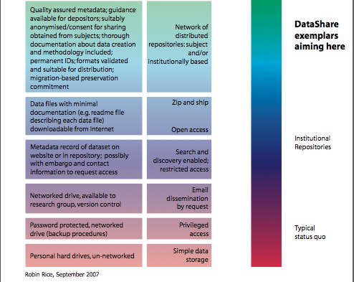
Jisc-funded DataShare Project: Edinburgh, LSE, Oxford, Southampton (DISC-UK)
to formal
institutional
arrangement
from informal
storage and
sharing

Slide 31
Side Note on Web-resident research objects
Web as dominant means to make & access scholarly statement
The Web enables rich aggregations of linked content, with data intrinsic to the statement
  research objects, composite digital objects, ‘multi-part works’
As scholarly statement has become digital, it becomes malleable & lacking in ‘fixity’
Notions of fixity may conflict with demands for usability:
  a record of activity, and thus be immutable?
  made available with secondary analysis by a third party in mind?
What should it be cited? Role of Linked Data?
Need to avoid Reference Rot for this ‘rich content’

Slide 32
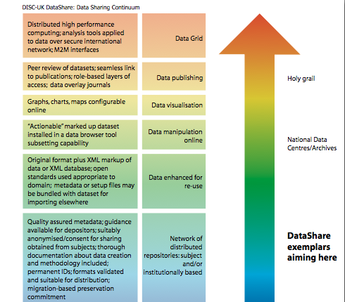
DataShare2
formal publishing into
In Llinked) Data infrastructure
from formal
institutional
arrangement

Slide 33
‘Is data publication the right metaphor?’ Data Science Journal. 12. 2013, Mark Parsons & Peter Fox cast doubt:
“Data authors and stewards rightfully seek recognition for the intellectual effort they invest in creating a good data set. At the same time, we assert that good data sets should be respected and handled like first class scientific objects,
i.e., the unambiguously identified subject of formal discourse. …
Discussion of the pre-release of the essay by M. Parsons and P. Fox:
http://mp-datamatters.blogspot.co.uk/2011/12/seeking-open-review-of-provocative-data.html
The authors note:
1. Confusions about over simplistic application of peer review & ideas of quality
2. Preferring use of data reference to the term data citation as primary purpose is to aid scientific reproducibility through direct, unambiguous reference to the precise data used in a particular study
3. Need to avoid downsides of copyright and restricted-access literature.

Slide 34
 | Reference Rot | E-Journal Archiving
Study | Investigation into status of references in scholarly statement to the web-at-large | Monitoring extent the scholarly record is at risk of loss: who is looking after e-journal content?
Project | Hiberlink Andrew Mellon Foundation with Language Technology Group & the Research Library at Los Alamos National Laboratory | Keepers+ ‘Unfunded’ (Jisc / UoEd) in collaboration internationally with archiving organisations & research libraries http://thekeepers.blogs.edina.ac.uk
 | hiberlink.org | thekeepers.org
Thank You!
edina@ed.ac.uk

