Slide 1
Dealing with data on peace and conflict
Experiences and lessons learned
Political Settlements Research Programme
Sanja Badanjak, Postdoctoral Research Fellow
January 15th 2020

Slide 2
About PA-X www.peaceagreements.org
The most expansive database of peace negotiation documents
120 countries, 153 peace processes
1990-2019
Third release expected in early 2020, with 1800+ documents coded for 225 substantive categories
Qualitative data, quantitative data, text-as-data
Suite of visual tools

Slide 3
Research questions
How do agreements affect the post-conflict political settlement
Which promises are kept? Does it matter?
Are there political arrangements that result in better post-conflict outcomes?
What impact can involvement of third parties have?
How can peace negotiations be more inclusive? Will they result in inclusive societies?
For more information: www.politicalsettlements.org

Slide 4
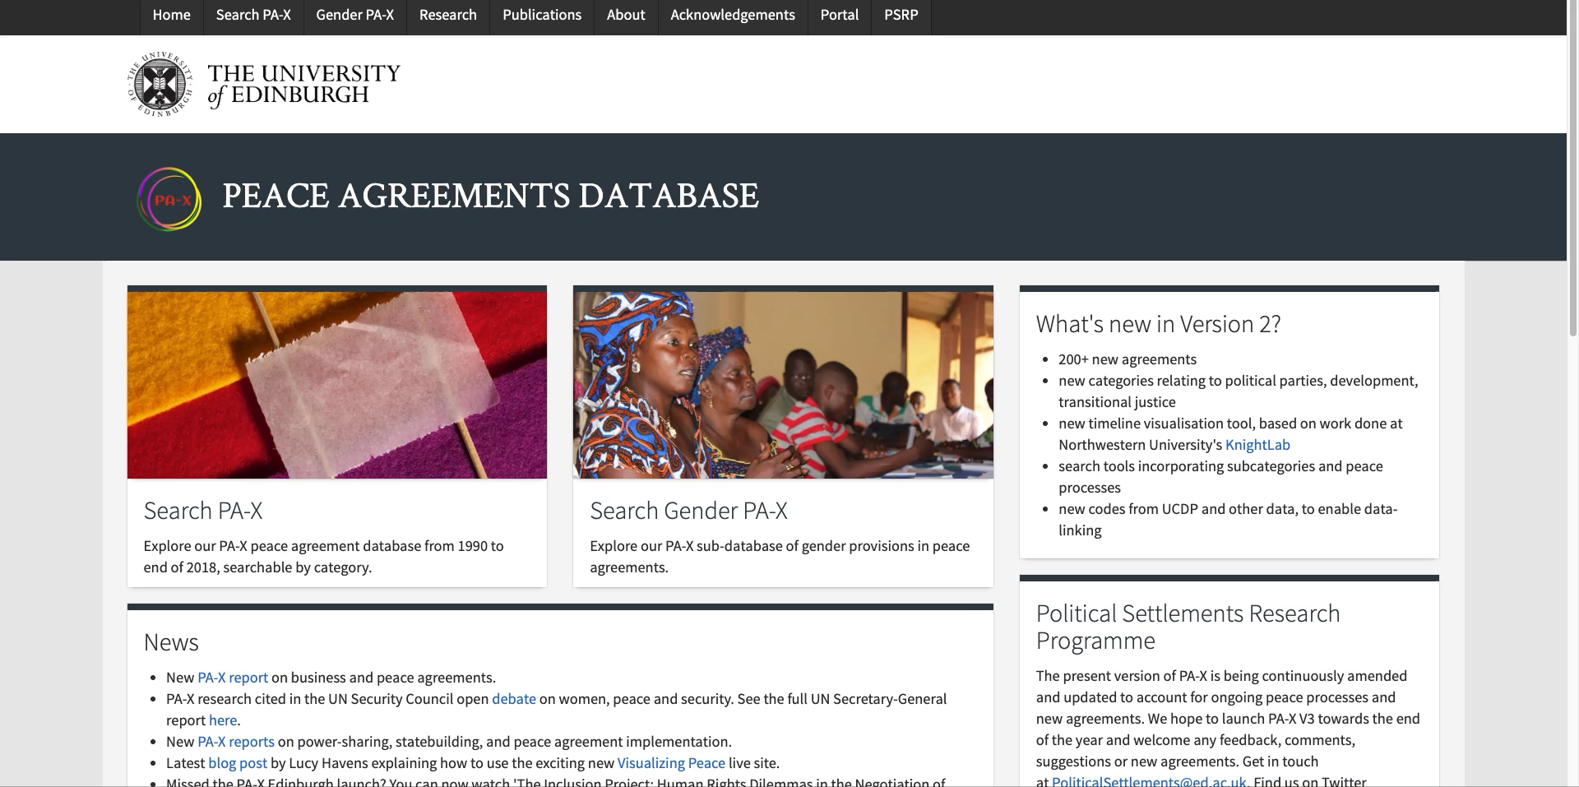

Slide 5
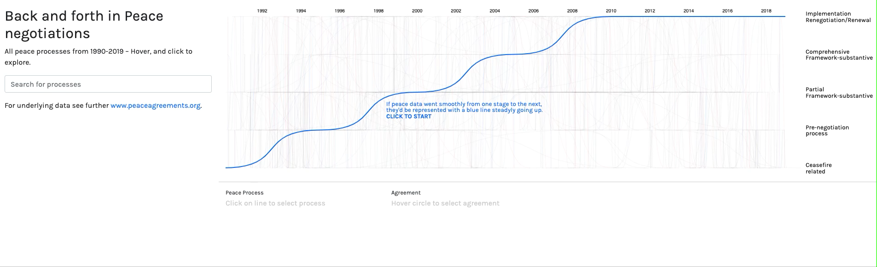

Slide 6
Key data issues
Equivalence of concept, measurement, scope, unit of analysis
Local context, including issues in translation
Bias in data collection

Slide 7
Unit/level of analysis
Shared definitions across countries and disciplines
Data merging problems
Scope of data
  Countries, regions, electoral districts …
  Governments, political parties, rebel groups, military units

Slide 8
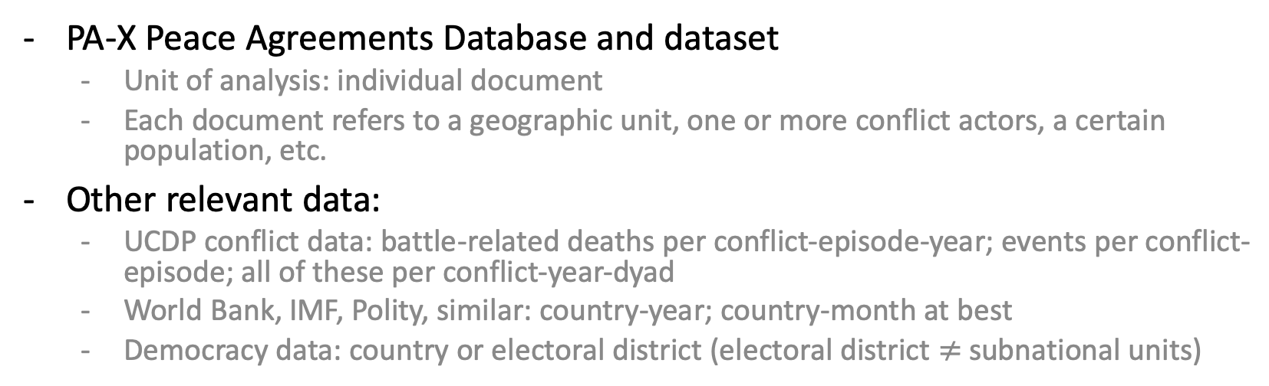
Unit/level of analysis
PA-X Peace Agreements Database and dataset
  Unit of analysis: individual document
  Each document refers to a geographic unit, one or more conflict actors, a certain population, etc.
Other relevant data:
  UCDP conflict data: battle-related deaths per conflict-episode-year; events per conflict-episode; all of these per conflict-year-dyad
  World Bank, IMF, Polity, similar: country-year; country-month at best
  Democracy data: country or electoral district (electoral district $≠$ subnational units)

Slide 9
Unit/level of analysis
Key problems
  One country – multiple conflicts
  One country – but only regional conflict
  One conflict – multiple countries
  One conflict – multiple actors/dyads
  Instability of actors/dyads
  One agreement – multiple conflicts
  One agreement – not all of the armed actors from a single conflict
Solutions?
  No matter what, time- and labour-intensive

Slide 10
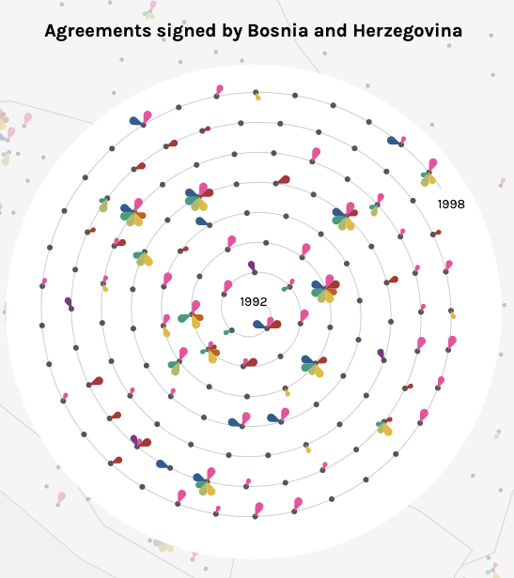
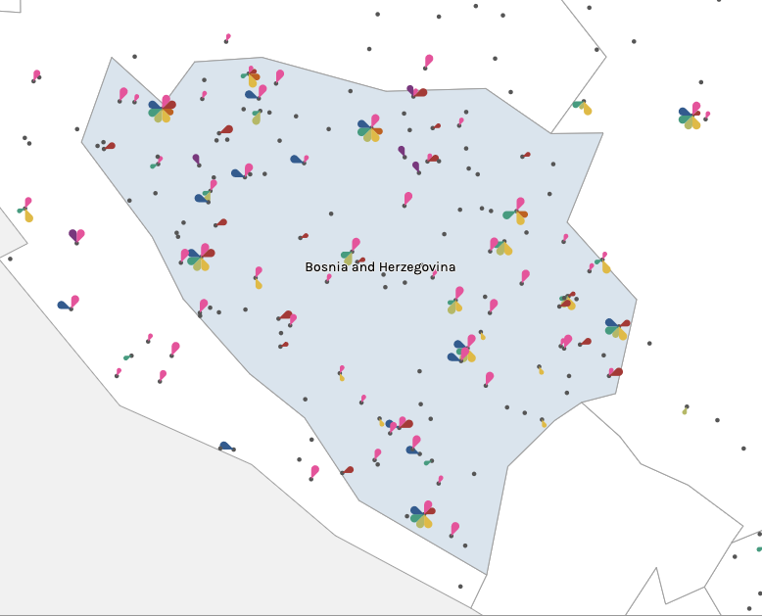
Example: conflict(s) in Bosnia and Herzegovina

Slide 11
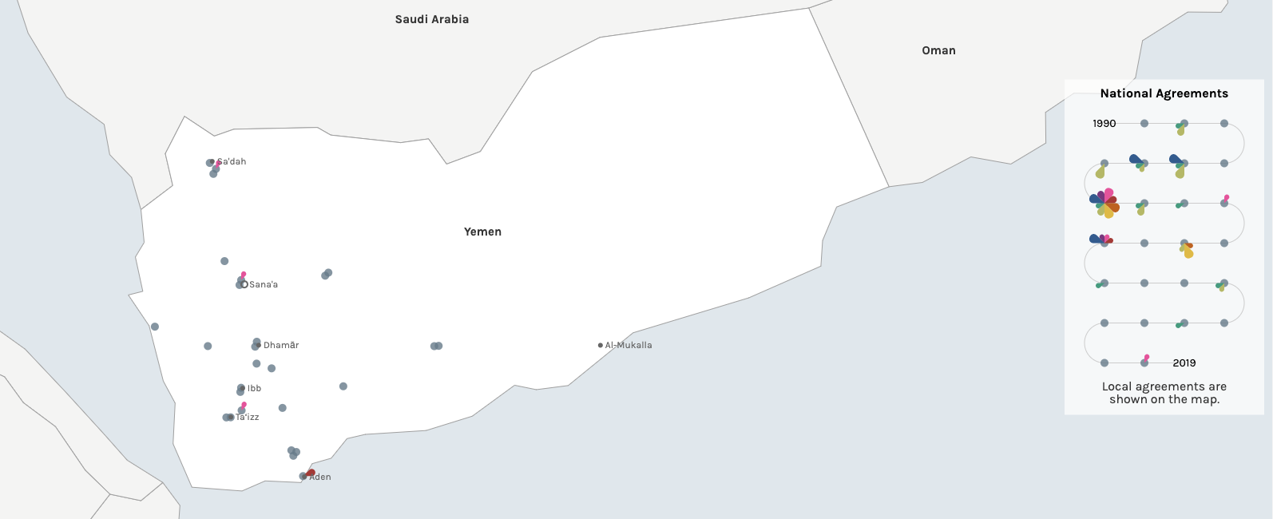
Example: conflict(s) in Yemen

Slide 12
Languages and translation
Data sources
  Newspaper articles
  Government/INGO/NGO reports
Text as data
  Automatic v professional translation

Slide 13
Bias in data collection
Availability bias in field and desk research
Linguistic bias
Geographic bias
(e.g. Weidmann, 2016 AJPS; von Borzyskowski and Wahman, 2019 BJPS)

Slide 14
Solutions in PA-X
Current solutions
  Human coding and expert input
  Collaborations: back and forth across borders and projects
  Professional and expert translations
Next steps
  Grid structure over territory (from Tollefsen et al. 2012, ‘PRIO-GRID: A unified spatial data structure’)
  Seeking funding for actor-based reshaping of PA-X data
  Additional field research, with focus on avoiding bias

Slide 15
Lessons learned
Value of collaboration with other data-collection endeavors
Reliance on country/topic specialists
Data collection as a step on the ladder of abstraction
Discuss, debate, contest
Context, context, context

Slide 16
Thank You
www.peaceagreements.org
www.politicalsettlements.org.uk
Twitter: @PolSettlements

