Slide 1

How can data make a difference to the impact of researchers’ work?
@growkudos www.growkudos.com
Notes:
Hallo, my name is Steve Smith and I’m part of the team at Kudos, which works with universities, publishers, funders and societies – as well as researchers themselves – to maximize the impact of research.
Over the last couple of years since Kudos launched, we’ve compiled a good size data set that maps researchers’ communications – via email, social media, and elsewhere online – against publication metrics for the works they are discussing.
We’ve been analyzing whether efforts to publicize work actually have any meaningful effect on the impact of those works, in terms of things like downloads, citations and altmetrics.
And in terms of “making a difference with data”, we’re sharing the results to try and provide researchers with the evidence they need to justify time spent on such outreach.

Slide 2


Too
much
information!
So many
ways to
communicate!
So many
metrics to
seek out and
analyze!
Can data help people
understand which communications
are best for achieving
IMPACT?
Notes:
A quick bit of background:
Researchers are under growing pressure, obviously, to increase the impact of their work, in a world where:
More and more research is being published, making it harder for them to ensure their work finds its audience
There are more and more ways they could be communicating about their work, making it hard for them to know how to direct their efforts
And their work is being measured in a range of new ways, which is hard for them to keep up with in terms of which metrics are available, where they come from, what they mean, how they relate to each other.
We wanted to try and make it quicker and easier for them to undertake outreach and measure the effect of that, to help them take more control over the visibility and impact of their work.

Slide 3
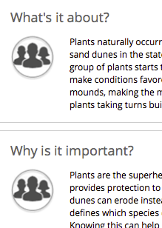
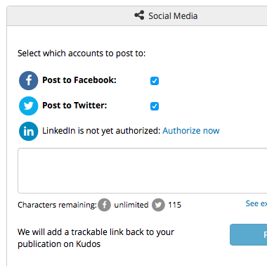

The difference data can make: correlations
We took 100,000 researchers,
and encouraged them to
explain their work in plain language, track their efforts to share it …
and analyse how
these actions correlate
to increases in
publication metrics
@growkudos
Notes:
So we built a standard, central toolkit that they could use across all their publishers, and all their communication channels, and for viewing all their metrics in one place.
It’s a platform for them to explain their work in plain language, and then to track their efforts to share it (by email, social media, academic networks and more).
By centrally managing and measuring communications across different networks and tools, Kudos enables correlation between actions and results
So that’s the first way in which we’re making a difference with data: helping researchers understand which efforts are most effective at driving readership and citations.

Slide 4
The difference data can make: surprises
Facebook is more commonly used for sharing academic work than you might expect
@growkudos
Notes:
In the two years since we launched, over 100,000 researchers have signed up and we’ve built up a dataset that enables largescale analysis of communications activities and publication metrics,
to determine at the aggregate level how researchers share, and whether those efforts really do increase readership.
We have a poster outside (number 7) which reports on this study of our data recently completed by the Altmetric team at Nanyang Techological University in Singapore.
They started by separating out the main social media channels that researchers can post to directly from Kudos.
And in the context of today’s theme – making a difference with data – well, sometimes the data surprises you!
I was taken aback to learn that academics are more likely to do their sharing via Facebook – I might have expected them to use Facebook more for personal updates, and Twitter or LinkedIn for posting about their work.
But the data shows us therefore that public sharing channels are the tip of the iceberg as far as sharing is concerned, and that boundaries between professional and personal networks are blurring.
What difference does this make? Well,
It becomes harder to connect with all the ways that researchers communicate, because so much of this is happening in closed channels.
And we need to be careful not to generalise based on what we see – because there’s a bigger picture that we can’t see!

Slide 5
The difference data can make: confirmation
But links shared via LinkedIn
are most likely to be clicked
.604
.564
.429
@growkudos
Notes:
On the other hand, the NTU study looked at the likelihood of links being clicked, based on the different channels in which they were shared,
and found that the highest correlation between shares and share referrals was for LinkedIn.
This aligns much more closely with what we might expect, so sometimes data is useful for confirming our suspicions!
What this tells us is that people might do more of their sharing via Facebook, but actually they are more likely to get clicks on the links they share via LinkedIn.
So what difference does this data make? It helps us understand how to guide researchers when they seek advice on the most effective way to share their work.

Slide 6

The difference data can make: evidence
Proactively explaining and sharing work increases downloads by 23%
149
n = 4,858
121
n = 4,866
Median full text downloads
@growkudos
Notes:
The other key finding of the NTU study was that when researchers used the Kudos toolkit to explain and share their work,
this correlated to 23% higher downloads of the full text for those publications.
What difference can this data make?
It’s starting to become the kind of evidence we need to persuade senior academics who frown upon communications efforts by their more junior colleagues
– because (in as much as we can correlate downloads to readership), then we’re starting to see that outreach efforts are correlated to improved readership which is key to the creation of any future impact, whether academic or otherwise.

Slide 7
How does all of this benefit institutions and repositories?
Notes:
Given the context of why we’re all here I thought I would close by putting what we are doing into context in terms of how it can benefit institutions and, more specifically, repositories.

Slide 8

For the institution:
Mobilizing researchers to increase the visibility of
their work
Making it easier for you to maximize the results of their efforts
Increasing the impact of the institution’s research
Reinforcing research support to continue attracting quality researchers
Notes:
There are of course a lot of high level benefits of Kudos for the institution –
By mapping activities to metrics, we’re motivating your researchers to take more actions to increase the visibility of their work
By centralizing the way they manage that, we’re making it easier for you to support, learn from, and amplify their efforts
By acting as a nexus for collaboration between researchers, institutions and others such as publishers, societies and funders, we’re helping everyone work together to increase the impact of the institution’s research
And by reinforcing your research support we’re ensuring that you continue to attract high-calibre researchers.

Slide 9
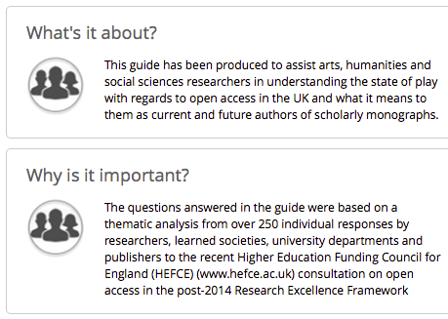
For the repository
A new source
of metadata
to increase discoverability of content in your repository
@growkudos
Notes:
But perhaps more importantly for us here, there are a number of ways we can integrate some of the data from Kudos into repositories:
Firstly, we can help you increase the discoverability of content in your repository – we have over 30,000 publications for which authors have added explanatory information
and you can use a simple widget to pull these plain text descriptions into the repository to make them more findable.
We are in talks with ePrints at the moment about implementing this widget, and
the University of Huddersfield has kindly allowed us to use their ePrints repository to mock-up how the Kudos widget will look when added to a page in the repository.

Slide 10
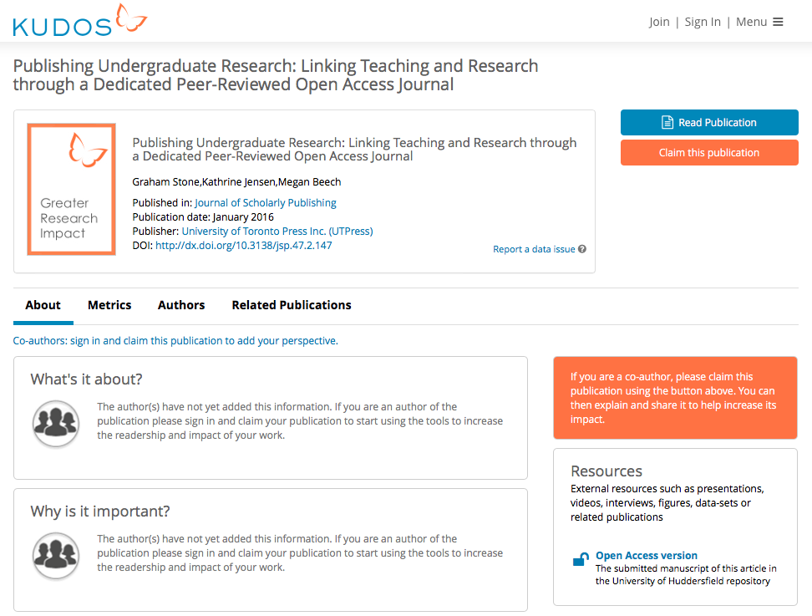
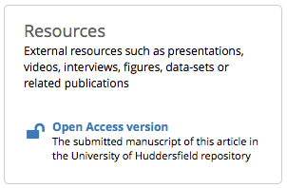
For the repository
A new way to make repository content visible and increase traffic
@growkudos
Notes:
We’ve also just added a new feature to our resources area.
This sits alongside the plain language explanations on Kudos and allows researchers to add links to any other materials, research outputs and so forth
that they think further help to explain the work or set it in context.
They love this field, actually – in large part because it enables the work to keep “living” after publication – they can add links to documents that show the impact their work has had.
Links added in this area can be categorised to enable analysis of which kinds of material are most popular, or most correlated to impact or usage.
Our latest development here is to add “Open Access version” as a category – researchers can then use this field to add a link to the repository version of the publication in question, and help increase traffic to the repository.
Thanks very much for giving me a chance to talk about how Kudos is trying to make a difference with data! I’ll be at poster 7 if you want to have a quick chat later.

