Slide 1

Dealing with Data Conference
26th August 2014

Slide 2
Capturing Datasets….. is only the half of it!
Notes:
Over the past three years in the role of Data Manager at The Roslin Institute working closely with Quality and our IT departments,
the one thing that has struck me more than anything else is the dedication and commitment to science each of our 70 + PI’s demonstrate.
I’m told time and time again that the ‘project’ is merely a stepping stone in providing the ability to deliver their science.
In the majority of cases the research continues from one grant to the next and therefore the datasets at any given time are merely snap shots
of a lifelong commitment to their research goals.

Slide 3
So you’ve got your datasets, what else is required?
Time Gaps?
What’s Changed?
Where is the documentation and is it still valid?
Notes:
With this in mind, capturing these datasets is all well and good.
Datasets can form the basis of continued research, either as a rolling project or with time lags imposed whilst funding is sought.
Using a scenario of a two year gap between one project finishing and another starting, I investigated what might have changed
and more importantly, although the datasets where captured and sufficiently documented at the time,
why other factors should be taken into consideration to truly reflect the authenticity of the science delivered.

Slide 4
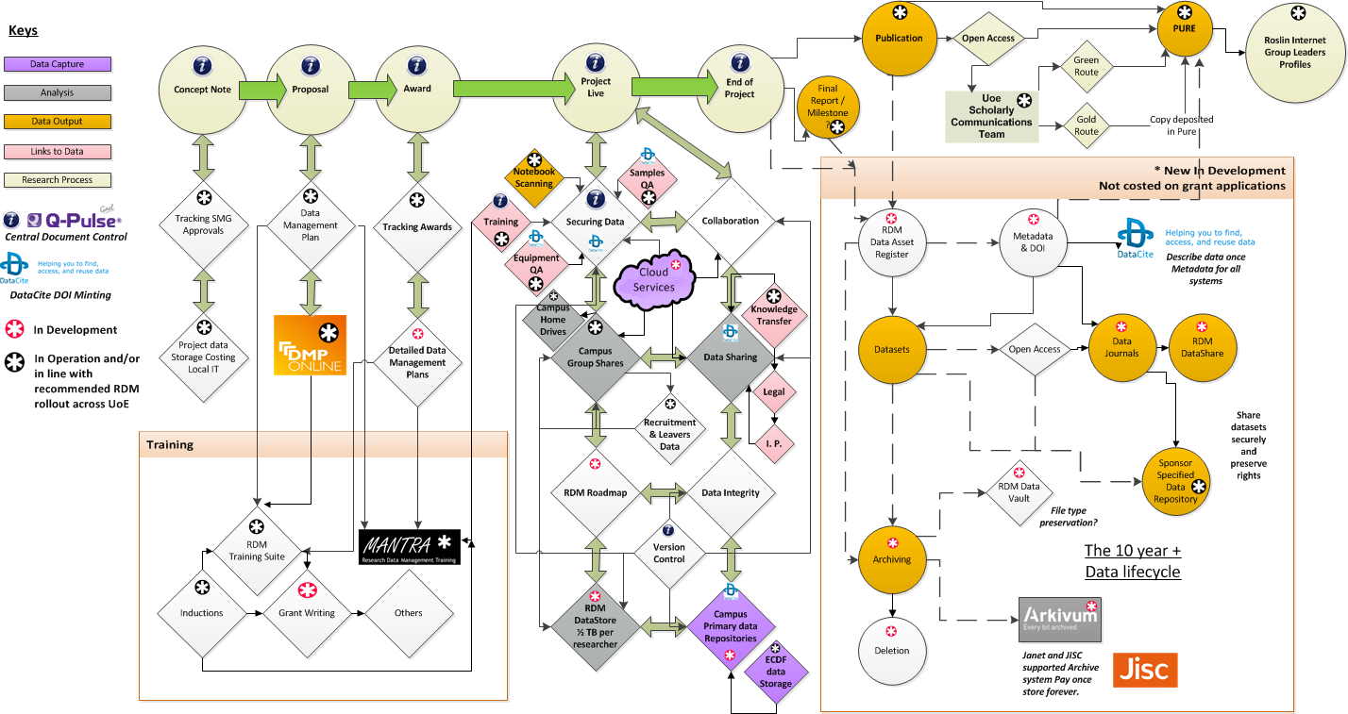

Easter Bush Research Data Management Workflow
Notes:
So what goes into affecting research dataset? In one word ‘PLENTY’. A multitude of potential factors as mapped out in our ever evolving aspirational research data management workflow.
Concentrating on the securing data element of the workflow you will see the following topics highlighted. These form an integral part of any dataset and should be considered just as viable in documenting and capturing datasets.

Slide 5
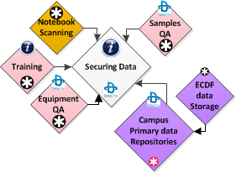
Additional Data Requirements
Notes:
Controlled, Raw and Primary data capture,
Sample storage,
training records.
Equipment records,
Scientific Lab Notebooks.
All integral to delivery of Quality Assured Datasets.

Slide 6
Potential data that requires capturing
Samples / Primary data
  Where are my samples stored?
  How were they labelled?
  Where did the samples come from?
  Which freezer, what conditions, have they moved?
  Where there any breakdowns or temperature fluctuations that could have affected the condition of my samples.
  Where is my primary data, is it secure, under what conditions was my data created?
  What secondary data is generated, Where is it stored? What about important interim data and images?
Notes:
Where is all my research that contributed and produced my datasets?

Slide 7
Potential data that requires capturing
Training
  What training did my researchers receive at the time of my project (records)? Equipment training, procedure training etc.
  What SOPs and policies were written / in place at the time of my project?
  What manuals were being used?
  How were the scientific methods performed?
Notes:
Training records key to success of research.

Slide 8
Potential data that requires capturing
Equipment
  What state was the equipment in when I conducted my research?
    Calibrations
    Service and repair history
    Who and what was it also being used for at the time of my research
    What was the version numbers of software used to generate the data?
Notes:
Services, Calibrations and Repair reports are now electronically scanned and date captured against all equipment held in our Easter Bush Campus Equipment Database.
This Equipment database is now discoverable via web search functionality.

Slide 9
Potential data that requires capturing
Plant & Machinery
  What were the building conditions?
  Which physical area was my research conducted in?
  Air conditioning calibrations?
  Room temperature at the time?
  More than one location?
Notes:
We are currently starting to capture the above data information in our Easter Bush Campus Equipment Database.

Slide 10
Potential data that requires capturing
Scientific Notebooks
  An integral part of any research conducted at Roslin. Documenting all aspects of the research project that is being performed, including:
    notes from group meetings,
    decisions made on direction of project,
    including documenting all procedures, results, conclusions and providing enough detail to allow another researcher to repeat the work again if required.
  In order to prevent loss of this irreplaceable recorded work, all completed books are scanned to provide backup for disaster recovery purposes.
Notes:
The bible for research, conducted at the Institute.

Slide 11
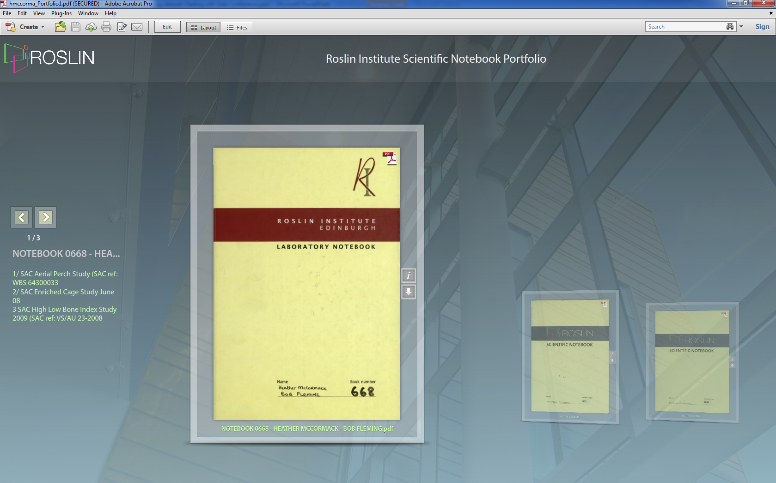
Scientific Notebook Portfolios
Notes:
Electronic scanned copies of lab book’s are compiled into pdf portfolio’s by individual researcher.
Optical Character Recognition software is run over the portfolio which gives the additional benefit of a search facility.
This has limitations due to hand writing but has been proven as successful.

Slide 12
Summary
At Roslin, we are currently working towards integration of the associated data highlighted today. Linkage of Equipment, Plant, Scientific Notebooks, Training records, Samples and Primary Datasets are all key to fully compliment datasets and produce authentic records of the science undertaken at the institute.
So when we say we want to capture datasets, we really are only looking at the half of it!

