Slide 1


Helping academics escape the Publishing Trap an introduction to copyright literacy
Chris Morrison and Jane Secker
Repo Fringe: 2-3 July 2018
Digital Curation Centre, Edinburgh

Slide 2
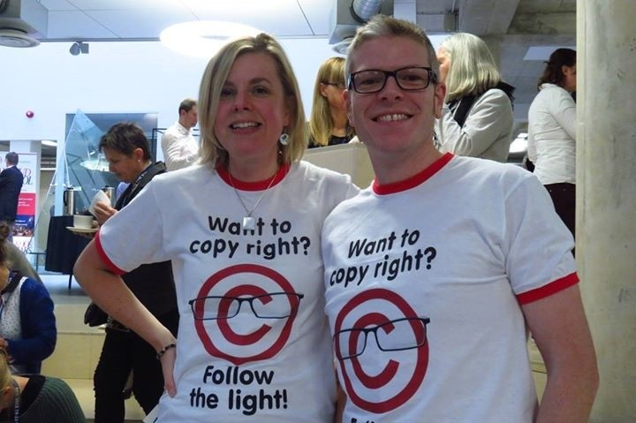
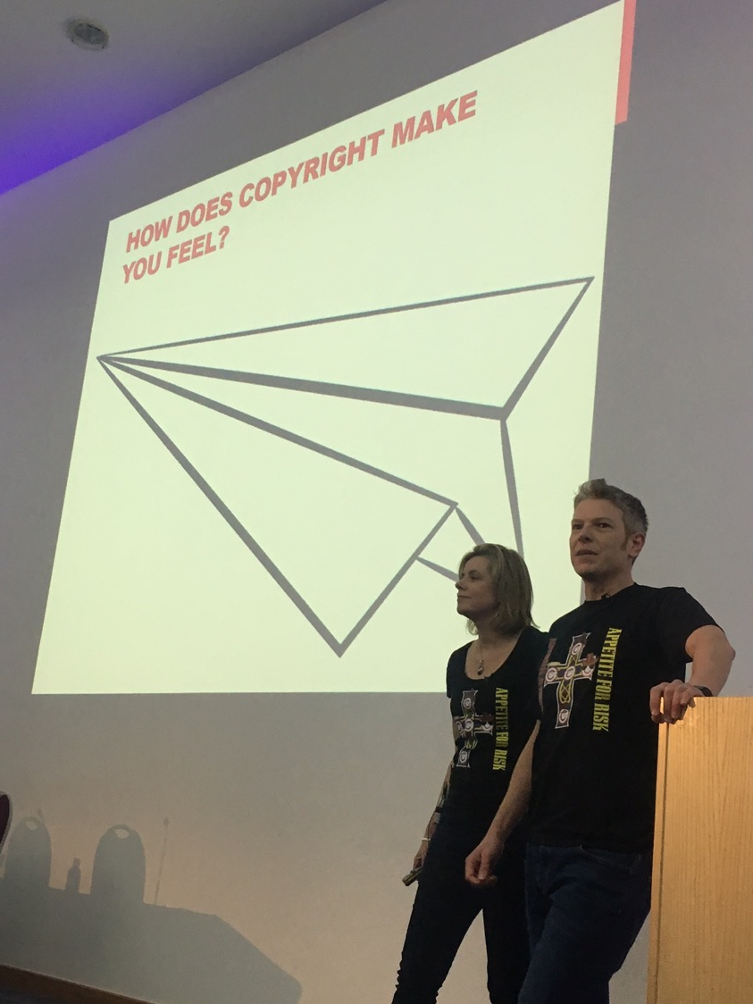
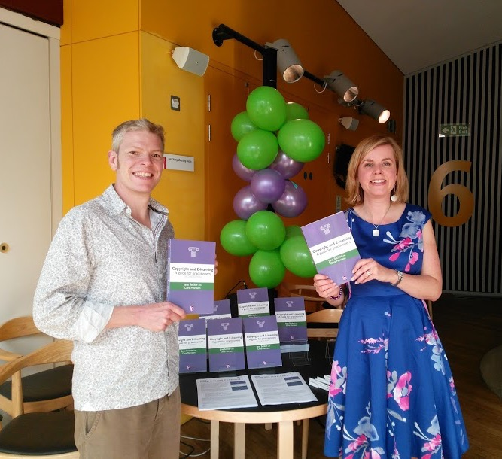
copyrightliteracy.org
Notes:
Replace with “How Does Copyright Make You Feel?” mentimeter thing (Padlet?)

Slide 3
How does copyright make you feel?
Go to menti.com and use code 63 08 12
Notes:
https://www.mentimeter.com/s/cf68e26c9a731b0a885900d86a56ca19/c909a85030ab/edit

Slide 4

“Warm and Fuzzy”
“Excited - like the idea that copyright is a gateway. Should enable access to culture, rather than barrier”
“Love it! It's kept me in the lifestyle to which I have become accustomed”
Notes:
Chris

Slide 5

“Worried, anxious”
“Frustrated, confused. Can I risk it? Can my organisation risk it?”
“Confused, cautious, faintly nauseous!”
“Like the receiver (and thrower) of a hot potato”
Notes:
Chris

Slide 6
Copyright literacy
“acquiring and demonstrating the appropriate knowledge, skills and behaviours to enable the ethical creation and use of copyright material.”
Secker and Morrison, 2016, p.211
Notes:
Chris

Slide 7
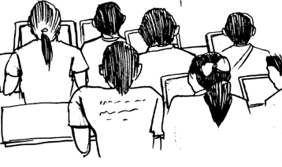



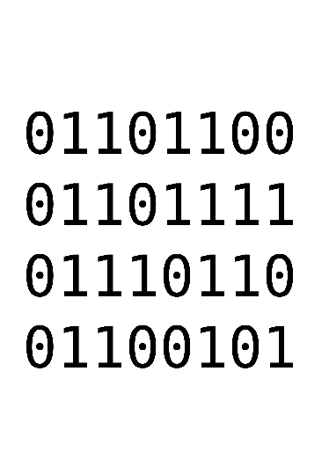

What does it mean?
?
Getting comfortable with uncertainty
Education
not training
Balance between content and approach
Avoiding binaries
Notes:
Jane

Slide 8
THE INTERNATIONAL COPYRIGHT LITERACY SURVEY
Levels of copyright literacy are less than satisfactory
Improvements are needed
There are differences across the countries
Highest scores are from countries with institutional copyright policies and training programs (such as the UK, USA, France, Finland and Norway)
Majority (92.9 percent, n=1790) thinks that copyright literacy should be included in LIS curriculum
Notes:
14 counries were involved, namely Bulgaria, Croatia, Finland, France, Hungary, Lithuania, Mexico, Norway, Portugal, Romania, Spain, Turkey, UK and USA.
Carried out between (2012-2016)
Main aim was to explore the levels of CL knowledge and skills of librarians and other professionals from cultural heritage institutions

Slide 9

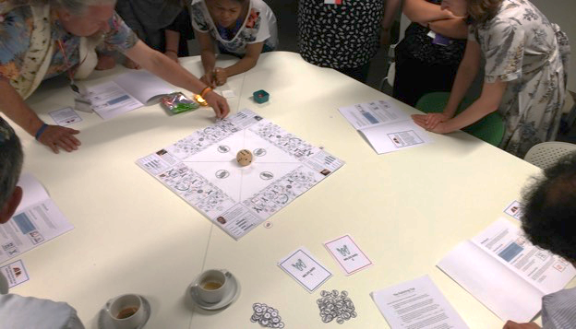
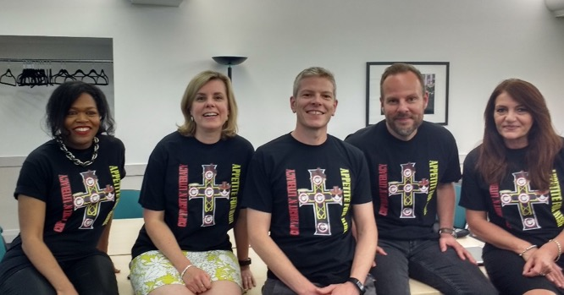



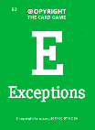

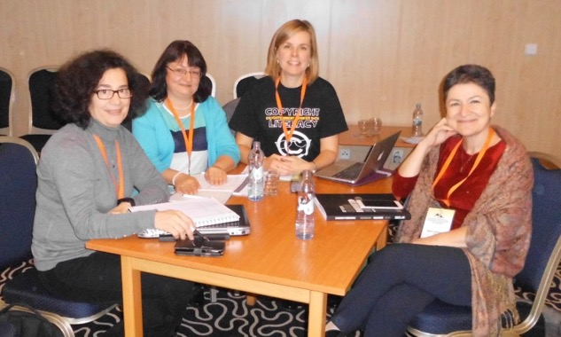
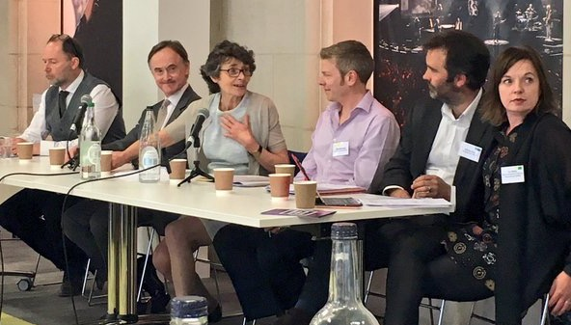
COPYRIGHT LITERACY IN THE UNITED KINGDOM
Community
Education
Research
Engagement

Slide 10
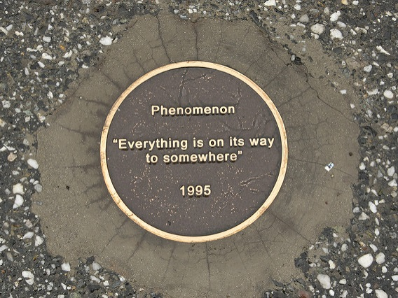
PHENOMENOGRAPHY
Notes:
Jane – variation in experience
3 groups interviews
Academic libraries
Rigorous data analysis – read the article

Slide 11
COPYRIGHT AS AN EXPERIENCE
Category 3:
Copyright is a known entity requiring coherent messages
Category 4: Copyright is an opportunity for negotiation, collaboration and co-construction of understanding
Category 2:
Copyright is complicated and shifting
Category 1: Copyright is a problem
Notes:
Chris

Slide 12
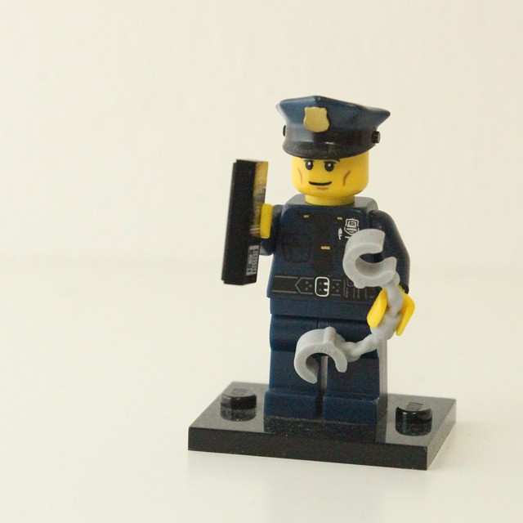

THE ROLE OF THE COPYRIGHT OFFICER
https://copyrightliteracy.org/2017/12/13/copyright-specialists-in-libraries-and-cultural-institutions-findings-from-a-recent-survey/
Notes:
Replace this with fanned out image

Slide 13
HEADLINE FINDINGS ….
66% of institutions in the UK have a designated copyright officer (higher in Higher Education)
74% are paid more than £30K per annum
They are 4 times more likely to be a librarian than to have legal training
63% of them are based in the Library
65% of institutions have other staff also involved in copyright matters
Notes:
CLS showed 64% had copyright officers (75% in universities)

Slide 14
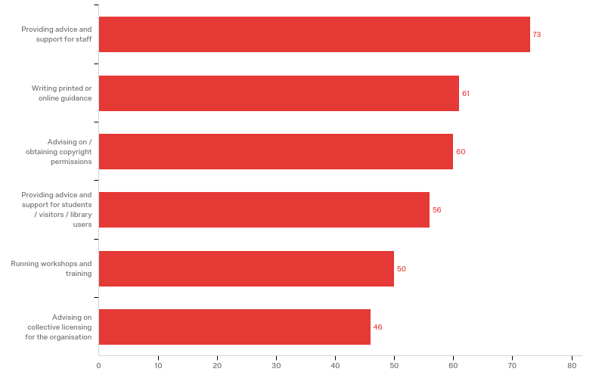
WHAT DO COPYRIGHT SPECIALISTS DO?
Providing advice and support for staff
73
Writing printed or online guidance
61
Advising on/obtaining copyright permissions
60
Providing advice and support for students / visitors / library users
56
Running workshops and training
50
Advice on collective licensing for the organisation
46
Notes:
Chris to re-order the chart and filter only the top 5 from Qualtrics and make them legible.

Slide 15

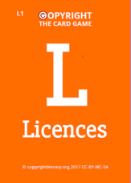
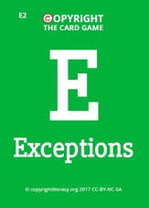
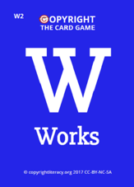
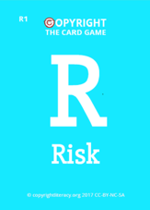
Lessons from Copyright the Card Game
Notes:
Chris
Embodied cognition – knowledge in your hand and head
The value of playing in teams and discussion
Scenarios
Avoiding binaries – right vs wrong

Slide 16
Teaching copyright, licensing and scholarly comms
Didactic vs experiential
Terminology and processes
Scenarios and real life problems
Complexity, frustration and confusion
Value of active learning and games-based learning
Notes:
Chris. Ask whether this is other people’s experience. Is this a provocation?
Our research and practice highlights the value of active learning and specifically game—based learning
Jane to mention ACRL study

Slide 17
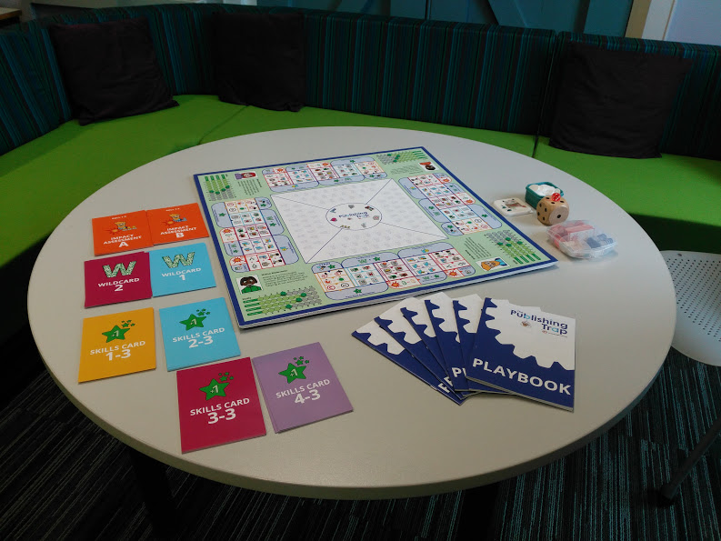


Slide 18
Background
ACRL (2013) Study on the Intersections of Information Literacy and Scholarly Communications identified 3 intersections:
  economics of the distribution of scholarship (including access to scholarship, the changing nature of scholarly publishing, and the education of students to be knowledgeable content consumers and content creators);
  digital literacies (including teaching new technologies and rights issues, and the emergence of multiple types of non-textual content);
  our changing roles (including the imperative to contribute to the building of new infrastructures for scholarship, and deep involvement with creative approaches to teaching).
Issues associating with teaching copyright and licensing lie at the heart of these intersections
Notes:
Jane

Slide 19
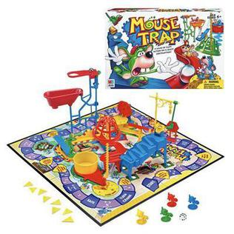
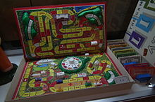
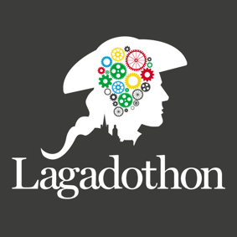
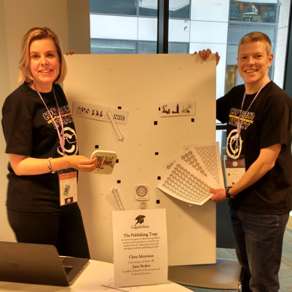
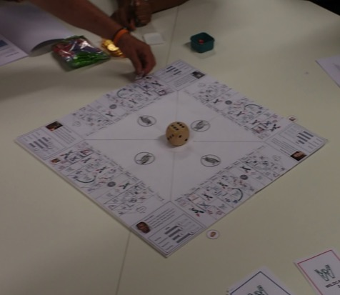

The Publishing Trap: the creative process
Notes:
Both but Jane to lead

Slide 20
Developing the game
Available for download from copyrightliteracy.org
Oct 20, 2017
Game based learning Leeds
Licensing choices and sharing the game CC-BY-NC-ND
Nov 23, 2015
Lagadathon at LILAC 2016 Dublin
Kent MA students
2015
Mar 22, 2016
Mar 14, 2017
Nov 16, 2017
2015
Nov
Feb
May
Aug
Nov
Feb
May
Aug
Nov
2018
Today
Nov 17, 2016
Oct 16, 2017
Playtest with PLSIG in London
Official launch Kent
Aug 23, 2017
1 day
Wroclaw Summer 2017
Input from Lisa Johstone Graphic Design
9/4/2017

Slide 21
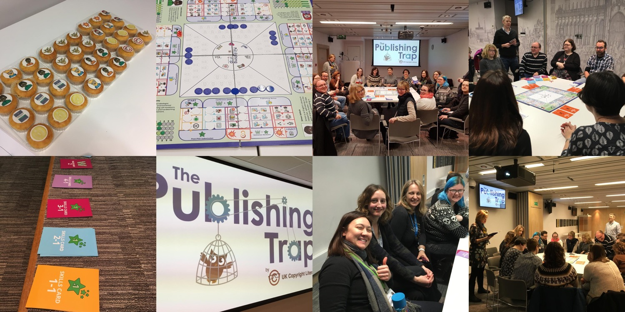
Introducing the Publishing Trap
Notes:
Chris – mentioning Cambridge

Slide 22



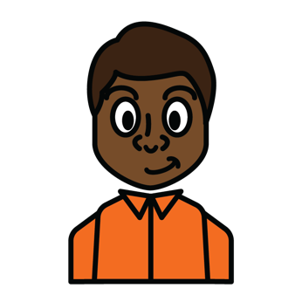
Meet the characters
Misha the criminologist
Brian the microbiologist
Mary the space scientist
Simon the Jane Austen expert

Slide 23
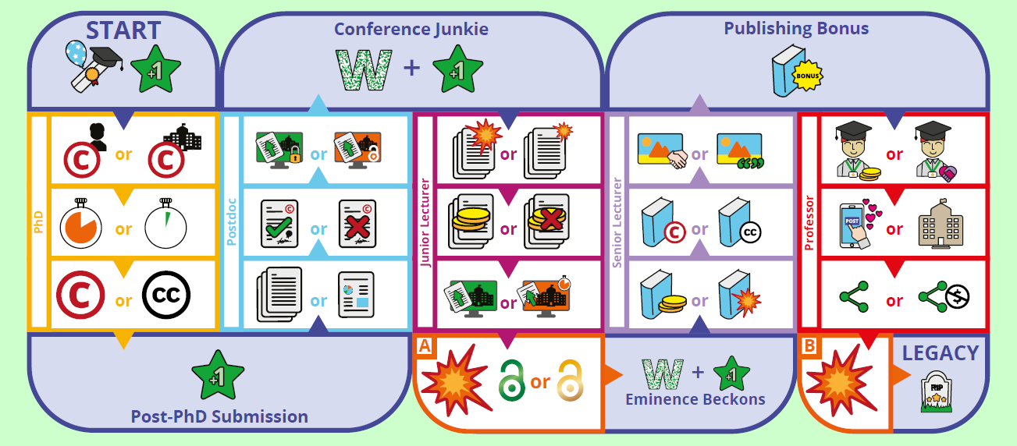
The Academic Game of Life

Slide 24
Impact to date
Downloads and hits on website:
  over 4,273 hits on website and 281 downloads to date*
Who has played it
  mainly librarians rather than intended audience (researchers)
Worldwide interest
  UK, USA, Canada, Australia, New Zealand
  Europe including France, Germany, Sweden, Czech Republic, Norway, Spain, Denmark
  Elsewhere: Japan, Singapore, Saudi Arabia and many more!
  * as of 29 June 2018
Notes:
Just to note that the hits on the (protected) download page are 1903 (so people could be sharing it or downloading it multiple times!)

Slide 25
What do people say?
“Valuable to me as a university librarian to remind me of the value of research and to help me understand and relate to the opportunities and challenges of scholarly publishing from an academic's point of view.”
Notes:
Jane

Slide 26
What do people say?
“Valuable to me as a university librarian to remind me of the value of research and to help me understand and relate to the opportunities and challenges of scholarly publishing from an academic's point of view.”
“It would help researchers to understand that the decisions they make in relation to publishing their work cannot be made in isolation. Each decision results in an impact further down the publishing path can could be positive or negative. It's a great game to convey the different routes to publishing.”

Slide 27
What do people say?
“Valuable to me as a university librarian to remind me of the value of research and to help me understand and relate to the opportunities and challenges of scholarly publishing from an academic's point of view.”
“I found it a really engaging way of understanding more about the academic publishing process and the impact that copyright/IP has on it.”
“It would help researchers to understand that the decisions they make in relation to publishing their work cannot be made in isolation. Each decision results in an impact further down the publishing path can could be positive or negative. It's a great game to convey the different routes to publishing.”

Slide 28
What do people say?
“Valuable to me as a university librarian to remind me of the value of research and to help me understand and relate to the opportunities and challenges of scholarly publishing from an academic's point of view.”
“I found it a really engaging way of understanding more about the academic publishing process and the impact that copyright/IP has on it.”
“It would help researchers to understand that the decisions they make in relation to publishing their work cannot be made in isolation. Each decision results in an impact further down the publishing path can could be positive or negative. It's a great game to convey the different routes to publishing.”
“It provides a great entry point to what can be a complex area of scholarly life. It is particularly good for library staff working with open access repositories.”

Slide 29
What do people say?
“Valuable to me as a university librarian to remind me of the value of research and to help me understand and relate to the opportunities and challenges of scholarly publishing from an academic's point of view.”
“I found it a really engaging way of understanding more about the academic publishing process and the impact that copyright/IP has on it.”
“It would help researchers to understand that the decisions they make in relation to publishing their work cannot be made in isolation. Each decision results in an impact further down the publishing path can could be positive or negative. It's a great game to convey the different routes to publishing.”
“It provides a great entry point to what can be a complex area of scholarly life. It is particularly good for library staff working with open access repositories.”

Slide 30
Improvements and suggestions
“The game is quite long, and, whilst I really enjoyed it and felt engaged throughout, I wondered whether PhD students would prefer something a little shorter. Would there be a way to cut it down so that it can be completed in about an hour?”
Notes:
Chris
It would be very helpful to have a separate, annotated rule book to provide context for the game and to explain the mechanics of how all of the rounds work, and how to translate decisions made according to the playbook onto the board. It is impossible to play the game "out of the box" from the playbook alone.
A straightforward way to improve the player experience would be to have individual playbooks for each character. Given that the game requires at least 8 people sitting around the board (two per player), it's likely that they won't be able to read the short descriptions upside down. Since everyone needs to have her own copy of the playbook during the game, having the playbooks individualized on a character-by-character basis would make it much easier for the players to engage with the stories and be aware of the differences in the characters' strengths.
Keeping track of the Skills tracks is very difficult. While they are attractive graphically, the individual tracks are so small that it is difficult to keep one's place with standard stationery equipment. (We ended up distributing post-its and asking players to keep track of their skills with a gate tally, which wasn't ideal.)
Given the difficulty of maintaining the Skills tracks, would it be possible to print those in the playbooks with the individual characters? Then the players could keep track of the Skills points sensibly. They could also take home their playbooks as a memento of the session and it would probably spark further discussion afterward.
The Instructions mention that 100 white tokens are needed, but their function isn't explained. Should they be used to record decisions on the board?
The Impact Assessment is extremely confusing. The distinction between "points" and "tokens" is not explained anywhere, and the function of the physical tokens isn't explained. The physical tokens are shaped like a distinct section on the board, but how does a player know which one to put down? Also, how are the points made during the Impact Assessment round recorded? Are they only relevant during the assessment?

Slide 31
Improvements and suggestions
“The game is quite long, and, whilst I really enjoyed it and felt engaged throughout, I wondered whether PhD students would prefer something a little shorter. Would there be a way to cut it down so that it can be completed in about an hour?”
“The playing space could be a bit bigger - i.e. the space at the edges of the board where all the action happens, and the middle bit smaller.”
Notes:
It would be very helpful to have a separate, annotated rule book to provide context for the game and to explain the mechanics of how all of the rounds work, and how to translate decisions made according to the playbook onto the board. It is impossible to play the game "out of the box" from the playbook alone.
A straightforward way to improve the player experience would be to have individual playbooks for each character. Given that the game requires at least 8 people sitting around the board (two per player), it's likely that they won't be able to read the short descriptions upside down. Since everyone needs to have her own copy of the playbook during the game, having the playbooks individualized on a character-by-character basis would make it much easier for the players to engage with the stories and be aware of the differences in the characters' strengths.
Keeping track of the Skills tracks is very difficult. While they are attractive graphically, the individual tracks are so small that it is difficult to keep one's place with standard stationery equipment. (We ended up distributing post-its and asking players to keep track of their skills with a gate tally, which wasn't ideal.)
Given the difficulty of maintaining the Skills tracks, would it be possible to print those in the playbooks with the individual characters? Then the players could keep track of the Skills points sensibly. They could also take home their playbooks as a memento of the session and it would probably spark further discussion afterward.
The Instructions mention that 100 white tokens are needed, but their function isn't explained. Should they be used to record decisions on the board?
The Impact Assessment is extremely confusing. The distinction between "points" and "tokens" is not explained anywhere, and the function of the physical tokens isn't explained. The physical tokens are shaped like a distinct section on the board, but how does a player know which one to put down? Also, how are the points made during the Impact Assessment round recorded? Are they only relevant during the assessment?

Slide 32
Improvements and suggestions
“The game is quite long, and, whilst I really enjoyed it and felt engaged throughout, I wondered whether PhD students would prefer something a little shorter. Would there be a way to cut it down so that it can be completed in about an hour?”
“Players wanted to do more with the money, e.g. pay for a research assistant or go to conferences or additional training. Also, the conflict between research and teaching was not highlighted - which is something a lot of researchers do struggle with and therefore work a lot overtime.”
“The playing space could be a bit bigger - i.e. the space at the edges of the board where all the action happens, and the middle bit smaller.”
Notes:
It would be very helpful to have a separate, annotated rule book to provide context for the game and to explain the mechanics of how all of the rounds work, and how to translate decisions made according to the playbook onto the board. It is impossible to play the game "out of the box" from the playbook alone.
A straightforward way to improve the player experience would be to have individual playbooks for each character. Given that the game requires at least 8 people sitting around the board (two per player), it's likely that they won't be able to read the short descriptions upside down. Since everyone needs to have her own copy of the playbook during the game, having the playbooks individualized on a character-by-character basis would make it much easier for the players to engage with the stories and be aware of the differences in the characters' strengths.
Keeping track of the Skills tracks is very difficult. While they are attractive graphically, the individual tracks are so small that it is difficult to keep one's place with standard stationery equipment. (We ended up distributing post-its and asking players to keep track of their skills with a gate tally, which wasn't ideal.)
Given the difficulty of maintaining the Skills tracks, would it be possible to print those in the playbooks with the individual characters? Then the players could keep track of the Skills points sensibly. They could also take home their playbooks as a memento of the session and it would probably spark further discussion afterward.
The Instructions mention that 100 white tokens are needed, but their function isn't explained. Should they be used to record decisions on the board?
The Impact Assessment is extremely confusing. The distinction between "points" and "tokens" is not explained anywhere, and the function of the physical tokens isn't explained. The physical tokens are shaped like a distinct section on the board, but how does a player know which one to put down? Also, how are the points made during the Impact Assessment round recorded? Are they only relevant during the assessment?

Slide 33
Improvements and suggestions
“The game is quite long, and, whilst I really enjoyed it and felt engaged throughout, I wondered whether PhD students would prefer something a little shorter. Would there be a way to cut it down so that it can be completed in about an hour?”
“Players wanted to do more with the money, e.g. pay for a research assistant or go to conferences or additional training. Also, the conflict between research and teaching was not highlighted - which is something a lot of researchers do struggle with and therefore work a lot overtime.”
“The playing space could be a bit bigger - i.e. the space at the edges of the board where all the action happens, and the middle bit smaller.”
“A choice of characters would be great, especially if there was a way to mix and match characteristics.”
Notes:
It would be very helpful to have a separate, annotated rule book to provide context for the game and to explain the mechanics of how all of the rounds work, and how to translate decisions made according to the playbook onto the board. It is impossible to play the game "out of the box" from the playbook alone.
A straightforward way to improve the player experience would be to have individual playbooks for each character. Given that the game requires at least 8 people sitting around the board (two per player), it's likely that they won't be able to read the short descriptions upside down. Since everyone needs to have her own copy of the playbook during the game, having the playbooks individualized on a character-by-character basis would make it much easier for the players to engage with the stories and be aware of the differences in the characters' strengths.
Keeping track of the Skills tracks is very difficult. While they are attractive graphically, the individual tracks are so small that it is difficult to keep one's place with standard stationery equipment. (We ended up distributing post-its and asking players to keep track of their skills with a gate tally, which wasn't ideal.)
Given the difficulty of maintaining the Skills tracks, would it be possible to print those in the playbooks with the individual characters? Then the players could keep track of the Skills points sensibly. They could also take home their playbooks as a memento of the session and it would probably spark further discussion afterward.
The Instructions mention that 100 white tokens are needed, but their function isn't explained. Should they be used to record decisions on the board?
The Impact Assessment is extremely confusing. The distinction between "points" and "tokens" is not explained anywhere, and the function of the physical tokens isn't explained. The physical tokens are shaped like a distinct section on the board, but how does a player know which one to put down? Also, how are the points made during the Impact Assessment round recorded? Are they only relevant during the assessment?

Slide 34
Improvements and suggestions
“The game is quite long, and, whilst I really enjoyed it and felt engaged throughout, I wondered whether PhD students would prefer something a little shorter. Would there be a way to cut it down so that it can be completed in about an hour?”
“Players wanted to do more with the money, e.g. pay for a research assistant or go to conferences or additional training. Also, the conflict between research and teaching was not highlighted - which is something a lot of researchers do struggle with and therefore work a lot overtime.”
“The playing space could be a bit bigger - i.e. the space at the edges of the board where all the action happens, and the middle bit smaller.”
“A choice of characters would be great, especially if there was a way to mix and match characteristics.”
Notes:
It would be very helpful to have a separate, annotated rule book to provide context for the game and to explain the mechanics of how all of the rounds work, and how to translate decisions made according to the playbook onto the board. It is impossible to play the game "out of the box" from the playbook alone.
A straightforward way to improve the player experience would be to have individual playbooks for each character. Given that the game requires at least 8 people sitting around the board (two per player), it's likely that they won't be able to read the short descriptions upside down. Since everyone needs to have her own copy of the playbook during the game, having the playbooks individualized on a character-by-character basis would make it much easier for the players to engage with the stories and be aware of the differences in the characters' strengths.
Keeping track of the Skills tracks is very difficult. While they are attractive graphically, the individual tracks are so small that it is difficult to keep one's place with standard stationery equipment. (We ended up distributing post-its and asking players to keep track of their skills with a gate tally, which wasn't ideal.)
Given the difficulty of maintaining the Skills tracks, would it be possible to print those in the playbooks with the individual characters? Then the players could keep track of the Skills points sensibly. They could also take home their playbooks as a memento of the session and it would probably spark further discussion afterward.
The Instructions mention that 100 white tokens are needed, but their function isn't explained. Should they be used to record decisions on the board?
The Impact Assessment is extremely confusing. The distinction between "points" and "tokens" is not explained anywhere, and the function of the physical tokens isn't explained. The physical tokens are shaped like a distinct section on the board, but how does a player know which one to put down? Also, how are the points made during the Impact Assessment round recorded? Are they only relevant during the assessment?

Slide 35
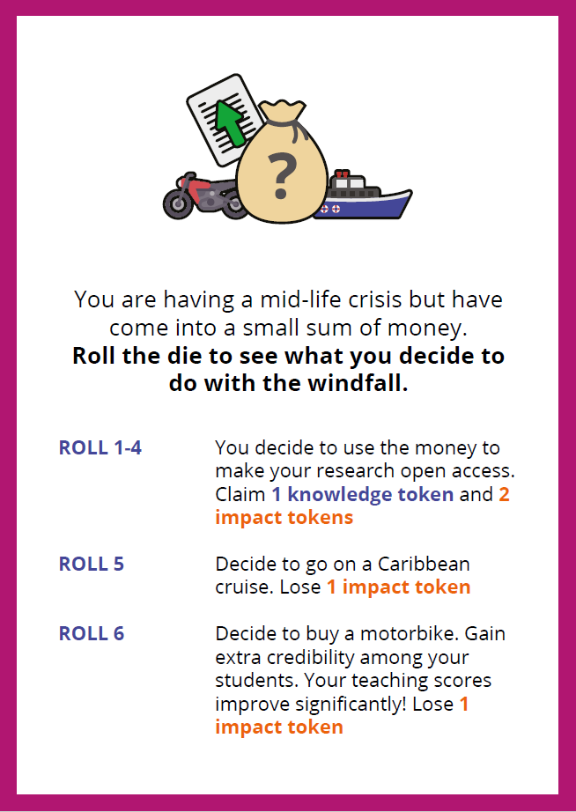
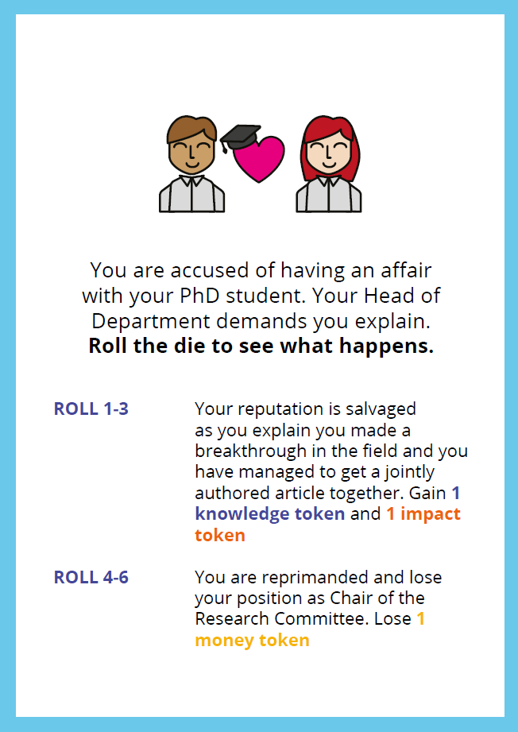
feedback
Notes:
Jane then Chris

Slide 36
The Publishing Trap and other training
Linking in with institutional policies and procedures
Putting copyright concerns in wider context
Complements wider scholarly comms and open access support

Slide 37
Future plans
New Zealand and Australian version
German translation
Updating game mechanics
Potential redesign of the board
Building 3D model

Slide 38
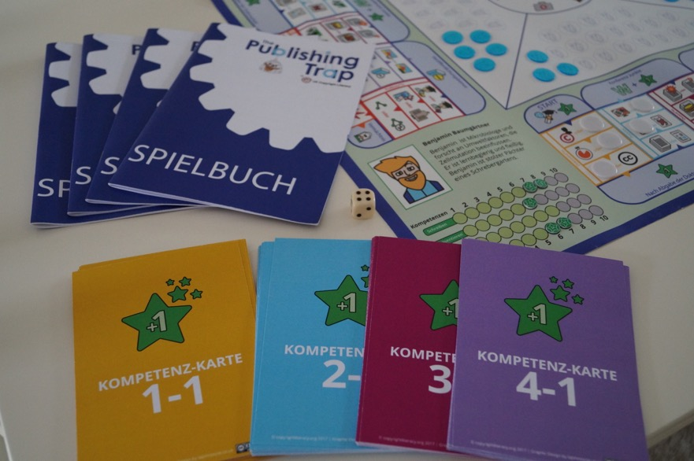
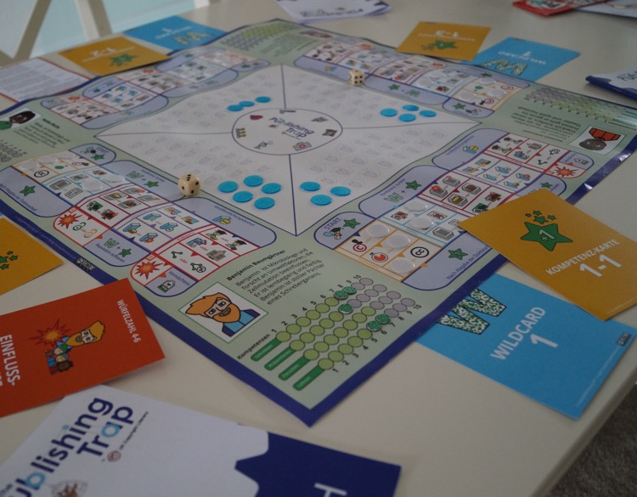
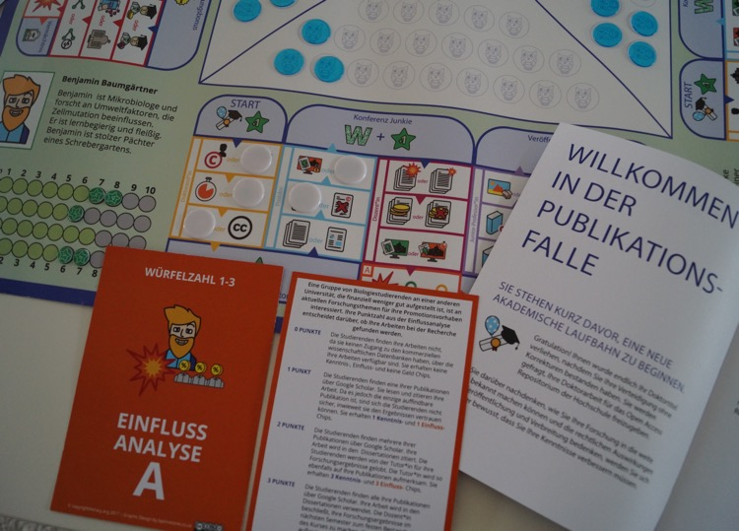
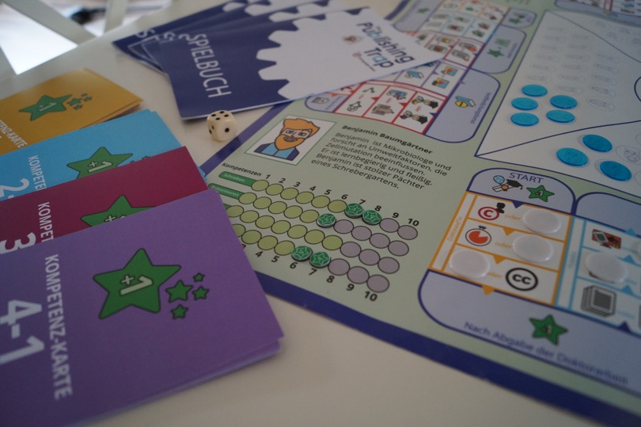
Die Publikationsfalle
Notes:
Update slide with pictures from Berlin

Slide 39

Come and play it now in the kelvin room

Slide 40
credits
Original content by Chris Morrison and Jane Secker (UK Copyright Literacy) licensed Creative Commons Attribution ShareAlike (CC BY SA) 4.0
The Publishing Trap images and photos licensed CC BY NC ND 4.0
Third party copyright images included under fair dealing provisions of Copyright, Designs and Patents Act 1988
Slide 4 – Photo by Amber Litzinger https://flic.kr/p/bEXT6H CC-BY
Slide 5 - Panic by Nate Stelner https://flic.kr/p/us2aa Public Domain
Slide 7 – Open Clip Art
Slide 10 - Phenomena by Nick Ares https://flic.kr/p/6m6uYA CC-BY
Slide 12 - Lego police officer byMartin @pokipsie Rechsteiner https://flic.kr/p/qmMDmS CC-BY
Slide 19 – Game of Life and Mousetrap by Hasbro
Slide 38 – Die Publikationsfalle photos by Cagla Bacaksiz
Notes:
Update credits

Slide 41
Further Reading
ACRL (2013) Scholarly Communication and Information Literacy: Creating Strategic Collaborations for a Changing Academic Environment. ACRL. Available at: http://acrl.ala.org/intersections/
Morrison, C and Secker J. (2015) Copyright Literacy in the UK: a survey of librarians and other cultural heritage sector professionals. Library and Information Research. 39 (121)
http://www.lirgjournal.org.uk/lir/ojs/index.php/lir/article/view/675
Morrison, C & Secker, J. (2017). Understanding librarians’ experiences of copyright: findings from a phenomenographic study of UK information professionals. Library Management, 38 (6/7)
Morrison, C and Secker, J (2017) The Publishing Trap: a game of scholarly communication. LSE Impact Blog http://blogs.lse.ac.uk/impactofsocialsciences/2017/10/28/the-publishing-trap-a-game-of-scholarly-communication/
Morrison, C. (2015) Copyright the Card Game. ALISS Quarterly. 9 (2).
Secker, J and Morrison C (2018). The Publishing Trap. Information Professional. April 2018 edition Available at: https://www.cilip.org.uk/page/PubTrapAprMay18
Secker, J and Morrison, C. (2016) Copyright and E-learning: a guide for practitioners. Facet publishing: London. Chapter 6: Copyright education and training available online.
Todorova, Tania et. al. (2017) Information Professionals and Copyright Literacy: A Multinational Study. Library Management, 38 (6/7).
The Publishing Trap is available under CC-BY-NC-ND at:
https://copyrightliteracy.org/resources/the-publishing-trap/

