Slide 1


The Grant is Dead, Long Live the Data
Johnny Hay and Tomasz Zieliński
Funded by a Wellcome Trust Institutional Strategic Support Fund (ISSF3)

Slide 2
PlaSMo repository
PlaSMo : ‘Plant Systems-biology Modelling’
“Ensuring the achievements of yesterday's Mathematical Modellers will be available for the Systems Biologists of tomorrow”
Envisioned at BBSRC and GARNet workshop in July 2005
Initial 2 years funding from 2008

Slide 3
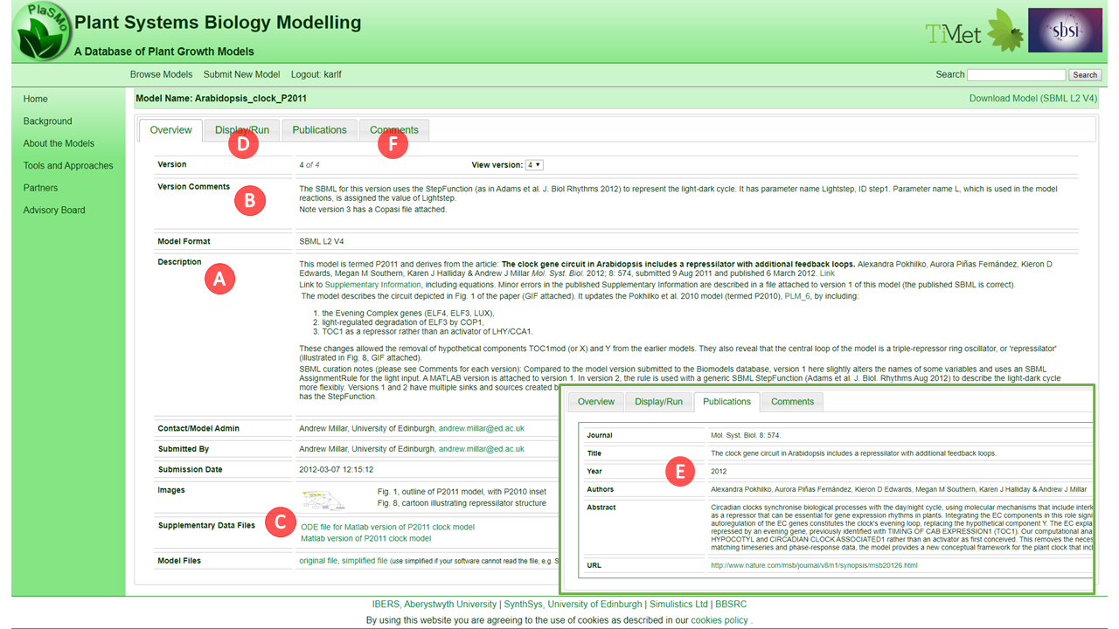
PlaSMo features

Slide 4
PlaSMo problems
In-kind contribution by unrelated projects
Java based easy to maintain, but
sys admin of the server
urgent web-framework updates (security threats)
user support
outdated web interface
lack of new users

Slide 5














It is a new world
Which Repository?

Slide 6
PlaSMo Future
PlaSMo real value lies in its data
Let’s find the new home for the data

Slide 7
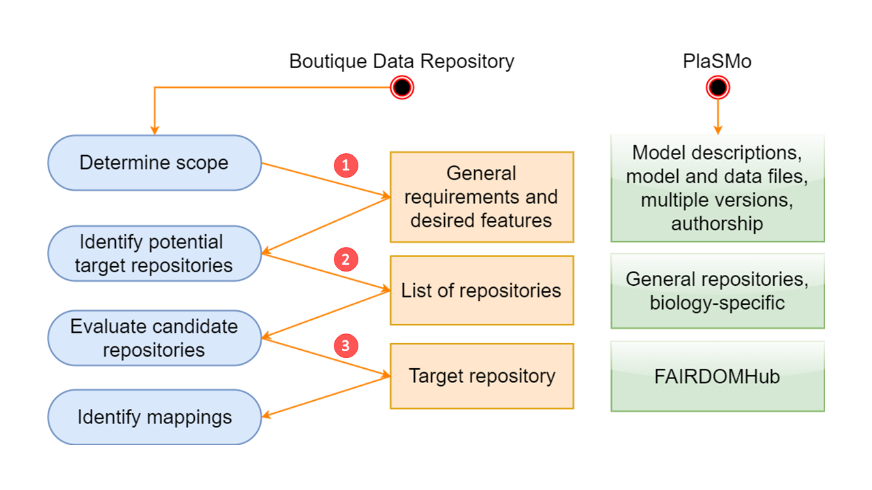
Migration process
Notes:
Analyse data assets to be migrated, their metadata, entity relationships, target audience, and determine baseline requirements for target repository accordingly
Compile a list of potential candidate public repositories, considering their sustainability, popularity, and audience
Evaluate compatibility of repositories, considering their features, data and metadata model, permissions and access control, and programmatic access tools

Slide 8
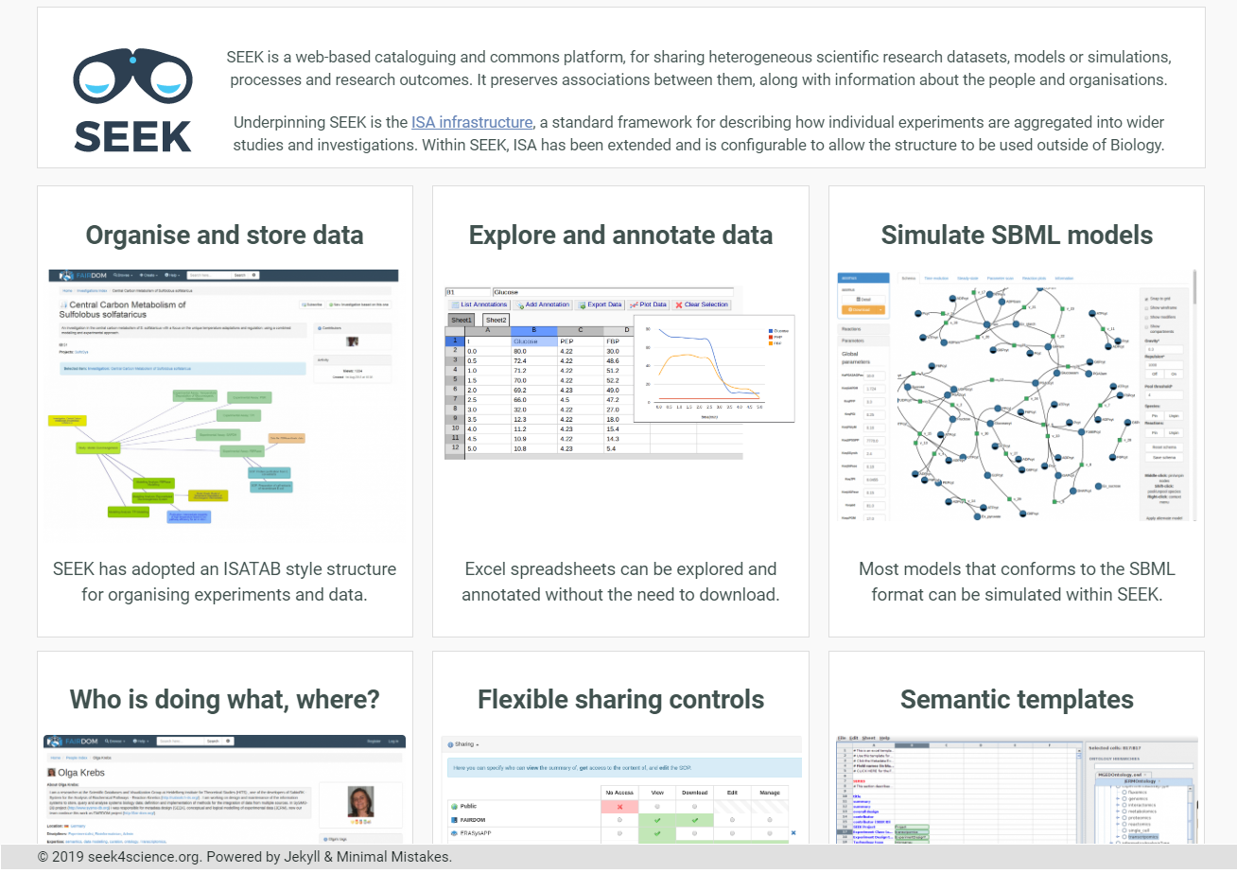
SEEK and FAIRDOMHub

Slide 9
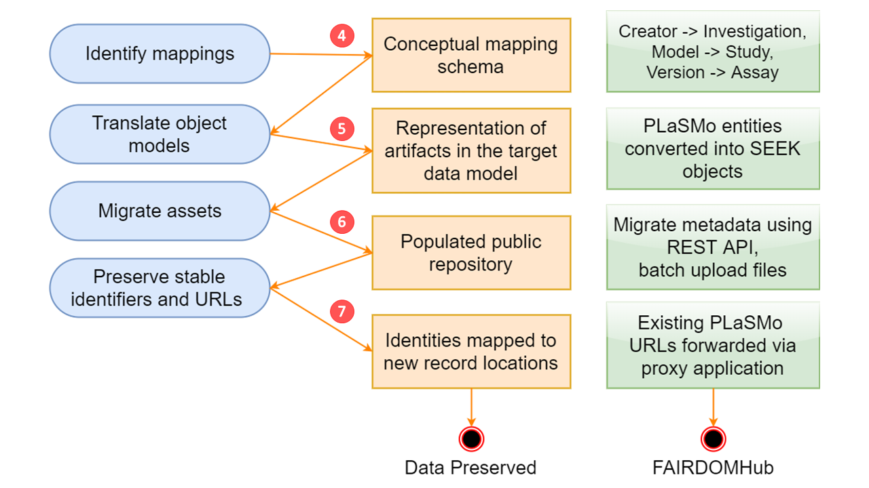
Migration process
Notes:
4. Analyse and define how elements of the boutique repository should be mapped and translated to the data object model of the target repository
5. Implement intermediate representation of the target repository domain entities, implement translation code for mapping between the two representations
6. Utilise target APIs (REST or client libraries) to perform bulk deposits and metadata migration, tracking the new target identifiers
7. Implement redirects from original stable URLs to new locations, update PermID records like Handles or DOI

Slide 10
The friction points
Security model, user accounts
Robustness of the upload
Stable URLs
Notes:
We were not in a position to make accounts because we were a third party user
We need a temporary solution that can grant ownership on demand

Slide 11
Implementation
REST API to programmatic artefacts (http://www.jsonschema2pojo.org/)
The replay database
SpringBoot simple app that translates PlaSMo URLs to FairdomHub links
Batch permission/ownership setting
Notes:
Addressed the issue for robustness of upload by creating

Slide 12
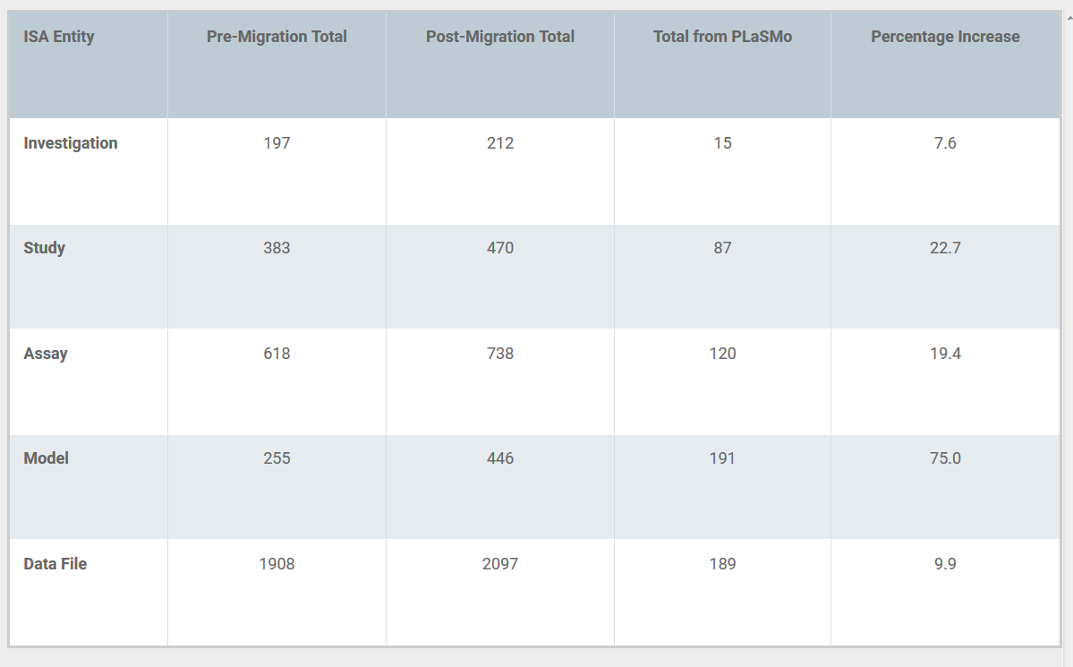
Results

Slide 13
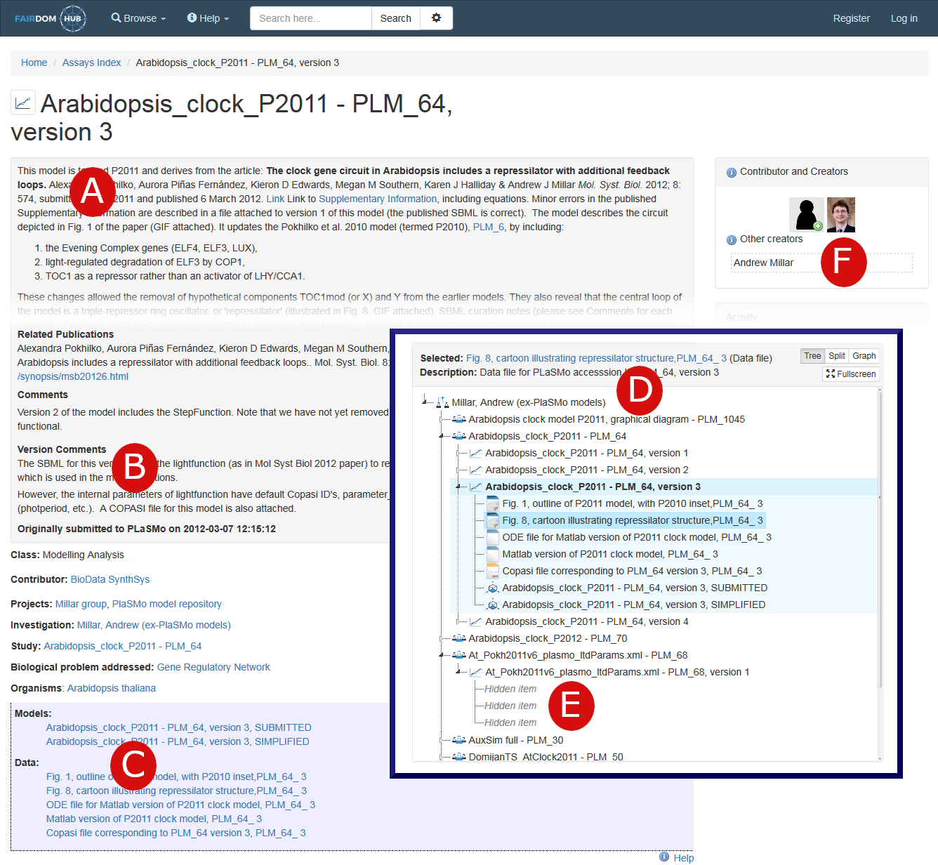
Results

Slide 14
RDM Funding
Should we fund new software for data management?
currently only “easy cases” supported
difficulty is in the “first mile”
“a stick” or “a carrot”

Slide 15
RDM Funding
Should we fund new software for data management?
The carrots are needed:
tools integration
analysis
visualization
improved user experience
YES!!! CUSTOMIZATION

Slide 16
RDM Funding
Can research data repositories be self-sustaining?
NOT REALY:
Scale of resources
Data producers won’t pay for the privilege
Data consumers should not = Open Science
Micropayments not practical/feasible in academia
YET
Funding still linked to novelty and impact

Slide 17
Data longevity
‘Boutique’ Repositories
Active Data
Large Public Repository
FAIR Data

Slide 18
Data longevity
‘Boutique’ Repositories
Active Data
Large Public Repository
FAIR Data
Permanent identifiers!!!

Slide 21
Conclusions
Write API is a must for any data management tool set
Reinventing the wheel – JSON REST vs SOAP WS
Semantic Web - Resource Description Framework

Slide 22
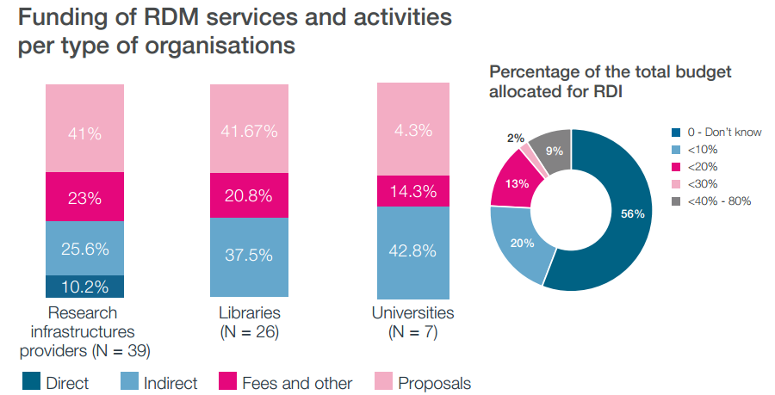
RDM Funding
Source: Funding Research Data Management And Related Infrastructures Report

