Slide 1

Integrated secure web application to deliver centralised management of research samples, histology services and imaging data
Mark Lawson
Project & Data Manager
MRC Centre for Reproductive Health

Slide 2
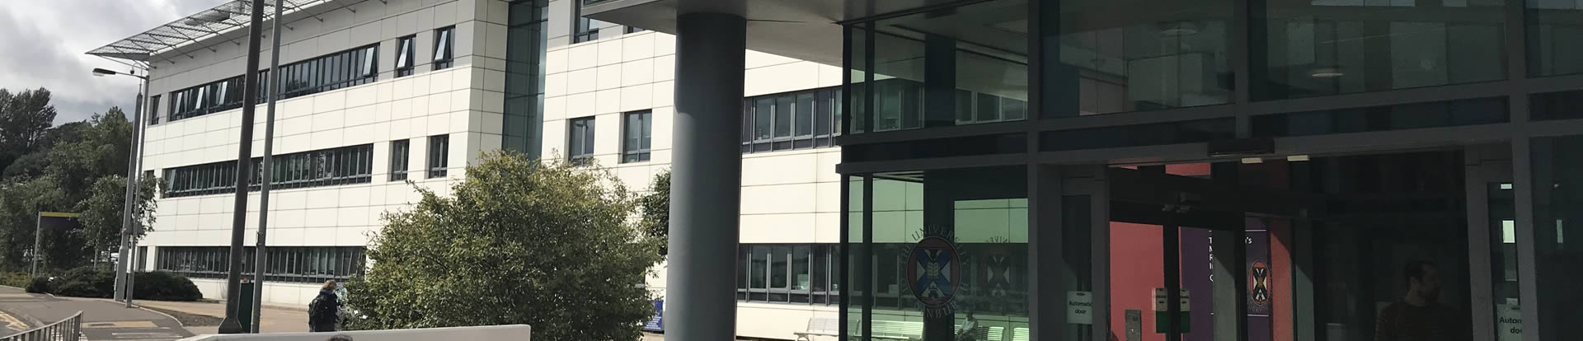
Introduction
MRC funded Centre at QMRI, BioQuarter, Little France
Core Research – clinical and scientific
SuRF (Small University Research Facility) Services
Histology
Microscopy
Image Analysis

Slide 3
Data Management Requirements
Sample Logging
Process Data Management
Data Output Management
Data Sharing
Notes:
The histology service has specific data management needs relating to the service offered
Who logged the sample, what ethics approved project it is linked to
How should the sample be processed?
Where should the data which is output at the far end of the service be stored?

Slide 4
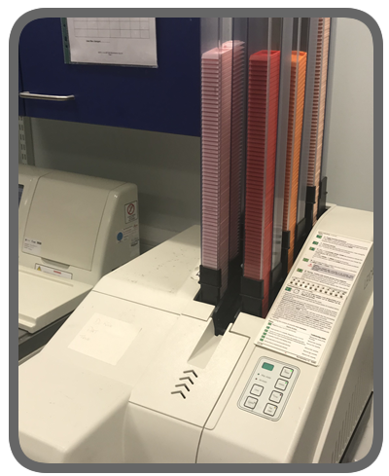
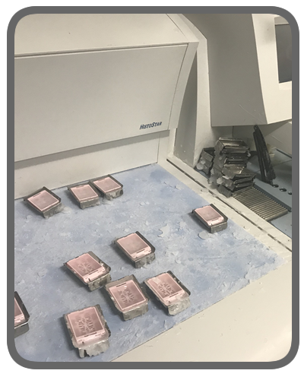
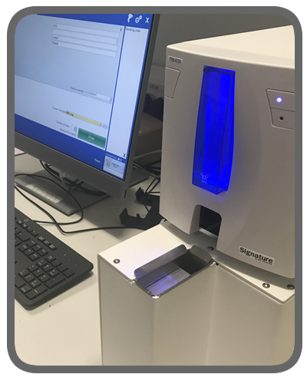
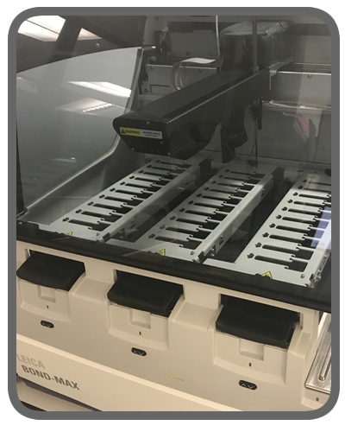
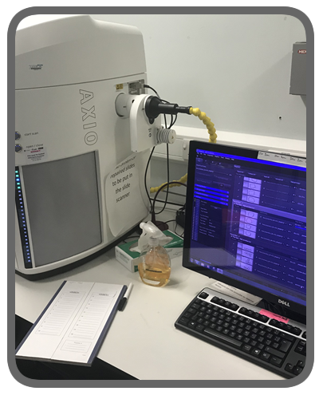
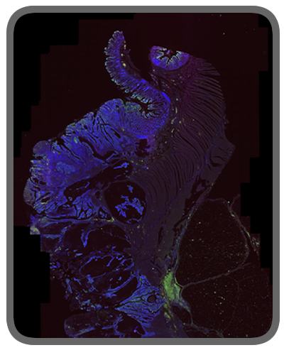
Sample Process Flow
Slide printing
Slide scanning
Robotic Staining Protocols
Image Analysis
Cassette Printing
Sample Preparation
Notes:
A graphical view of the typical process stages for a sample which comes through the CRH histology service

Slide 5
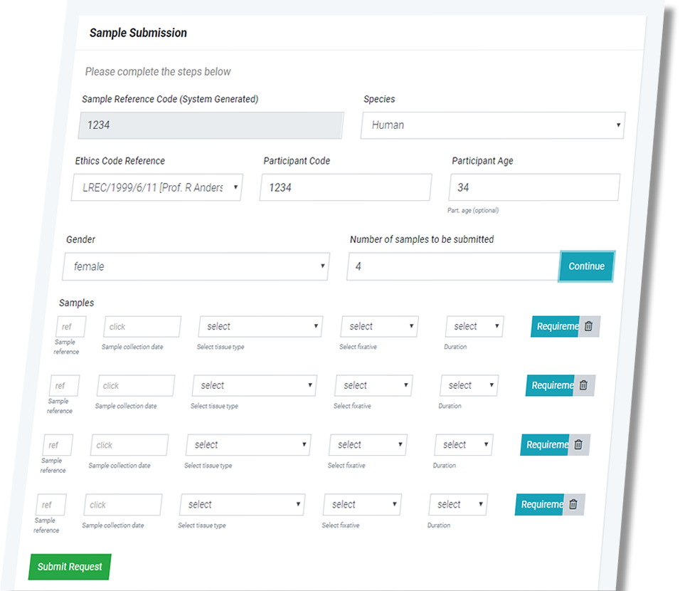
Technologies
Secure web application for sample logging
Ethics approved human projects
Data model GCP/GLP compliant
Notes:
The secure application requires EASE log in, and authenticates the research user against a list of authorised users
The data model is GCP and GLP should be compliant

Slide 6
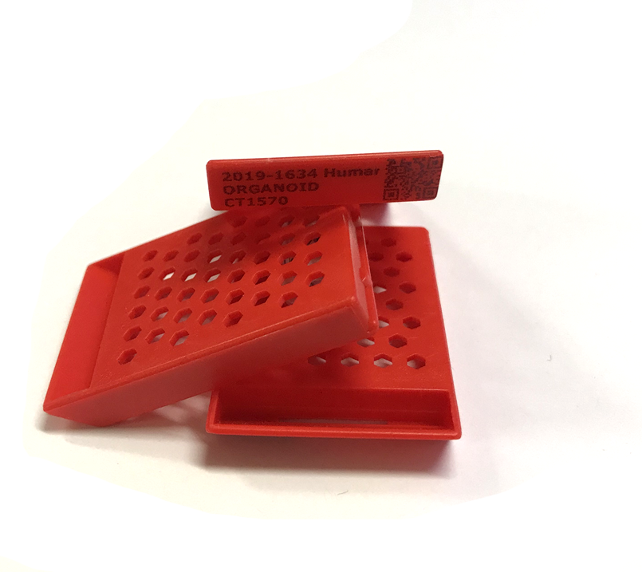
Technologies
System database-generated QR code
Containing
Sample ID
Study ID
Tissue Type
Species
Fully portable data packet
Notes:
Using an internal library for QR Code generation
Code will include all the relevant visual data printed on the cassette
Data Packet encapsulated within the QR code can be shared across associated systems which will become clear

Slide 7
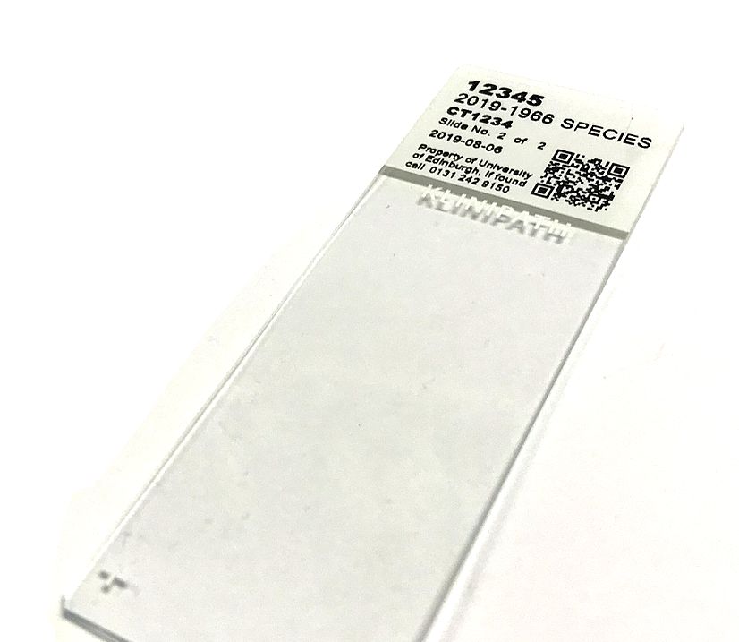
Technologies
Scanned Code generates template
Output to slide printer
Notes:
A slide printer will scan the QR code from the cassette and directly print a facsimile of the data onto the slide header.
Both this code and the QR code on the sample cassette can be read using a handheld scanner in the histology service (or any QR enabled device) to show the ownership of the sample (obviously depends on the logged in status of the scanner..)

Slide 8
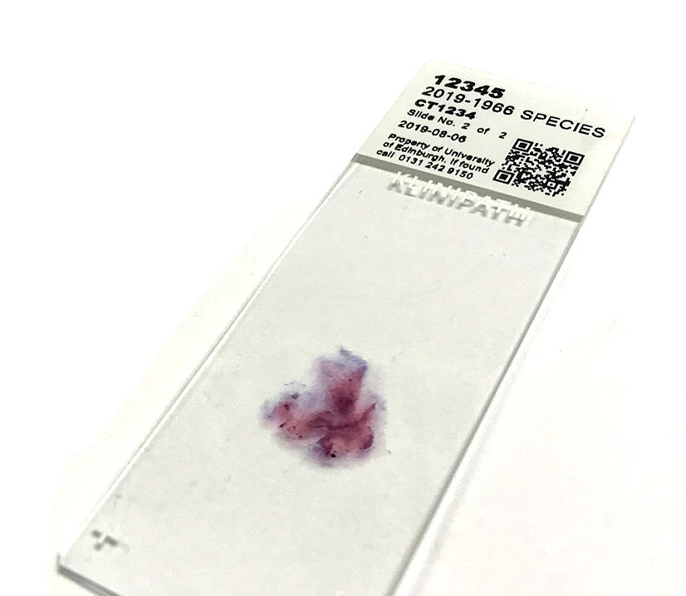
Technologies
Staining Protocol read from robot management PC
Web Application Database
Logs protocol
Notes:
We have 2 Leica staining robots which can perform titrated antibody incubation, blocking and washing and the specific protocol used is tracked within the web application by the creation of a dedicated API service written by yours truly
This will provide the basis for checking/validating the protocol schema downstream (a GLP/GCP requirement)

Slide 9
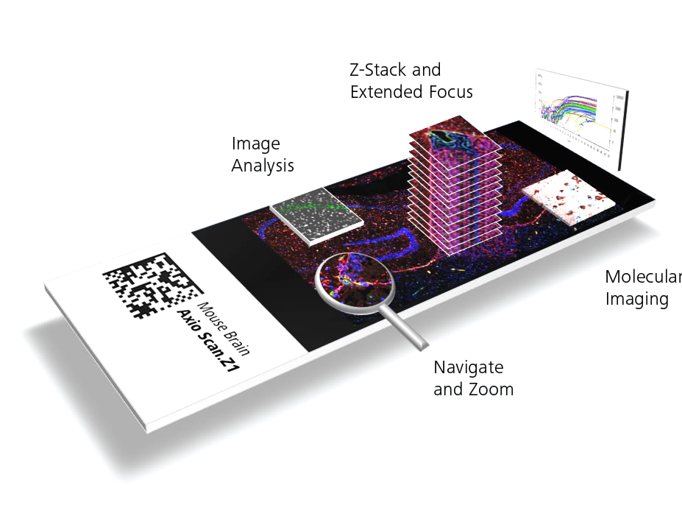
Technologies
Slide complexity
File size > 40Gb
Data Sharing
Hurdles
Notes:
So we have our slides stained and back, its worth mentioning the potential sheer size and complexity of the slides that are stained and then subsequently scanned. Not only can they be full organ scans, I.e. a mouse brain they can also be visualized through the z-stack, discrete heights through the section that can be stained as well.
The net outcome here is that the resultant slide image can be BIG, upwards of 40Gb on occasion which presents a bunch of data sharing obstacles

Slide 10
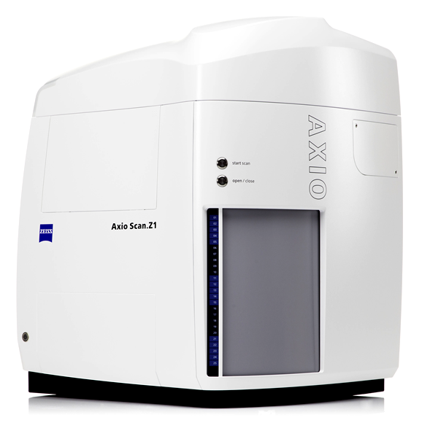
Technologies
Slides scanned (100)
QR Code read
User profile read
Meta data written to output
File saved to DataStore (via local file cache)
Notes:
The surf facility has over £500,000 of slide scanners that are equipped to scan 100 slides at a time
They are equipped with QR code scanners so they can read the head of the slide, grab the user profile (i.e. name, UUN) decode the
Species, ID, tissue type and participant ID and write these to the metadata of the image without any manual intervention by the user.
When you’re scanning 4500 slides, this affords a tremendous time saving, which we are doing for a study right now

Slide 11
Sample Lifecycle
Sample Submitted via
Web Application
Processed based on instruction
Sample logged and location tagged
Image stored in DataStore via User Profile Service
Slide Scanned and metadata logged into image output
Staining Requirements set up in Robot Protocol Manager
Invoicing template for cost recovery
Notes:
So we have all the processes mapped, lets just recap how the web application tracks and manages the data flow
Sample Submitted
Sample processed based on the instruction from the researcher – how it should be stained, how the sample should be stored
Sample is then logged by the histology team and then location tracked in the web application (its in freezer A, shelf 2)
If downstream processing is required, sometimes researchers just want the embedding and slicing of samples before anything else (maybe a large study over 12 months) , then the protocol is mapped in the robot management system and our own API reads the protocol into the web application
Slide scanned and image stored eventually in the users temporary storage on DataStore
Costs incurred then charged out, it is a Surf facility after all.

Slide 12
System Communication
Web application generates ID
QR Code read by slide printer
Staining Protocol read into web application
Automated billing feature
Web application logs expenditure
PPMS booking system API inline planning
Notes:
So there are a number of associated management systems at play in the sample lifecycle.
Initially the web application will create the core ID in the form of the data-embedded QR code
This is read and printed onto the necessary number of slides, using the slider printer management system which then writes a secondary QR code
The Staining Robot then undertakes its role and the specific protocol logged back into the web application
Now another university system, PPMS comes into play, this is used by the surf facility to log equipment bookings and also consumable use so is used for the invoice generation as the cost recovery model. Luckily the vendor has an API which we use to push and pull booking time and antibody, fixative and image analysis costs into the web application to allow us to provide in-line planning and historical invoice display for the PI
This will then finally emerge as a monthly automated billing feature on the web application

Slide 13
Summary
Secure Web application
GCP/GLP-compliant data system
Sample identification and traceability
Data provenance and integrity
Notes:
Publications > Grants > Data integrity

Slide 14
Thank You

