Slide 1

HOW DO WE GET READY FOR REF?
Pauline Jones, head of strategic performance and research policy university ref manager

Slide 2
We are here

Slide 3
We are here

Slide 4
REF 2021 timeline
Long time period over which submission is prepared
No period over which outputs, impacts, environment don’t count
Academics thinking now about what to include:
  2017 REF readiness exercise: focus on open access and numbers
  2018 Mock REF: focus on quality
Supporting input to CRIS system needs to be continuous

Slide 5
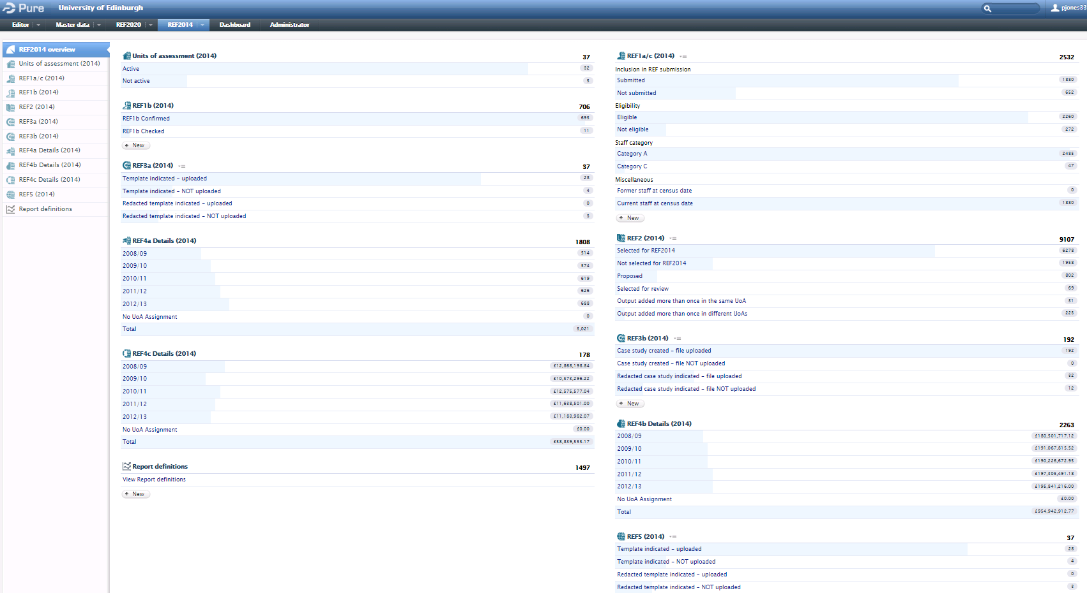
Notes:
REF2014 system in PURE

Slide 6
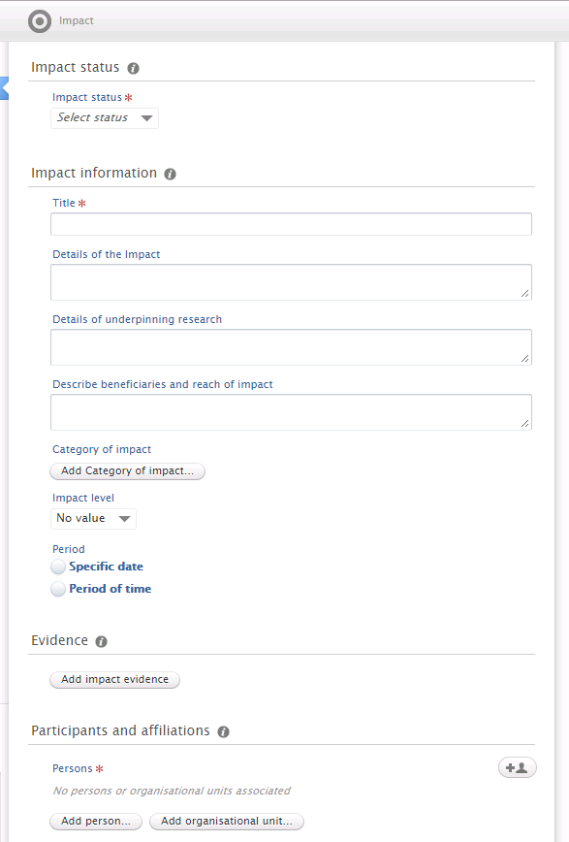
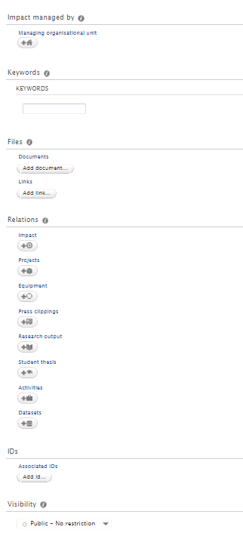
Lots of fields – because we’re not quite sure what we need
Hopefully transferrable into new REF module
Need to be agile once we know the rules
Notes:
REF impact module

Slide 7
What’s new?
Open access journal articles/ conference proceedings
Lots of unknowns: proposals from Stern Review
Probably:
  Submitting all research staff
  Decoupling: breaking the one-to-four staff-to-output ratio
  Non-portability: Research staff can’t take outputs with them when they leave
  Institutional impact case studies
  Institutional environment
Each new element will have implications for how CRIS systems support REF submissions

Slide 8



REF2028?
Open data
Open access monographs
Institutional impact?
New metrics?

Slide 9
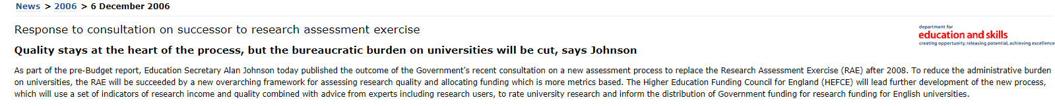
Responsible metrics: we haven’t heard the last
Forum for responsible metrics
Data and metrics to support decisions, not the sole driver
BUT the conversation will not end with the metric tide:

Slide 10
How do we prepare?
For REF2021: Be agile; support research managers to help academics deposit work; help us lobby CRIS system designers to have fit-for-purpose systems
For REF2028: help us understand the benefits and challenges of making more research open
Be part of the conversation on responsible metrics
Support system interoperability

Slide 11
How can I find out more? How do I get involved?
www.hefce.ac.uk/rsrch/refconsultation/
If you work at Edinburgh:
www.ed.ac.uk/governance-strategic-planning/research/ref2021
Pauline Jones, University of Edinburgh REF manager
pauline.jones@ed.ac.uk 0131 651 4985
Notes:
Your university needs you!

