Slide 1
Reference Rot in Theses: A HiberActive Pilot
A #hiberactive 10x10 for #rfringe17
Nicola Osborne
Digital Education Manager, EDINA
Nicola.osborne@ed.ac.uk
@suchprettyeyes

Slide 2
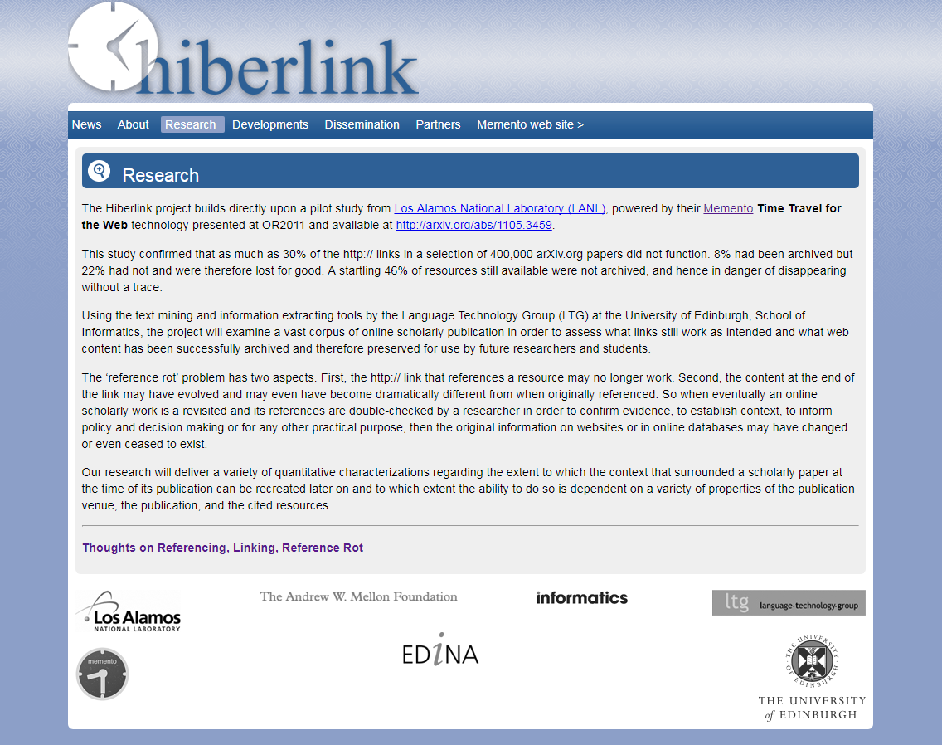
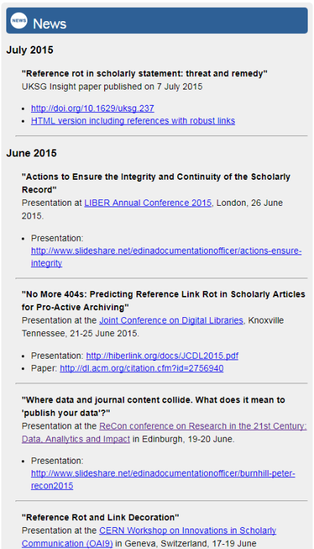
A 60-second History of Hiberlink…
Notes:
Hiberlink was a two year study to look at how web links in online scientific and other academic articles can “rot” and fail over time. It was an Andrew W. Mellon Foundation-funded project which ran from 2013 to 2015 and involved EDINA working in partnership with Los Alamos National Laboratory and the Memento project, as well as the University of Edinburgh School of Informatics.

Slide 3
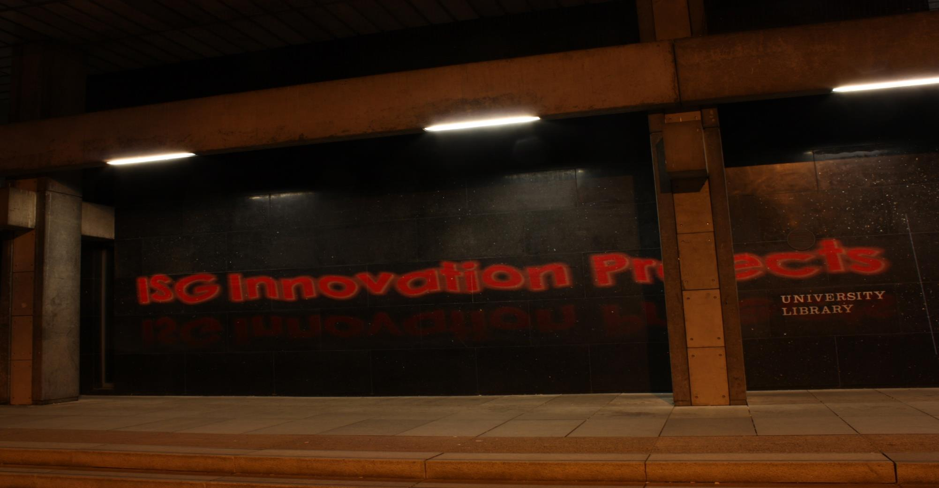
Becoming proactive and HiberActive…
Image credit: Nicola Osborne, PixelThis Project (cc-by)
Notes:
With funding from the ISG Innovation Fund we have undertaken a project to develop tools for PhD researchers at the University of Edinburgh.
We began by talking with colleagues working in the University’s Library and Collections’ Digital Library team who manage etheses and have a rich understanding of the submission and despite process. With their input we developed several use cases to shape our project.
We employed 5 PG Interns to conduct research from May-July 2017. They undertook 25 interviews with PhD students from across all three University of Edinburgh colleges. We sought to understand how PhD students manage their references, particularly web references; if they knew about or had heard of reference rot or content drift; and what kind of tools they thought might be useful in their own practice.
Tools were developed and 7 follow up usability testing sessions took place with the site design iterating throughout.
Our new name suggestions came from interviewees and student interns with Site2Cite selected.

Slide 4

Some initial research highlights
Many PhD students are not aware of the risk of “reference rot” or “content drift”.
Most PhD students some challenges or issues with their reference management software – crashes, lost data, etc.
Some PhD students don’t use any reference management software at all, instead using word docs or similar to manage their references
Use of Web citations depends primarily on the topic of PhD, rather than subject area, school, college.
Current web archiving tactics include:
  No action at all – little awareness of impact of reference rot for some participants.
  Printing to paper or PDF.
  Use of available clipping tools (e.g. Evernote).
Very few PhD students were aware of web archiving facilities like the Internet Archive. None of our interviewees were proactively archiving the sites they use in web archives.
Image credit: Stack of papers – Phillip Wong (cc-by)
Notes:
Despite reporting many poor experiences of reference management tools, our interviewees nonetheless said they would prefer that any tools to integrate with these and/or browsers.
PhD students using web citations were interested in web archiving, once asked. And several had experienced reference rot and context drift.
One finding we will be passing onto training colleagues is the wider need to help students understand when it is appropriate to cite websites and how best to do this, as this was also a source of confusion in some cases.
This is increasingly important as government, public sector bodies, and other organisations, move to digital-only publishing making the web copy of reports the version of record that should be cited.

Slide 5
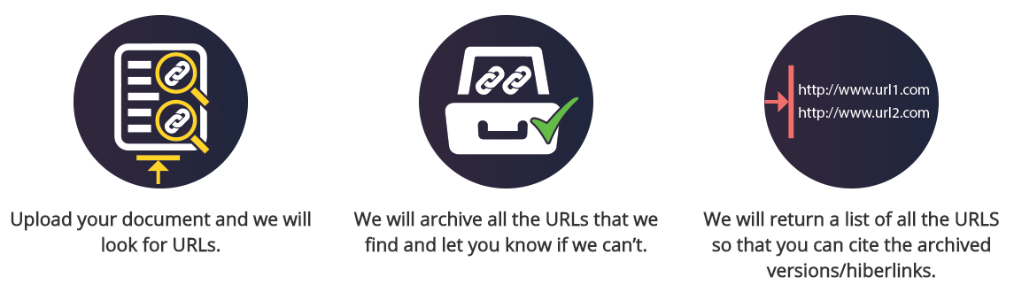
Introducing Site2Cite…
Notes:
Technical development work has been built around three use cases but one has been identified as most useful: being able to upload a thesis, chapter, draft article or similar; extracting URLs; returning hiberlinks (or an error).
Archiving is powered by Internet Archive but designed to enable flexibility so that other archiving tools and/or UK Web Archive and/or local archives could be used.
We believe this could be hugely useful prior to deposit in institutional repositories, subject repositories, at the point of finalising a preprint for submission and deposit, etc.

Slide 6
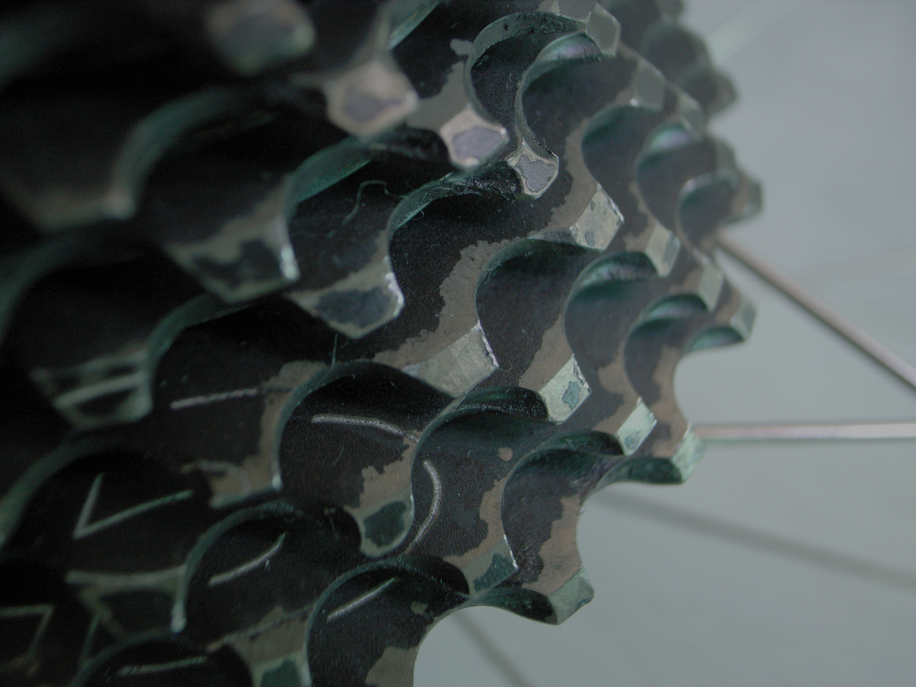
Components of Site2Cite
Individual URL Archiving → detects URLs and returns URI-M and URI-G as well as Robust Link.
Word/PDF/Open Doc upload → detects URLs and returns CSV with URI-M and URI-G as well as Robust Link.
Bibliography upload → detects URLs and returns “hiberized” version with URI-M and URI-G archive links added to URL fields.
Image credits: Stronglight CT2 Cassette – Ryoichi Tanaka (cc-by)
Notes:
Individual URL Archiving → detects URLs and returns URI-M and URI-G as well as Robust Link.
Bibliography upload → detects URLs and returns “hiberized” version with URI-M and URI-G archive links added to URL fields.
Word/PDF/Open Doc upload → detects URLs and returns CSV with URI-M and URI-G as well as Robust Link.

Slide 7
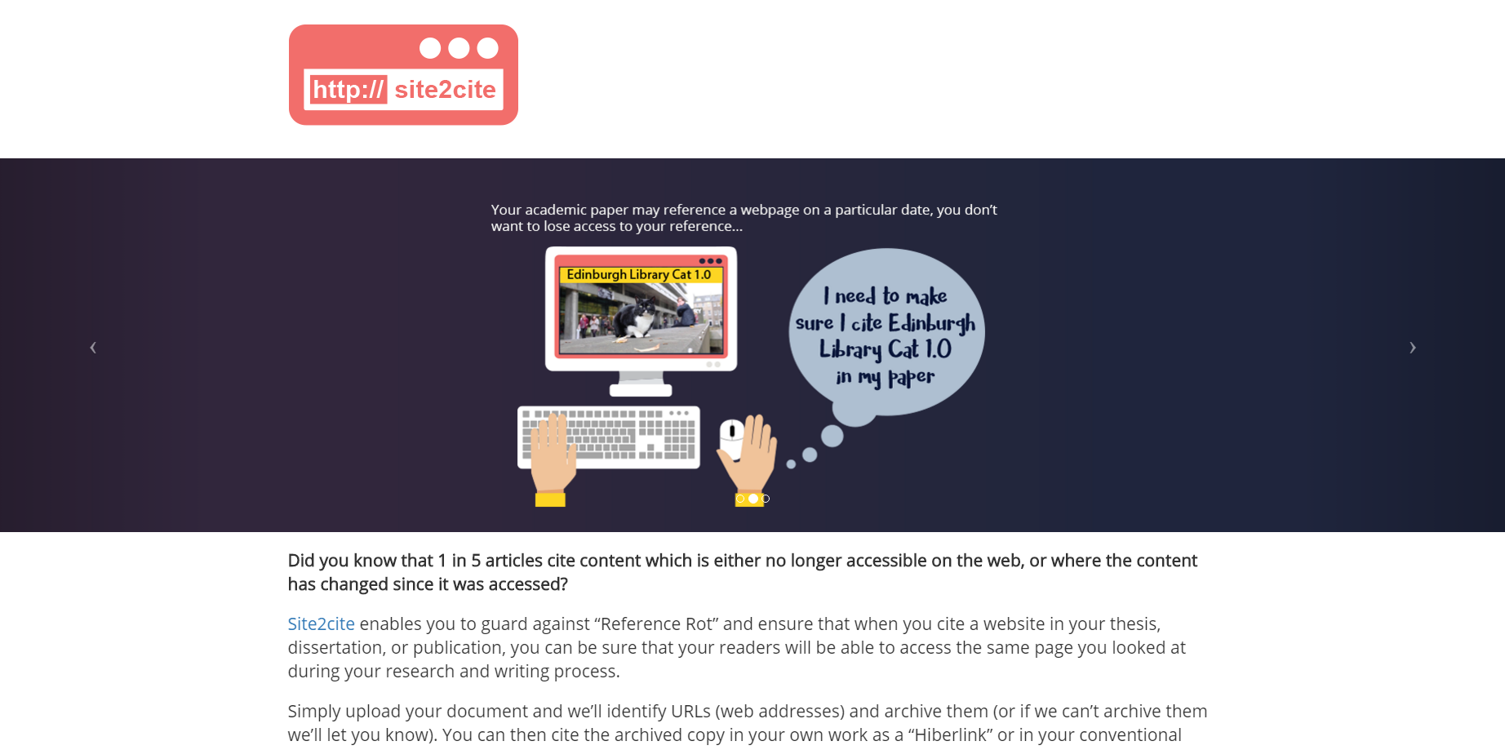



http://hiberactive.edina.ac.uk/
Notes:
Our working demo site introduces why you should care about reference rot – including a gif inspired by Edinburgh’s own Library Cat - and how Site2Cite works.
To be relevant to PhD students we wanted to make it clear why this may matter to them, how it could impact their work and long term usefulness of their work.
We would like use of the site to fit into submission guidance and the supervision process, prior to deposit but benefiting deposited versions which should stay current for longer.

Slide 8
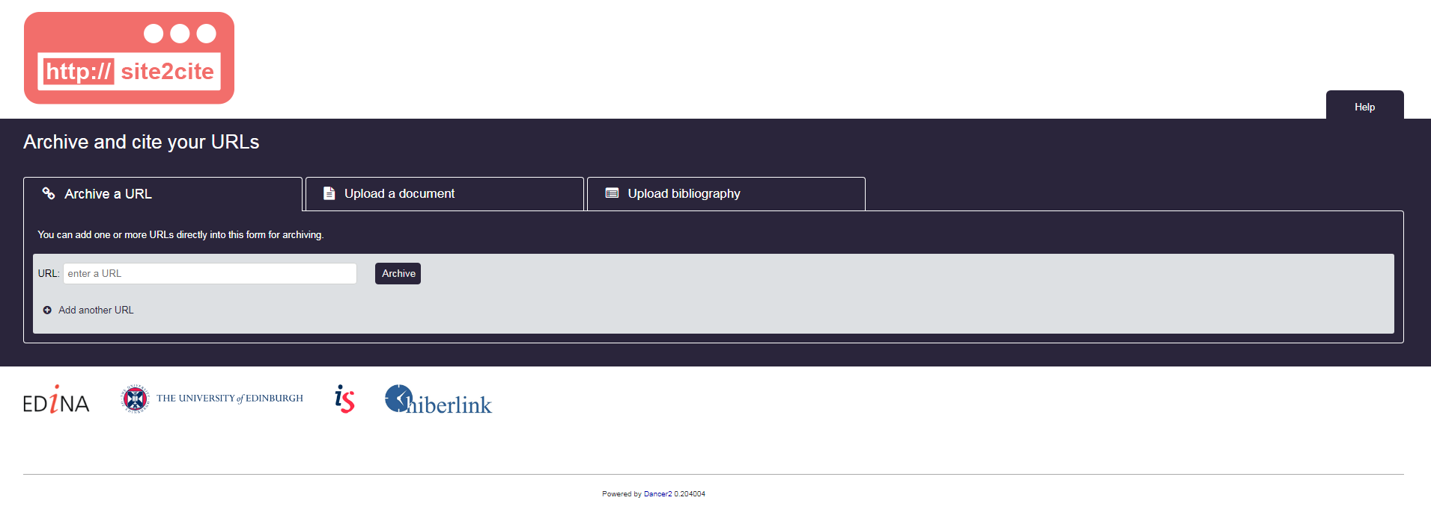
The Site2Cite demo site is live – try it out!*
http://hiberactive.edina.ac.uk/site2cite/
*We recommend trying it during Repository Fringe whilst you are on the University of Edinburgh network.
Notes:
On the live site you can archive a link, a document or a bibliography…
*Best to try it during Repository Fringe whilst you are on the University of Edinburgh network!

Slide 9
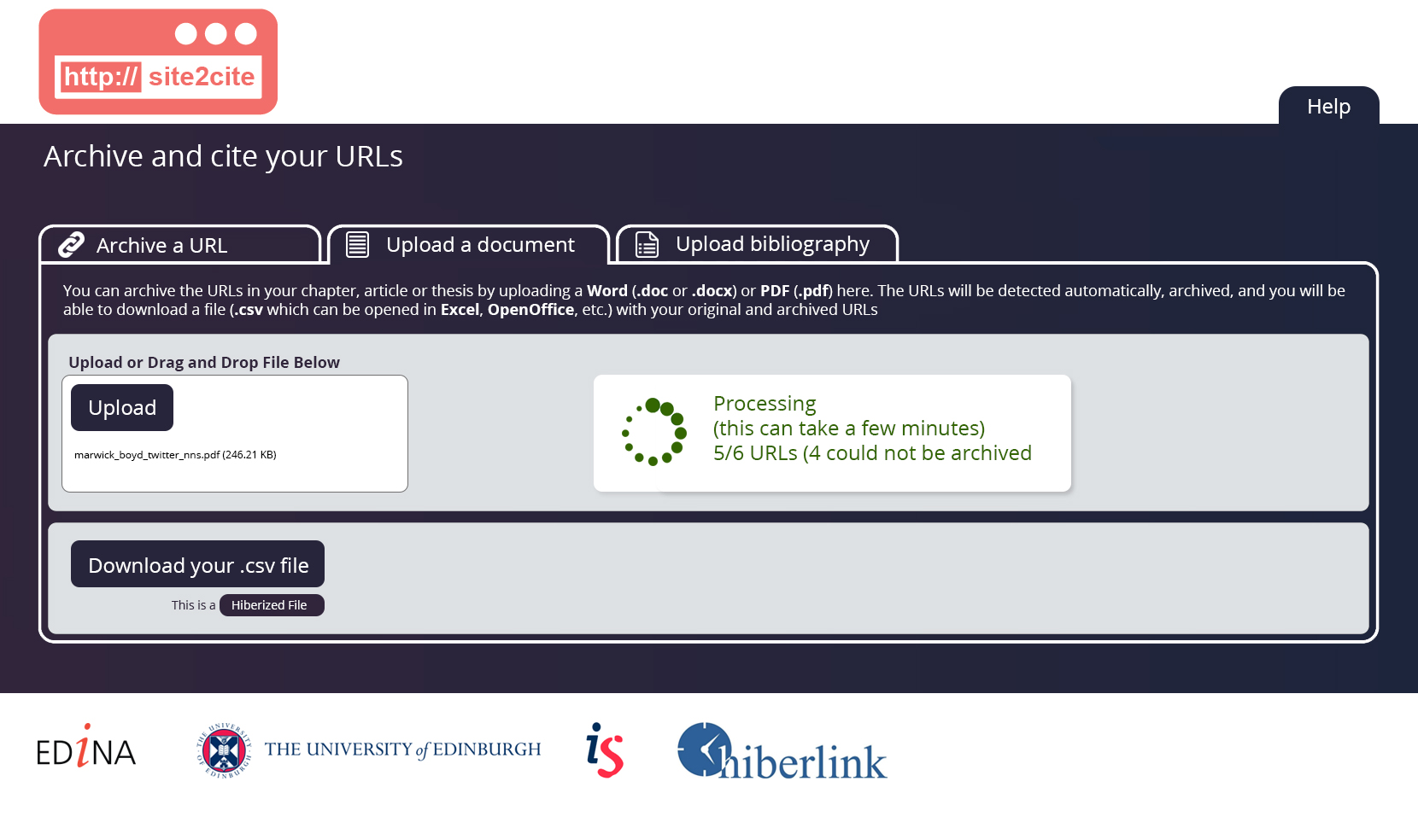
Notes:
This is what the Site2Cite archiving process looks like in practice.
The demo site reflects some of the feedback from our usability work but we have changes we would like to make to ensure that the terminology of Hiberlinks are more clear to users so that they understand how they can use the dated archive links in their own work.

Slide 10
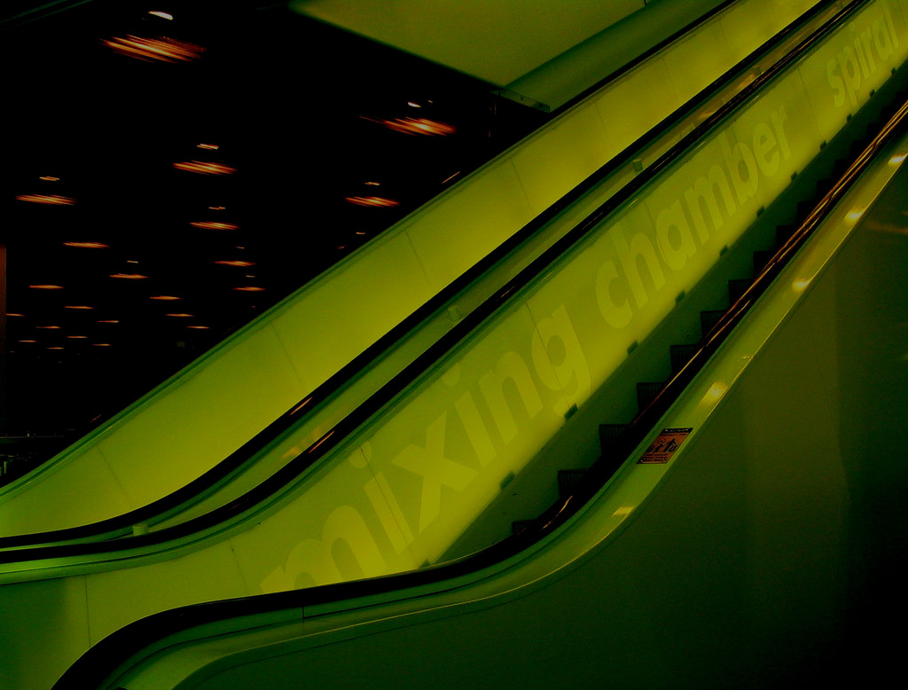
Next Steps
The ISG Innovation Funded project concludes this week with a final report.
EDINA are looking at how we might develop and scale out Site2Cite to support individuals in universities and other organisations to be more hiberactive about managing and archiving the key web resources used in their work.
Our research participants have suggested lots of potential improvements, developments and ideas – some of which are now in place…
But what about you?
Would this be useful for you, your organisation, your students?
We would love your feedback, comments and ideas…
Email: nicola.osborne@ed.ac.uk
Tweet or tag posts with any combination of: #hiberactive, #hiberlink, and #site2cite
Image credit: Jan Tik – Green Shadow (cc-by)
Notes:
Whilst the focus of this project has been PhD students at Edinburgh, we are keen that we reach out to other people and other organisations as we think Site2Cite has much wider relevance.
So, how would you use Site2Cite? Would it be useful in your research, your teaching, your students work?
We would love your feedback
Acknowledgements:
Huge thanks to Gavin McLachlan and the ISG Innovation Fund
The Hiberlink team are: Tim Stickland (Development); Jackie Clark (Design); Viv Mayo (Usability); Steven Peter (Market Research); and project sponsers Paul Walk & Peter Burnhill.
The fabulous HiberActive interns: Catherine Clarissa, Irene Cabeza Luna, Juliet wairimu Kariuki, Luke Kersten, Shivashish Wali.

Slide 11
Acknowledgements
Huge thanks to Gavin McLachlan and the ISG Innovation Fund
The Hiberlink team are: Tim Stickland (Development); Jackie Clark (Design); Viv Mayo (Usability); Steven Peter (Market Research); and project sponsers Paul Walk & Peter Burnhill.
The fabulous HiberActive interns: Catherine Clarissa, Irene Cabeza Luna, Juliet wairimu Kariuki, Luke Kersten, Shivashish Wali.

