Slide 1

Lessons in OA Compliance for HE (LOCH)
University of St Andrews
Case study
Jackie Proven
Repository & Open Access Services Manager
jep10@st-andrews.ac.uk @jackieproven
Open Access in REF: Planning Workshop 5 Aug 2015
Email: open-access-support@st-andrews.ac.uk
http://openaccess.wp.st-andrews.ac.uk/

Slide 2


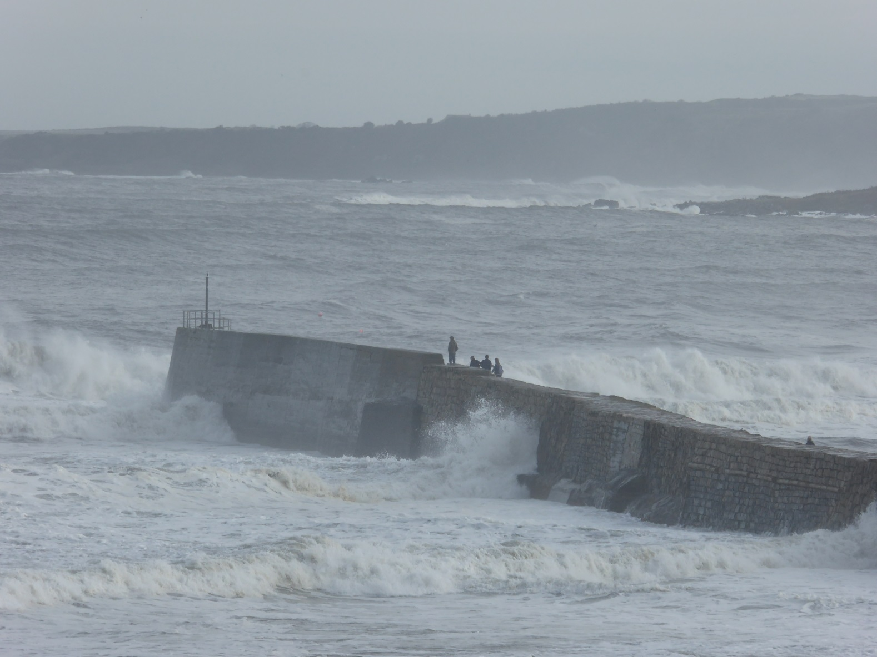

Slide 3



Slide 4
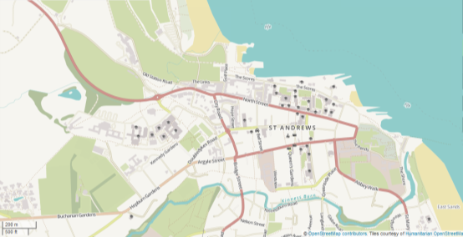
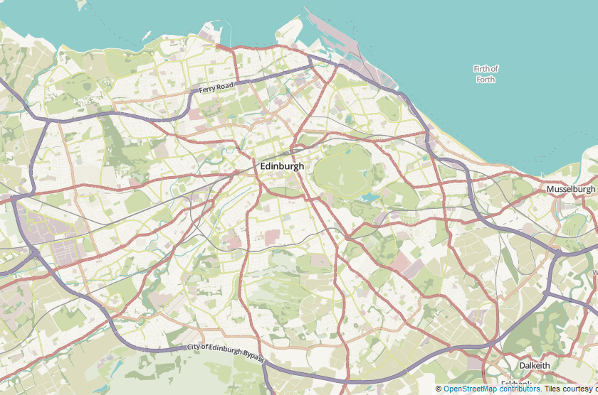

Slide 5
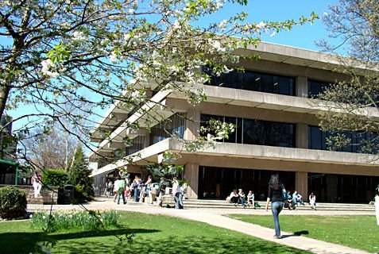




Slide 6



St Andrews
c.700 Academic staff
c. 8000 students (80% UG, 20% PG)
47% of students non-UK
Research intensive and competitive
2-2.5k research publications annually
42,000 research outputs recorded in PURE, 10% f/t
Notes:
High staff/student ratio (approx 1:11)
6,000 items in our repository (33% theses)

Slide 7



Activities
Impact
Publications
Award/ recognition
Indicators
WoS, arXiv, PubMed, Scopus…
Case Studies
Bibtex, Refman
Dissemination// Engagement
Entered
Measures
Manual
Input
Uploaded
Entered
Harvested
University Structure [HR]
Entered
Industry / SME’s
Interface
St Andrews
PURE CRIS
HEI – Strategic
Planning, Benchmarking
Staff Records [HR]
Pulled In
Fed Out
REF, RCUK
SFC, HESA
Student Records [Registry]
Linked
Linked & held
Public, Media Recognition / Impact
Full Text
DSpace Repository
Open Access
Projects, Grants, KT
[Finance]
Collaborations
Research Pools
Research data sets
(multiple locations and formats)
Theses, other content

Slide 8
OA support
Open Access Support team
  3 FTE (2 posts funded from RCUK block grant)
External funders’ open access mandates and funds
  RCUK block grant
  Wellcome Trust / Charities OA fund
  Institutional Library OA fund
Selection and management of publisher schemes
Copyright, licensing and policy advice
Active programme of advocacy and support
Notes:
Library support for Electronic theses deposit
+ NEW Digital Research Division (April 2015)
Open Access
Research Data Management
Online journal hosting service
Digital Humanities, Research Computing
Strong links with research office

Slide 9
OA policy
The University encourages its researchers to provide Open Access to published research outputs…
http://www.st-andrews.ac.uk/library/services/researchsupport/openaccess/oapolicy/
  Researchers are free to publish in the venue of their choice
  Preference is for the ‘green’ route
  Also supports ‘gold’ in particular circumstances
Policy development
  Library and Research Policy Office
  Open Access Steering Group
  Research Forum
Notes:
“The University encourages its researchers to provide Open Access to published research outputs so that they are online and freely available, meeting the requirements of the growing number of research funders in the UK and internationally who now encourage or mandate Open Access.”
OASG - (VP Research and Academic reps. Including researchers and admin, and key staff from Library and Research Policy Office)
RF - (Directors of Research from individual Schools and VP Research)

Slide 10

REF OA policy
Post-2014 REF Open Access Policy
Policy applies to journal articles and conference proceedings with an International Standard Serial Number (ISSN)
To be eligible for REF, final peer-reviewed manuscripts must have been deposited in an institutional or subject repository on acceptance for publication
HEFCE understands that not all REF outputs may be able to meet requirements and so limited exceptions will be permitted

Slide 11
Advocacy
OA actions for researchers
Check the terms of your research grant
Check your publisher’s policy and copyright terms
See Library web pages for guidance
Contact open-access-support@st-andrews.ac.uk for advice
Keep your accepted manuscript and deposit in PURE
Acknowledge funders including Grant IDs
Link Projects to Publications in PURE
Provide statements on access to underlying data and links where possible (or required)
Use the University’s finance detail code if paying OA fees

Slide 12
Advocacy
OA actions for researchers
Check the terms of your research grant
Check your publisher’s policy and copyright terms
See Library web pages for guidance
Contact open-access-support@st-andrews.ac.uk for advice
Keep your accepted manuscript and deposit in PURE
Acknowledge funders including Grant IDs
Link Projects to Publications in PURE
Provide statements on access to underlying data and links where possible (or required)
Use the University’s finance detail code if paying OA fees

Slide 13
Challenges
How do we get to know about new publications so that the support and dialogue can begin?
Can we get into the publishing dialogue early enough to support and advise on gold or green open access options?
How do we manage the increasing volume of enquiries and support needs?
Notes:
The natural dialogue of authors is with their publishers, not their CRIS/IR or Library
University strongly encourages OA via local deposit but no mandate
Do authors understand the varied options on publisher sites and submission processes or understand if journals are compliant with funder policies?
Do authors even know that their funder has a mandate or that funds are available?
We don’t often see the submission process interface

Slide 14
Solutions
Build a dialogue through local systems
Begin the dialogue as early as possible
Integrate deposit into researchers’ workflows
Harness data in publisher submission systems
Emphasize incentives for authors
Change the culture
Make it easier!
Notes:
Change the culture and try to integrate this deposit process into the researchers workflow when publishing
Change the culture and open up channels between the researchers’ workflows and open access support workflows
More open publisher submission systems where we can view the questions and give advice in advance
Alerting services? Push publisher metadata into institutional systems? Make it easier for authors.
Emphasize incentives for authors

Slide 15


Building the third Forth bridge
Queensferry Crossing - north cable tower © Copyright M J Richardson and licensed for reuse under this Creative Commons Licence.

Slide 16
Lean exercise: process mapping
Originally envisaged to cover funder mandates and APCs
Extended to cover REF OA policy and publication lifecycle
SPECIFIC: ‘Deposit in PURE’ should become part of University research culture by April 2015
MEASURABLE: Baseline deposit statistics in May 2014, to be reviewed in 6 months
ACHIEVABLE: Yes - Has to be to prepare for the next REF
REALISTIC: Incentives to change behaviour are now greater (REF). We have PURE and central support in place
TIMESCALE: April 2015 (to be well prepared for REF)
Notes:
Energised us and gave focus
Involving the right people
Communications strategy for open access
Simple message(s) at key points
New web pages
Clear points of contact
Using 2014 and 2015 as a learning experience and build up to the real onset of compliance in April 2016

Slide 17
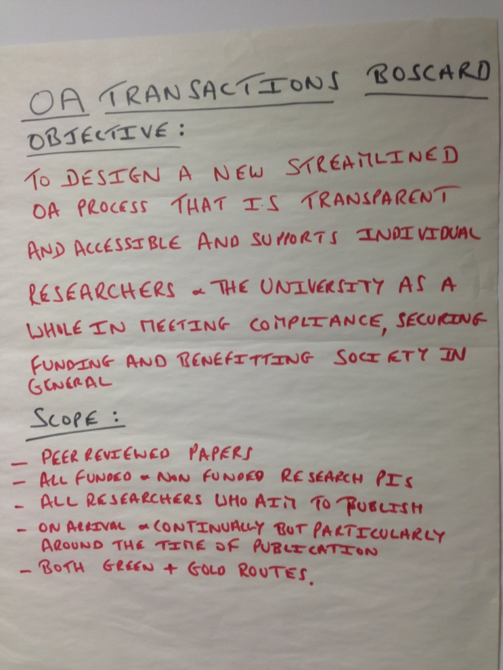
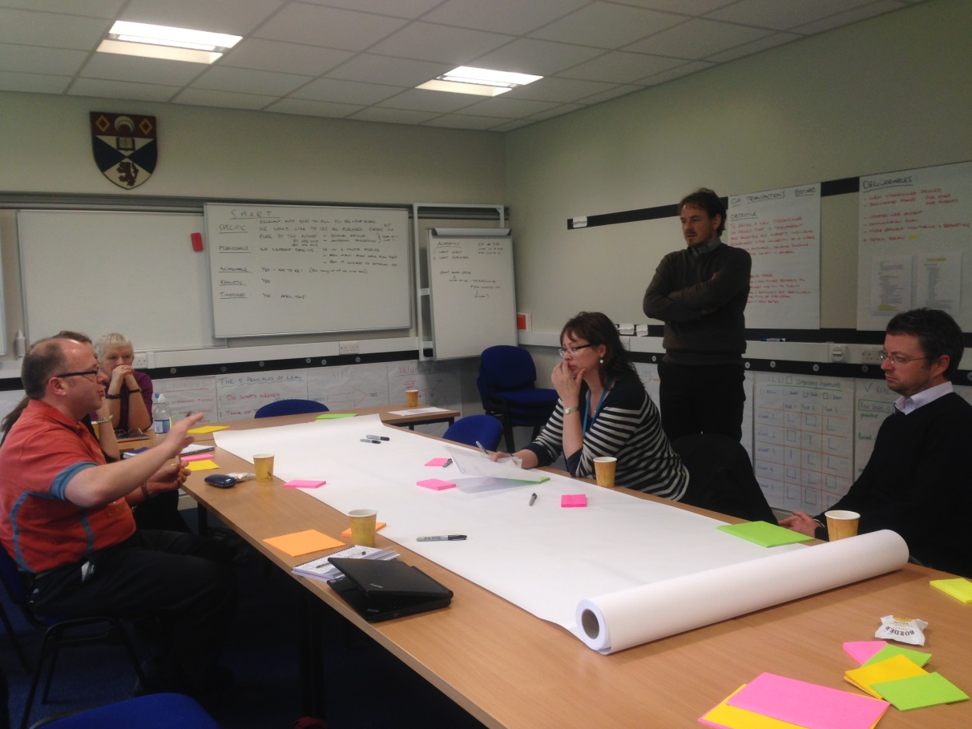
http://hdl.handle.net/10023/6430

Slide 18
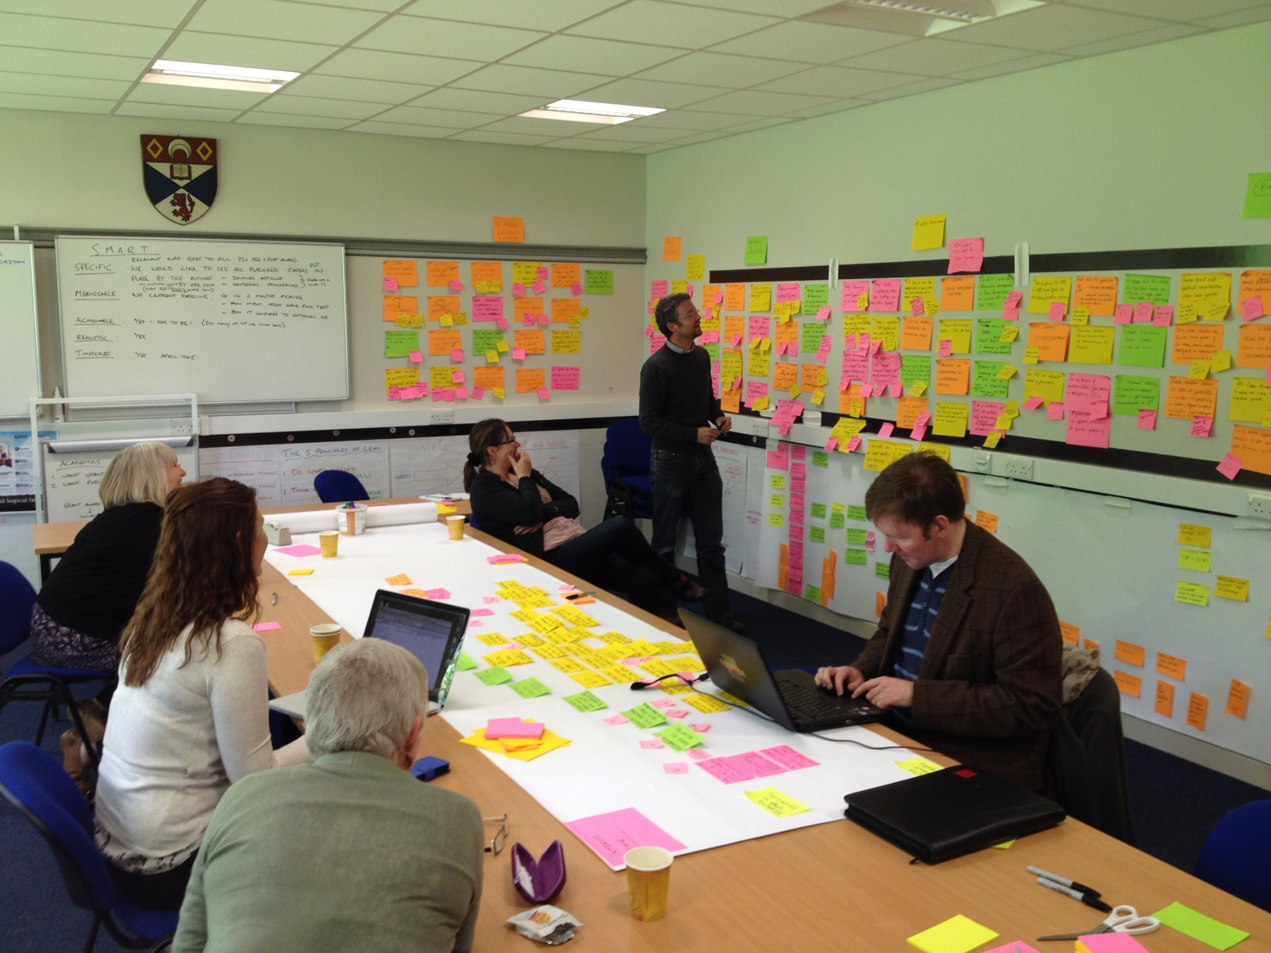

Slide 20
Notes:
High level view of lifecycle, and where the CRIS currently helps… where else?

Slide 21
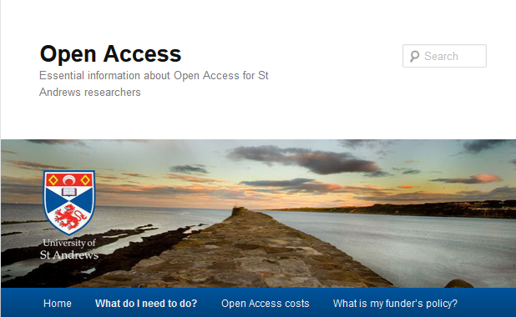
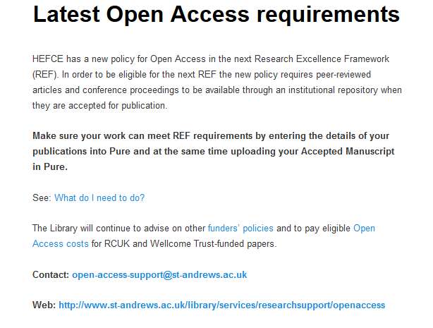
Simple, consistent message
‘REF monitoring’ workflow
Email templates
OA dialogue begins at acceptance
Advice on options
Compliance and validation checks
http://openaccess.wp.st-andrews.ac.uk/

Slide 22
Pathfinder project
Joint LOCH project with Edinburgh and Heriot Watt
http://libraryblogs.is.ed.ac.uk/loch/2014/06/24/welcome-to-the-loch-blog/
System and workflow elements
Human elements
Synergies with Lean
Mini pathfinder pilot projects with academic schools to lead on best practice and efficiencies

Slide 23
Mini pathfinders
Initial meeting with key School staff
  varies with each School
Have a set of questions and discussion points ready, relevant to their discipline.
Ask about their needs and how they think they can achieve compliance
Seed ideas for partnerships and joint working
Listen!

Slide 24
Scoping
Best communication paths and tactics?
Who already has dialogue with authors?
Are there trigger points?
Who will take responsibility for deposit?
How do we work together?
How do we measure effectiveness?
Notes:
Important to figure out key messages that works for the School eg compliance, REF, benefits of OA?

Slide 25
Chemistry pilot
High volume of publications and staff
Large EPSRC-funded research groups, familiar with OA requirements
Engaged with existing publisher schemes eg RSC vouchers, ACS membership
New Head of School, keen on getting processes in place
Goal = 100% of publications meeting REF OA policy compliance

Slide 26
Article accepted by publisher
Author receives notification
(Library may receive notification)
Author notifies School office
Forward notification email
Send accepted manuscript
School office enters article in PURE
Create new metadata record
Upload full text accepted manuscript
Library validation
Library enhances metadata
Library checks version, applies embargoes
Follow-up and advice
Library contacts authors/office for additional information and/or correct versions
Additional actions
Library advises authors on additional funder requirements
Library advises on funding for immediate OA
Advice on data management
Notes:
Piloting a distributed model:
School admin staff become a hub for the deposit of accepted manuscripts into Pure
Library and RPO teams do training and support
People in the chain know about it and can step in to provide support
Data can be revisited, with revalidation triggers

Slide 27
Computer Science
Existing culture of sharing papers
Used to subject repositories, not institutional systems
Focus on Conference publications
Proactive School manager who organises Conference attendance
Pure publications will be the gold source to inform staff review
Proposal to involve PG joint authors in deposit process
Alternative distributed model
  School office becomes a hub and prompts deposit into Pure
  Library and RPO maintain close links with School manager
Notes:
Activity in other Schools patchy, but some appetite for rolling out similar models

Slide 28
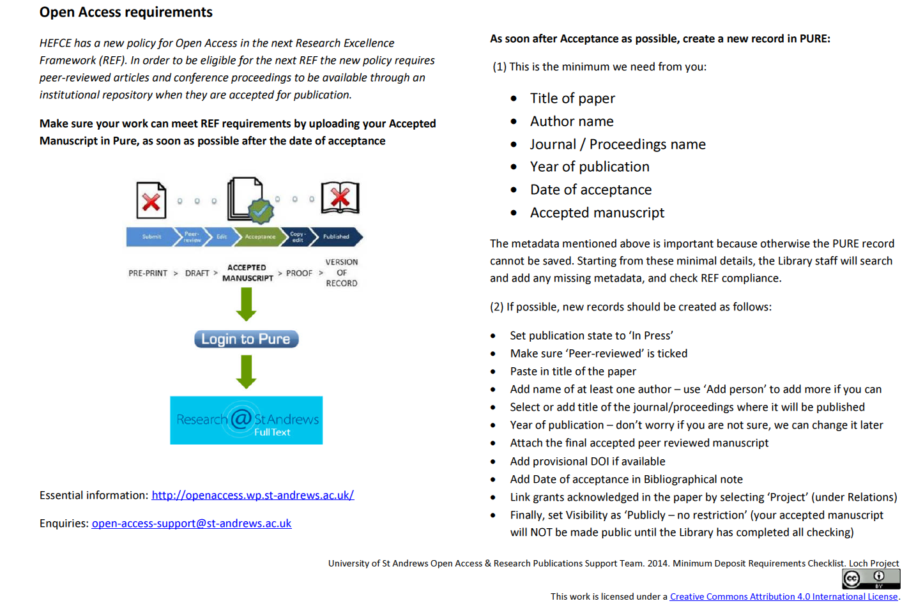
Checklist

Slide 29
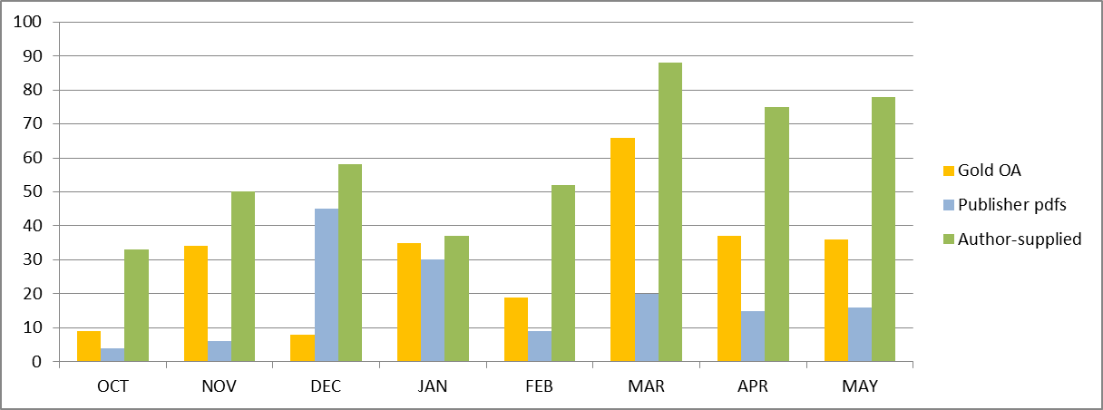
Changing profile of deposits
Pure deposits validated 2014/15
Notes:
Gradual move to author-driven deposits

Slide 30
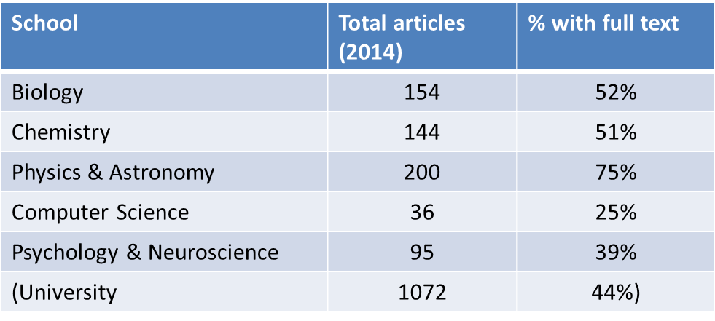
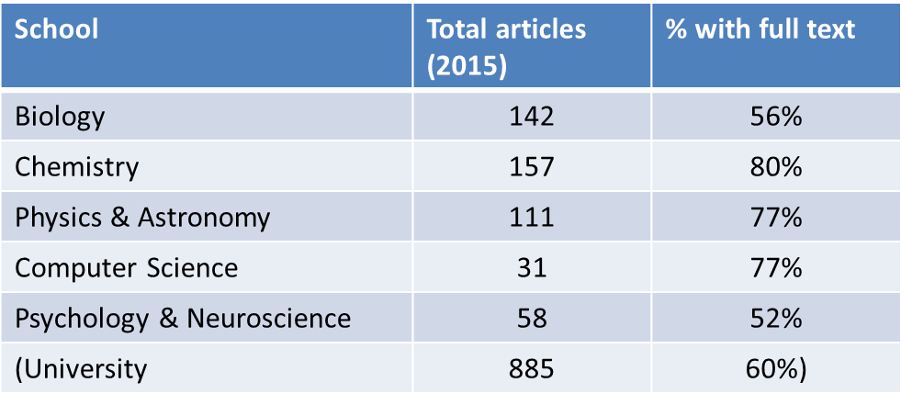
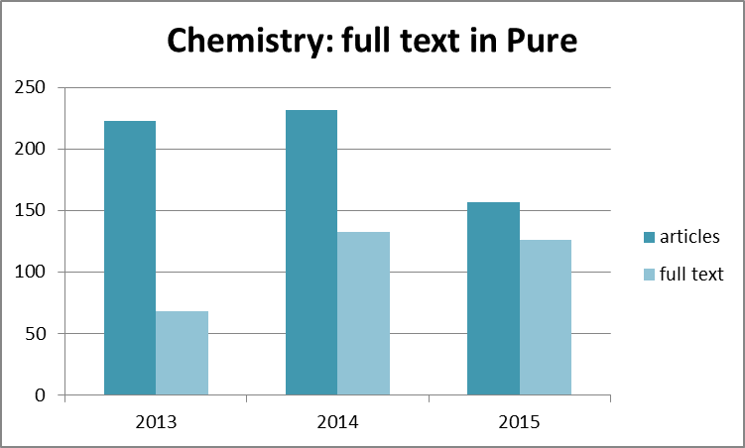
Changing culture through pathfinder
Notes:
Benchmarking on progress with regular compliance reports from Pure
Support in the right places leading to change of attitudes – ‘it’s actually not that hard’
Effect on attitudes in School of Medicine
Ongoing results:
Returning customers
Requests for training sessions
More enquiries… more dialogue
Upskilling in fine detail of Hefce policy
Contact with School administrators and PAs
Learning what motivates authors to buy in to OA
Understanding disciplinary needs and approaches
Reporting good stats on usage
Increase in content and compliance

