Slide 1

Building the Knowledge Graph for UK Health Data Science
Minhong Wang, Qianyi Zeng, Wenjun Chen, Jeff Pan, Honghan Wu, Cathie Sudlow and Dave Robertson

Slide 2
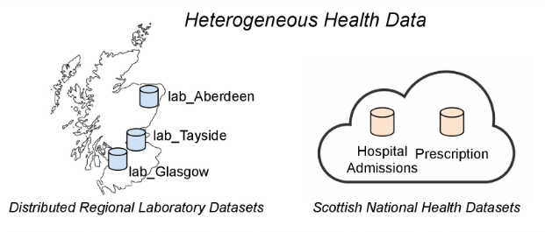
Motivation
A wide variety of data sets
(primary, secondary, social care, etc)
Different dimensions
(genotypic, phenotypic, etc)
Standardised accessing
Data Federation
Generate the required data set for specific analysis
Influence clinical care, enrich local data sets, generate healthcare knowledge
Notes:
Data stored locally and different standards
WanCheng’s project as an example (type 2 diabetes SMR01(hospital admissions)+prescription)

Slide 3
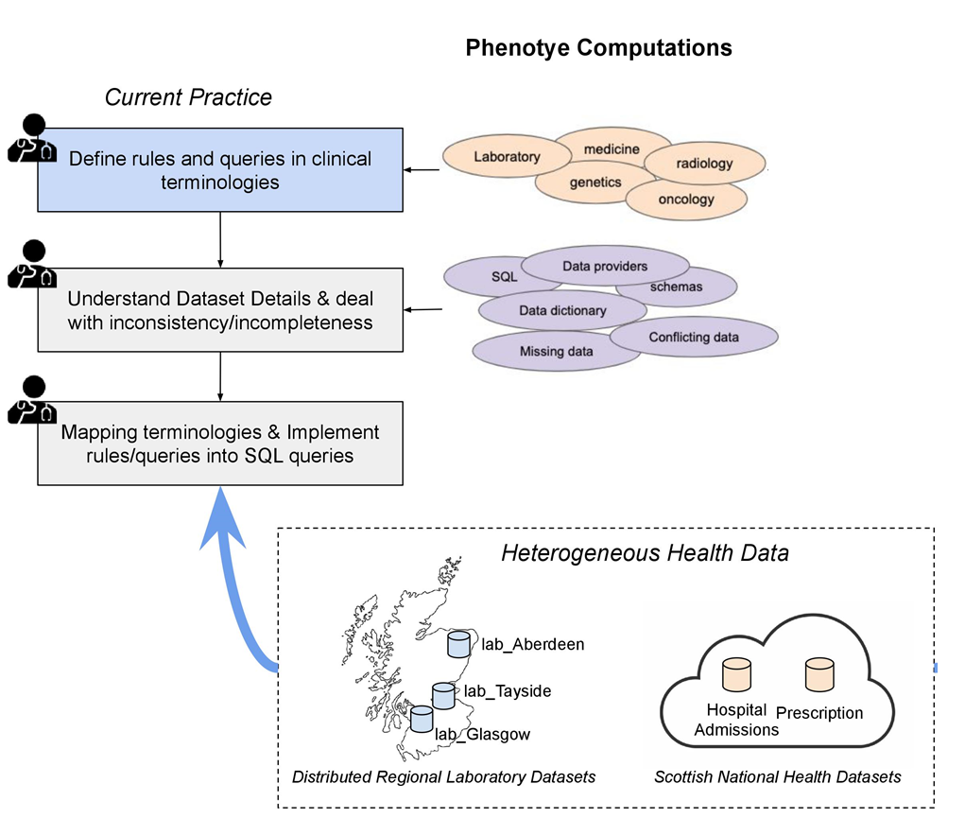
Current Situation

Slide 4
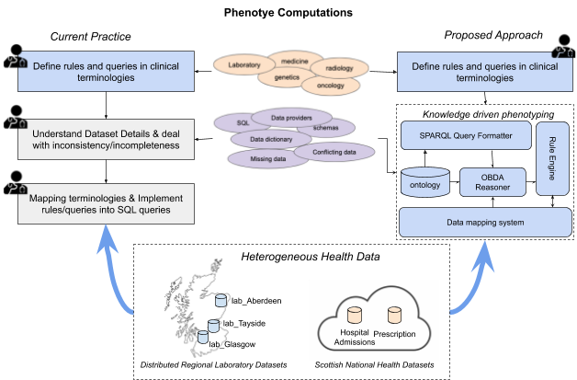
Architectural Overview

Slide 5
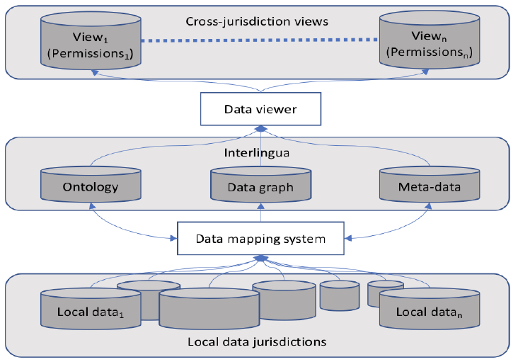
Implementation
Makes the underlying data sources transparent to phenotype computations
User friendly and easily executable data query
i2b2 + SHRINE
Open source clinical analytics platform with a large/active community
i2b2 + SHRINE
OBDA + SWRL
Knowledge Graph supporting ontologies, inference & inconsistency checking
OBDA + SWRL
StarLinker
StarLinker
Efficient, Interactive Semi-automated mapping from local data to “ever-evolving” ontologies

Slide 6
Example
Query patients with Type 2 Diabetes
Phenotype Definition using Ontology
$$icd10:E11(?x)⇒Type2_Diabetes_Patient(?x)$$
Standard Terminology Inclusion and Subsumption Inference
e.g. $icd10:E11.2⊑icd10:E11$

Slide 7
Example
Makes the underlying data sources transparent to phenotype computations
Rule for Dealing with Incompleteness
h$asPrescription\left(?x,?p\right)∧prescribedDrug\left(?p,?d\right)∧drugName\left(?d,\text{Sulphonylurea} \text{SR}\right)⇒Drug_Inferred_Types_Diabetes(?x)$

Slide 8
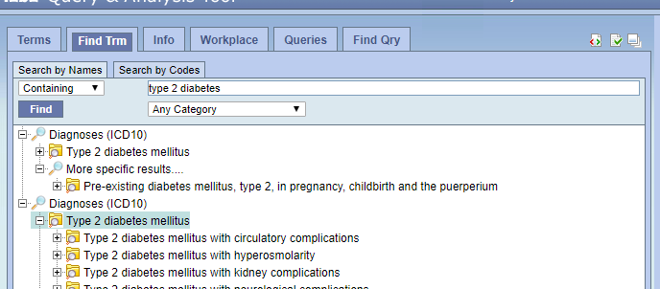
Example
Makes the underlying data sources transparent to phenotype computations
Type 1 and Type 2 Diabetes are mutually exclusive
Rule for Dealing with Inconsistency
$$icd10:E11\left(?x\right)∧icd10:E10\left(?x\right)⟹DiabetesConflictPatient\left(?x\right)$$
$$DiabetesConflictPatient ⊑PotentialCodingErrorPatient$$
Much more simple than SQL

Slide 9
Conclusion
We developed a new framework for interlinking health data at a large scale
Our new framework makes the underlying data sources transparent to phenotype computations
We defined an interlingua by implementing a knowledge-driven approach
Practitioners can represent the phenotype semantics they want to use and automatically translates this to computations as database queries on participating data sources

Slide 10
Thank you!

