Slide 1
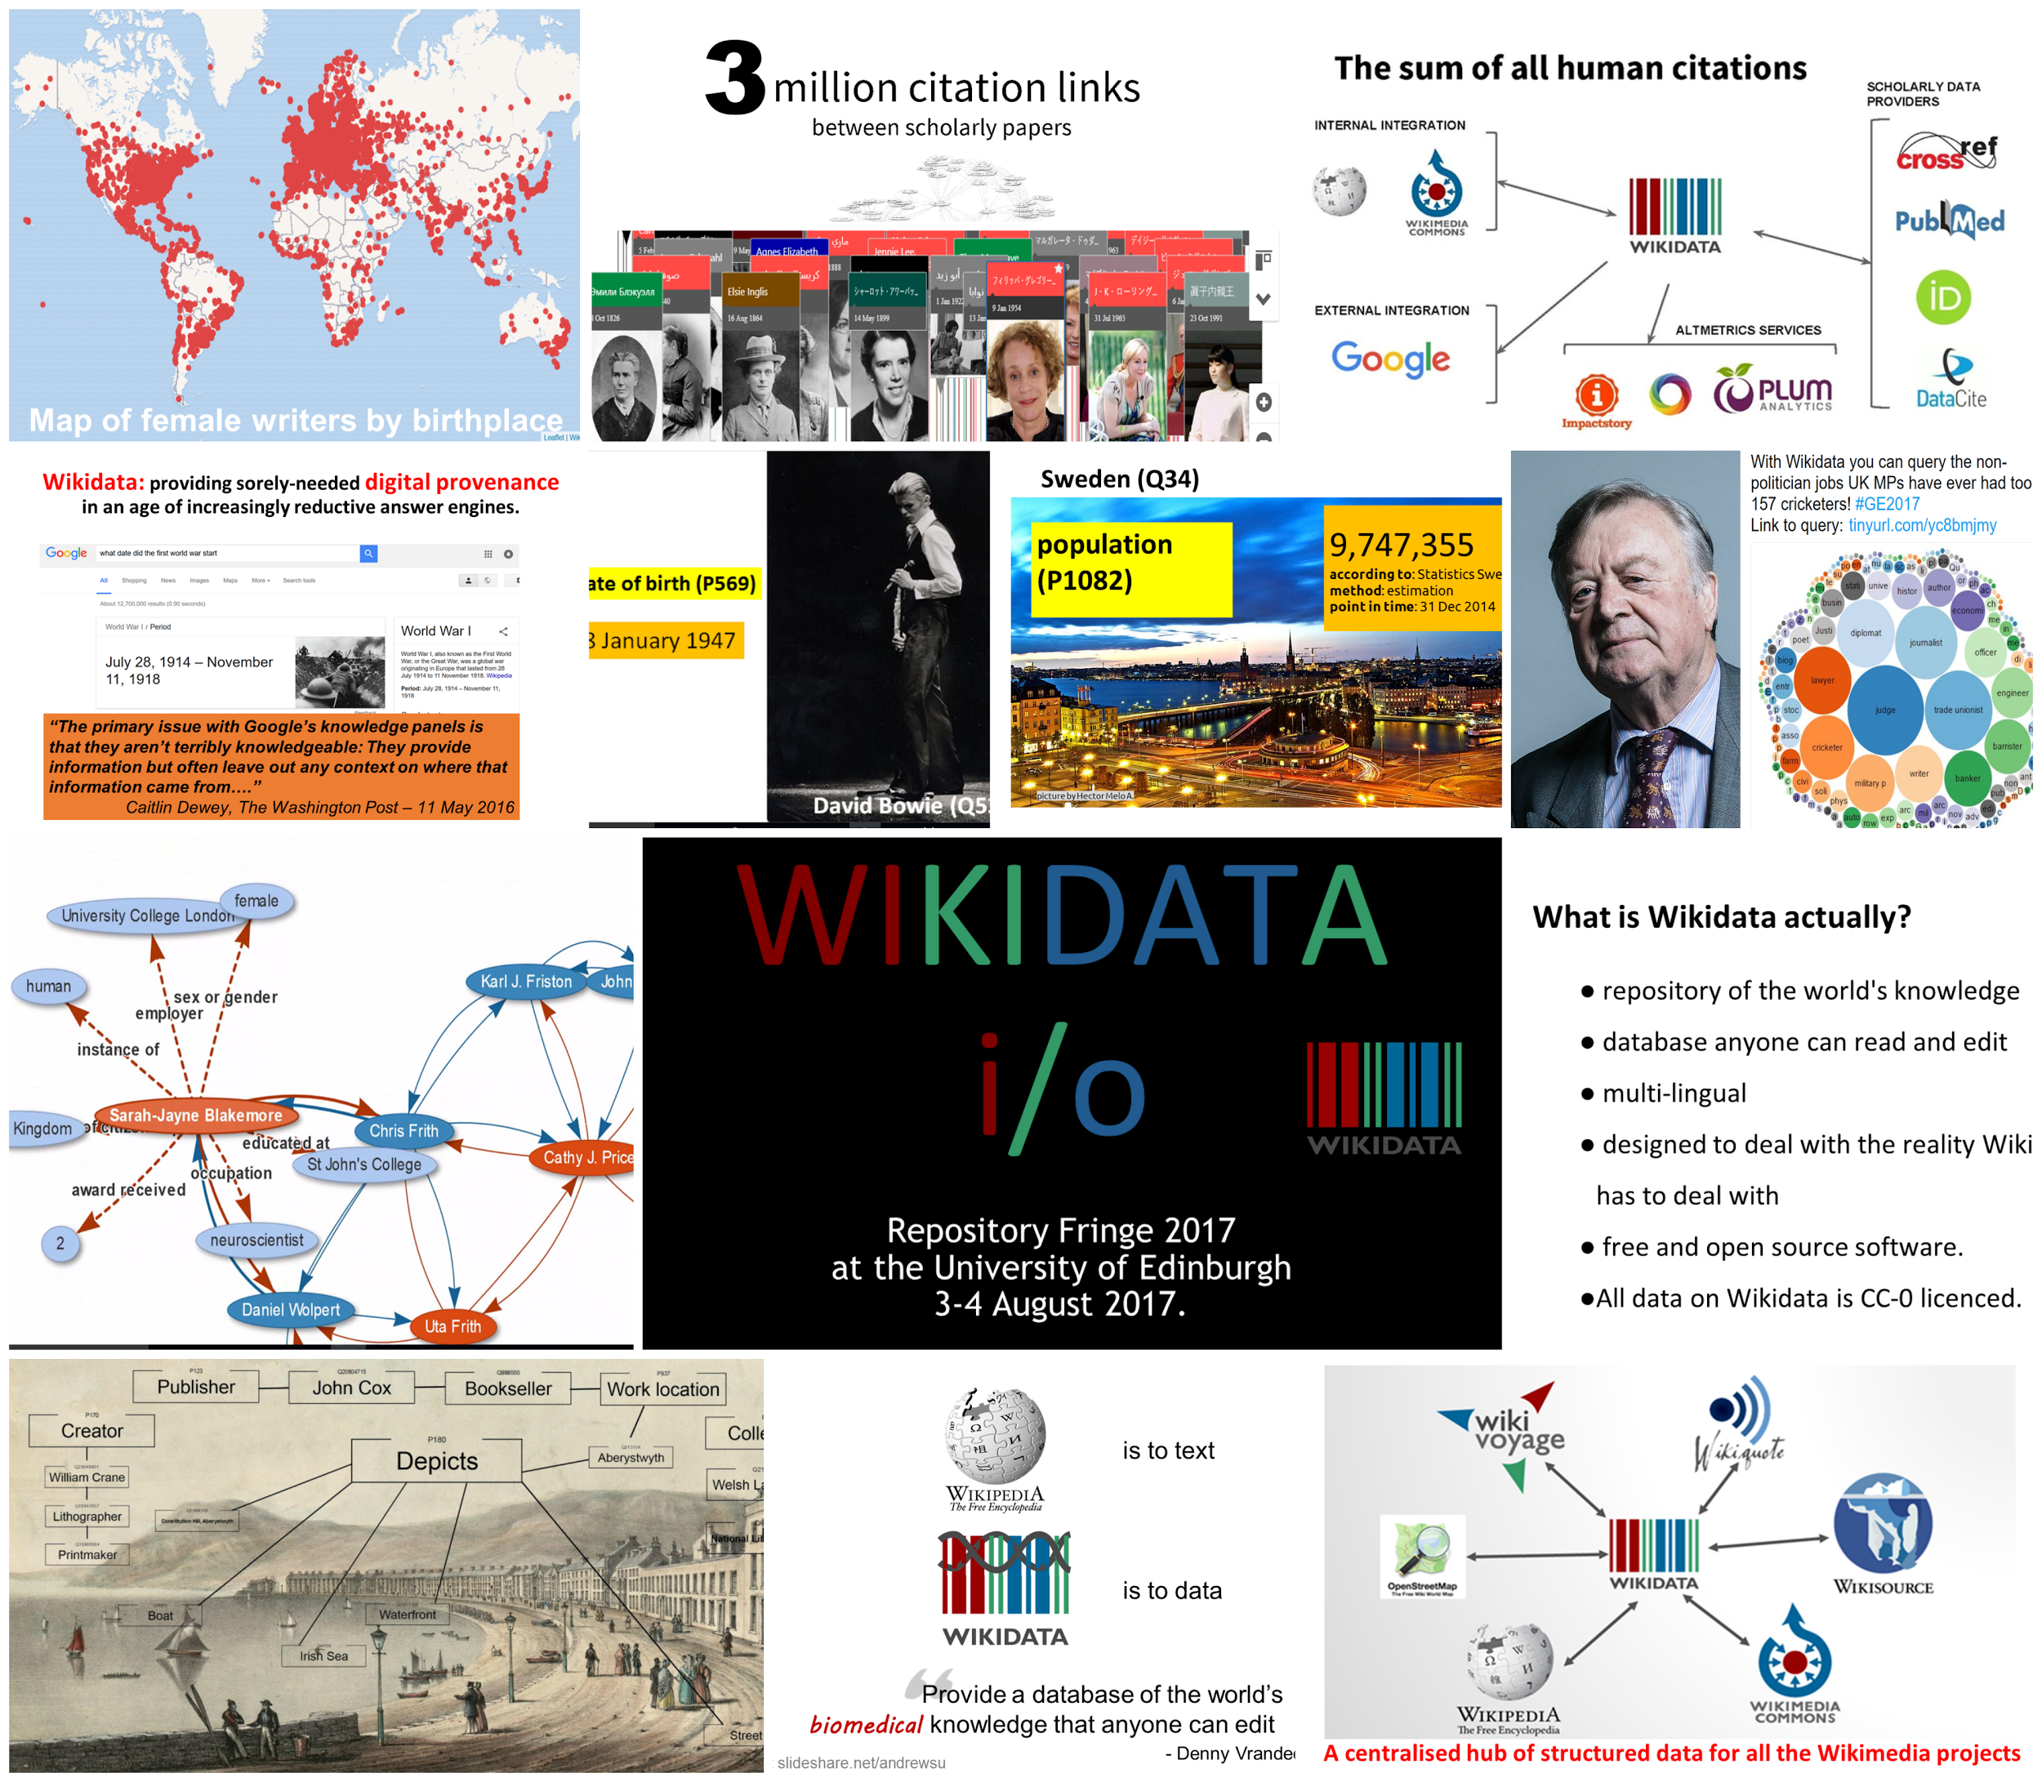

Slide 2

Wikidata
The free and open knowledge base
Part 1: How to add data to Wikidata
Repo Fringe 2017
Ewan McAndrew - @emcandre
Navino Evans - @NavinoEvans
https://tinyurl.com/WikidataRepo1
Notes:
Welcome

Slide 3
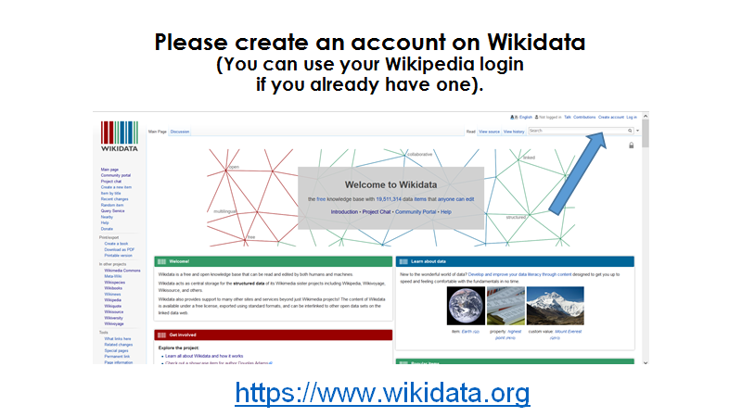
Notes:
Reminder to please set up an account on Wikidata as step 1
And that this will be the same login as your Wikipedia login if you have a Wikipedia login.

Slide 4
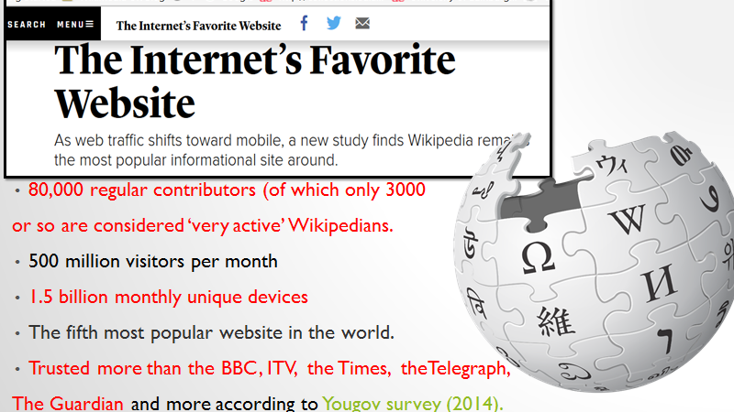
Notes:
With 17 billion pageviews a month, it’s fair to say that most people have heard of Wikipedia, the free encyclopedia, if not use it on a regular basis. English Wikipedia is the 5th most popular website in the world and the internet’s favourite website in terms of information.
https://yougov.co.uk/news/2014/08/09/more-british-people-trust-wikipedia-trust-news/

Slide 5
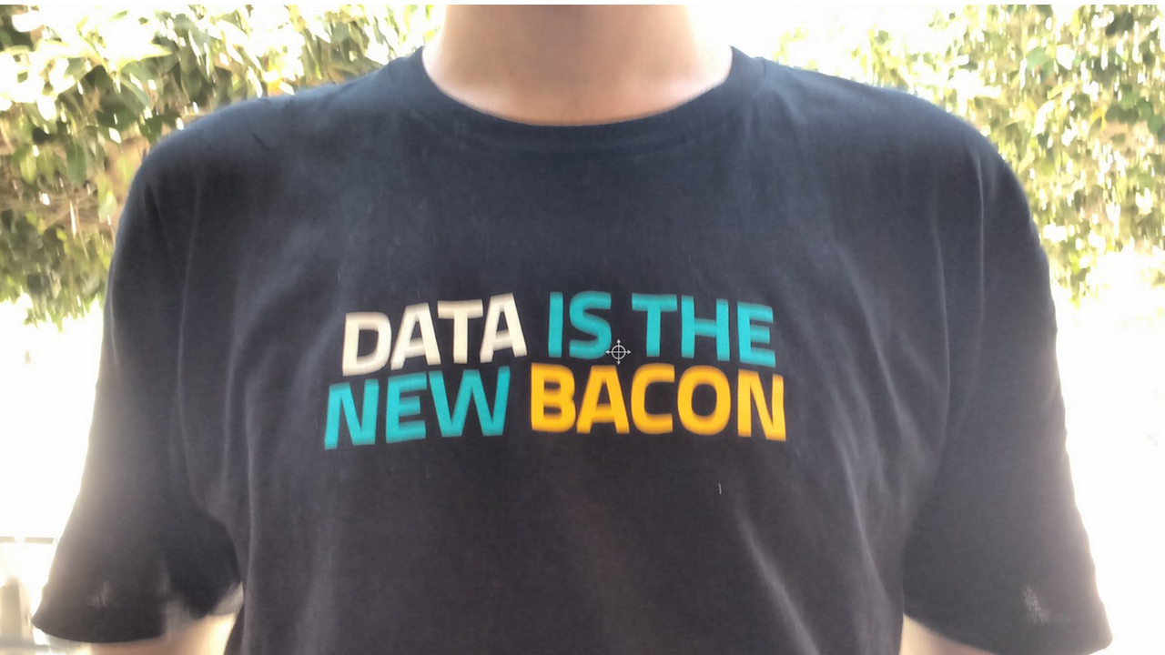

Notes:
But Wikipedia is only one of approximately 12 projects that Wikimedia, the charitable foundation, supports. Wikidata is the newest project, created in 2012 and coming up for only its 5th birthday in October. Yet it is generating excitement because of the advantages it has over Wikipedia.

Slide 6

What is Wikidata?
Wikidata is a free linked database of secondary data that can be read and edited by both humans and machines.
Wikidata acts as central storage for the structured data of its Wikimedia sister projects including Wikipedia, Wikivoyage, Wikisource, and others.
Bibliographic
Biographic
Biomedical
Geographic
Taxonomic
Authority file
Notes:
We’ll start with a short introduction - What is Wikidata?

Slide 7
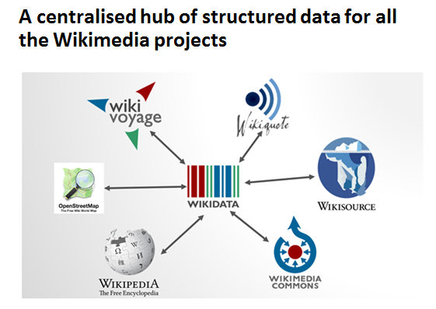
Notes:
It acts as a centralised, machine-readable, hub of structured data for all the Wikimedia projects and for structured data across the internet; be it biographical data, biomedical data or bibliographic data.

Slide 8
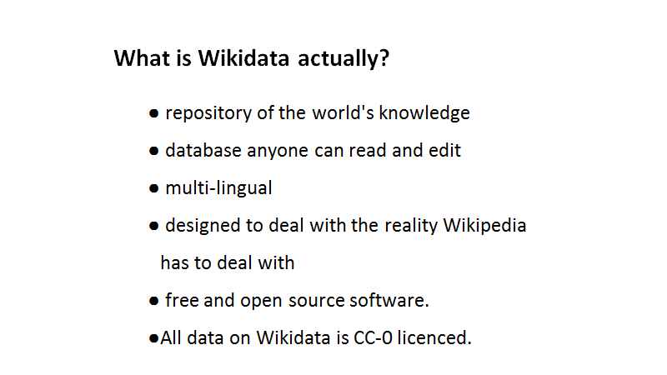
Notes:
In this way it is a repository of the world’s knowledge that anyone can read and edit. It is multi-lingual in a way that Wikipedia isn’t. And it is designed to deal with the reality Wikipedia has to deal with. I.e. if you have 3 different sources telling you that a celebrity’s date of birth was on 3 different dates then Wikidata can input all 3 dates for that person’s date of birth and provide a link to the source information. And all this information is on a CC-0 licence so can be downloaded, queried, used and combined however you see fit.

Slide 9
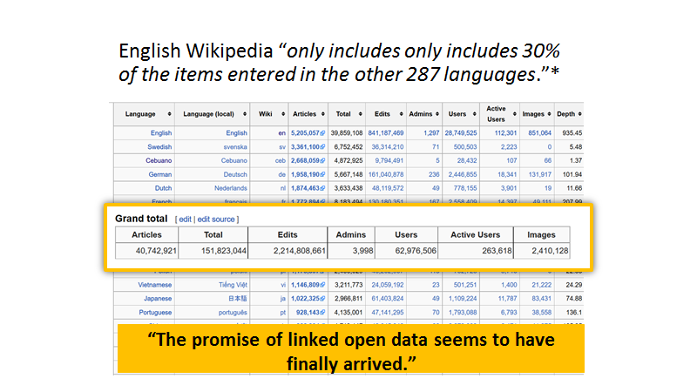
Notes:
Taking structured data information only from English Wikipedia only yields 30% of the structured data available from all 295 different language Wikipedias. In this way, Wikidata has a distinct advantage over Wikipedia in that it can harness the sturctured data from all 295 language Wikipedias in a machine readable format.

Slide 10
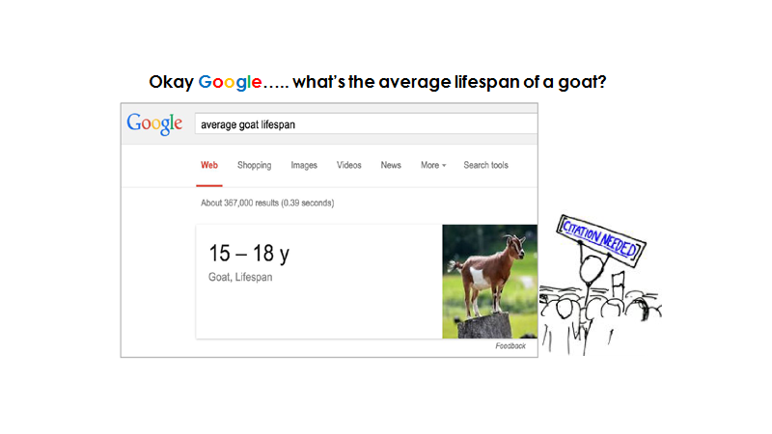
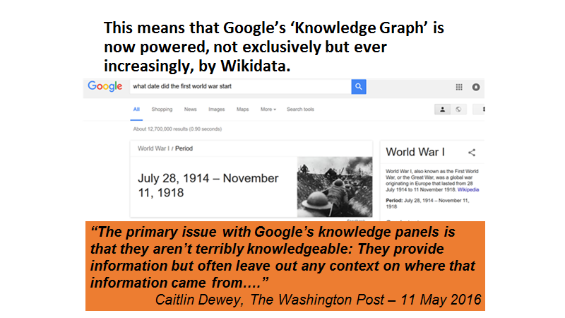
Notes:
It also provides sorely-needed digital provenance in an age of increasingly reductive answer engines. If one were to ask Google what the average lifespan of a goat was, ofr instance, one would be told 15-18 years without any indication as to where the information is coming from and so making the fact’s veracity impossible to judge.

Slide 11
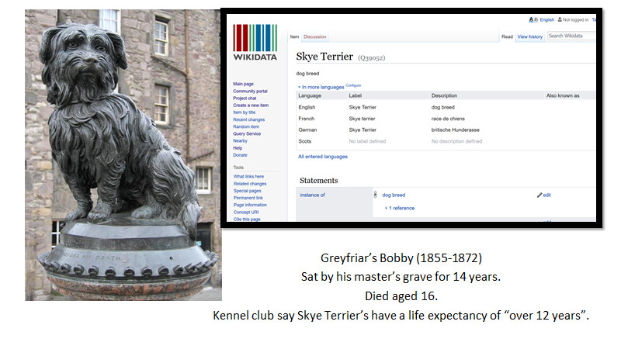
Notes:
Wikidata on the other hand will provide you with the provenance of where information came from. Take Edinburgh’s own ‘Greyfriar’s Bobby’ - a Skye terrier - is listed on Wikidata as having a life expectancy of “over 12 years”. Why - because that is the information the Kennel Club have provided for the life expectancy of Skye Terriers and Wikidata provides a link through to this Kennel Club page. (Incidentally, Greyfriar’s Bobby outlived this by some 4 years making him all the more remarkable.)

Slide 12
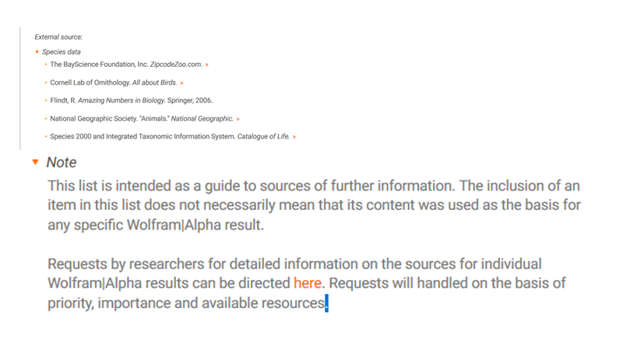
Notes:
Siri and Wolfram Alpha are the same - returning answers without providing any provenance for you to check the answer is correct. Wolfram Alpha will return an impressive list of sources at the bottom of the query BUT also provide a disclaimer saying that the information may NOT have come from any of these sources.

Slide 13
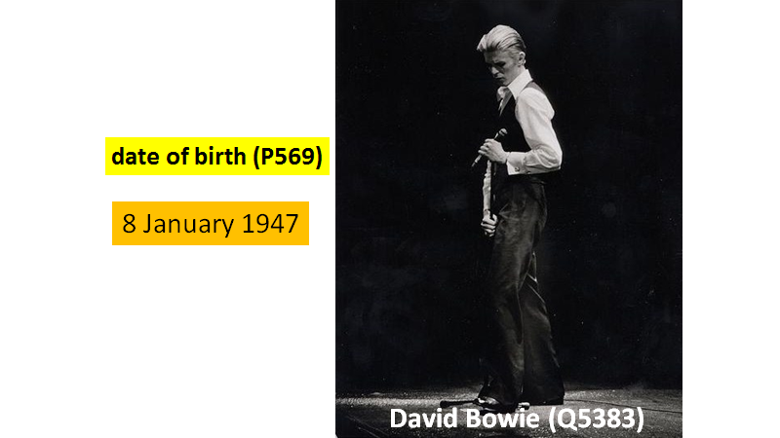
Notes:
What form does this data take? Well data on Wikidata is organised into triples.
Each item of data, like David Bowie here, will have a unique identifier. With this being the English label for this unique identifier. Within this item are a series of statements. Statements consist of a property (identified with a unique P number) and a value for that property.

Slide 14
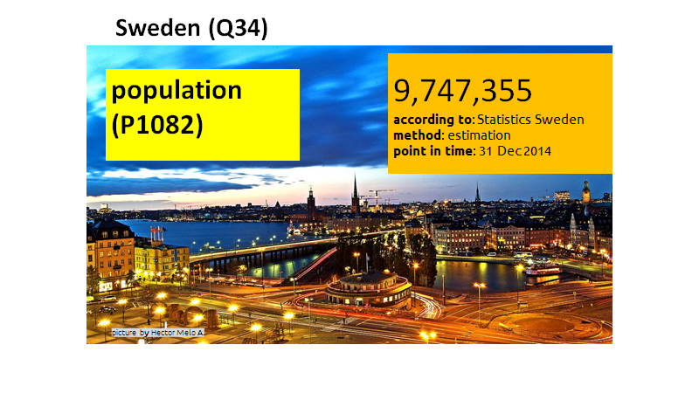
Notes:
We can go even more granular. So the data item for Sweden (Q34) has a statement about its population. So property P1082 has a value of 9,747,355. Obviously that number will change over time so Wikidata can also input a qualifier to provide a point in time as to when that information was collected and how it was collected. And in terms of veracity, it’s important we also provide a reference as to where that information came from.

Slide 15
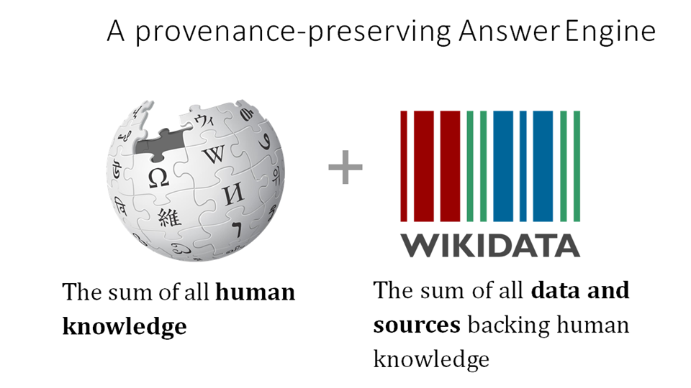

Slide 16
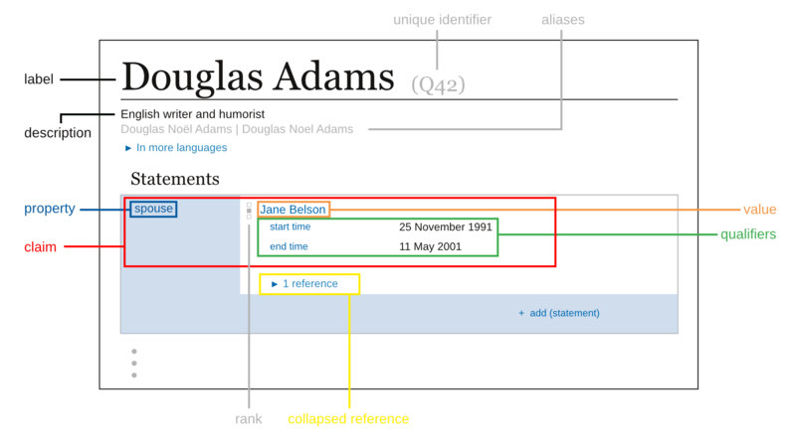
Example Wikidata item & statement
wikidata.org/wiki/Q42
Douglas Adams
Notes:
Explain:
Items are real things or concepts (e.g. people, places, organisations, scientific theories etc). They all have a Unique id (that never changes)
Data is stored in statements on items
Parts of a statement (make clear that qualifiers & references are optional)
Link to item,then search for barack obama
Show birth certificate

Slide 17
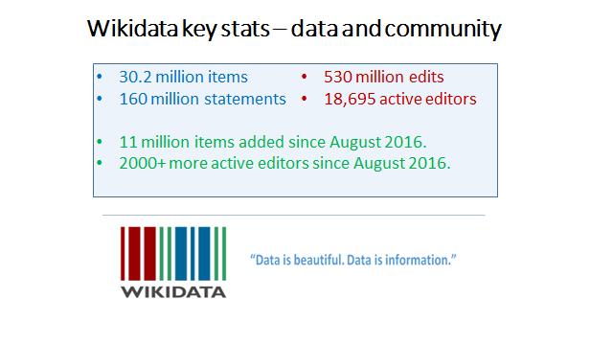
Official Wikidata stats More stats

Slide 18
SECTION
MANUAL EDITING
Notes:
Okay - for our first practical, we will show you how to manually edit Wikidata. The Royal Society of Edinburgh is Scotland's national academy of science and letters and it was established in 1783. Of the 242 women awarded fellowship of the Royal Society of Edinburgh, only 28 have a statement on Wikidata which says as much. So we’re giving out awards today - credit where credit is due.

Slide 19


Practical session - Adding data
Open you selected batch from the batches spreadsheet
Show how to add ‘award received’ (P166) statement + reference.
Show how to create an item from scratch
‘Instance of’ = ‘human’
‘Gender’ = ‘female’
‘Award received’ = ‘Fellowship of the Royal Society of Edinburgh’
  Qualifier: Point in time = year of election
  Reference: Reference URL = Url of page on RSE website
Notes:
You will each receive a batch number which has 4 names of Female Fellows who do have a Wikidata item. The 5th name is one who has no Wikidata page at all. The task is to add a statement to the first 4 names using the property P166 award received and a value of ‘Fellowship of the Royal Society of Edinburgh’.
Once you have done that - you can add a qualifier of ‘point in time’ and the year they were elected and you can add a reference URL as to where the information came from.
If you complete all 4 then we need to create the 5th from scratch. To do that we will click on ‘Create a new data item’ and add 3 statements.

Slide 20
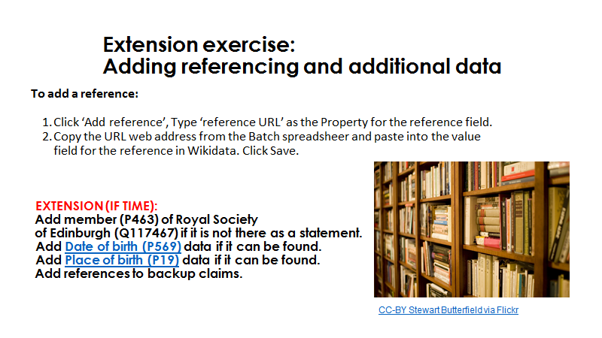

Slide 21
SECTION
MASS EDITING

Slide 22
Essential tools for mass editing Wikidata
Quickstatements v.2
For importing data from a spreadsheet into Wikidata. The syntax you need to use is explained in QuickStatements v.1
Wikipedia and Wikidata Tools for Google sheets (Demo)
Google sheets add-on for pulling data from Wikidata and Wikipedia directly into a spreadsheet (Note: you need a Google account to install this)
Notes:
We’re using QuickStatements in the practical in a moment
Google sheets add on demoed now - Will show the data processing that has been done prior to the practical

Slide 23
Practical - mass editing using QuickStatements
Go to the batches spreadsheet, then click the link with your selected batch number
Select all cells highlighted orange (the QuickStatements commands), then copy them to your clipboard ( click edit then copy
Go to QuickStatements and click
Click 'Import commands' -> 'Version 1 format'
Paste in the commands copied in step 2, then click ‘import’
Check a selection of the commands to make sure they have imported correctly
Click the “RUN” button at the bottom to launch your first mass edit!
Notes:
Demo the entire sequence
NOTES:
QUERY - UNESCO languages without a country statement - http://tinyurl.com/y85eurfs (should show zero results when we’re done)

Slide 24
Demo results
Using the Wikidata Query Service
Bubble chart - countries with the most UNESCO endangered languages
Using Listeria to generate a Wikipedia list
List of UNESCO endangered languages
List of female fellows of the Royal Society of Edinburgh
Notes:
NOTES:
Listeria snippet for Endangered languages:

Slide 25

End of practical - let’s see the improved results!
Map query - http://tinyurl.com/RSEmap
Link straight to map - http://bit.ly/RSEmap2
Timeline – http://tinyurl.com/RSEtimeline
Wikidata query itself – http://bit.ly/RSEquery
Listeria list – http://tinyurl.com/RSEListeria

Slide 26
Links and further reading
https://www.wikidata.org/wiki/Wikidata:Data_Import_Guide
https://www.wikidata.org/wiki/Wikidata:Database_download
.https://www.wikidata.org/wiki/Property:P2966 – National Library of Wales ID for collection items.
.https://www.wikidata.org/w/api.php
.https://tools.wmflabs.org/reasonator/ - Wikidata made ‘pretty’
https://tools.wmflabs.org/reasonator/?q=Q42 – Reasonator page for Douglas Adams (Q42) by way of example.
https://www.mediawiki.org/wiki/Extension:ArticlePlaceholder – another way of placeholding articles using structured data from wikidata to populate information in the meantime until an article can be created.
Wikidata: Current trends and priorities (May 2017 presentation with current statistics)
Wikidata video presentations on Media Hopper.

Slide 27
Developer links
#wikidata on chat.freenode.net
wikidata-l@lists.wikimedia.org
Wikidata – The New Rosetta Stone (article).
Google closes Freebase (article).
Google’s sketchy attempt to control the world’s knowledge (article).
api @ wikidata.org/w/api.php
sandbox @ wikidata.org/wiki/Special:ApiSandbox
The Wikidata Game: https://tools.wmflabs.org/wikidata-game/distributed/
PHP
Wikibase API Library: github.com/addwiki/wikibase-api
SPARQL abstraction: github.com/Benestar/asparagus
Python
Wiki bot Framework: mediawiki.org/wiki/Manual:Pywikibot/Wikidata
C# .NET
Wikibase API Library: github.com/Benestar/wikibase.net

