Slide 1

Bringing researchers to data: computing skills training with Edinburgh Carpentries https://edcarp.github.io/
Edward Wallace, @ewjwallace
Dealing with Data 2019

Slide 2
Bringing researchers to data
Data availability is essential
Researchers also need to find and use the data
They need the right knowledge and skills
How can we empower researchers to use data well?
Ask researchers what they need – SBS Computing survey
Build skills as a community – Edinburgh Carpentries

Slide 3

Why do I care about data and software?
I’m a research fellow in biology, funded by Wellcome & RS
My work relies on re-using other people’s data (past me!)
Biology is a data-intensive discipline
Better Software, Better Research - https://www.software.ac.uk/
Training is a Pathway to Impact
All my colleagues need to analyse data:
Reproducibly
Reliably
Efficiently

Slide 4
Goals of the SBS research computing survey
Inform training for research students, staff, faculty
Find out what data & software people use
Find out what skills & training they think they need
Input to UKRI/BBSRC data-intensive bioscience review
We used https://www.onlinesurveys.ac.uk/
Designed 1-page survey completable in 5 minutes, April 2019
We can share the survey design for you to adapt

Slide 5

Who filled in the survey?
We had 147 responses, about 25% response rate
35 Group Leaders (out of 130)
40 Postdocs, 56 PhD students, 16 RA/other
Responses from many institutes & subfields
Self-selecting!
Computing is required as proportion of success of most projects:

Slide 6


Many of us do not have formal training
In computing:
Or statistics:

Slide 7
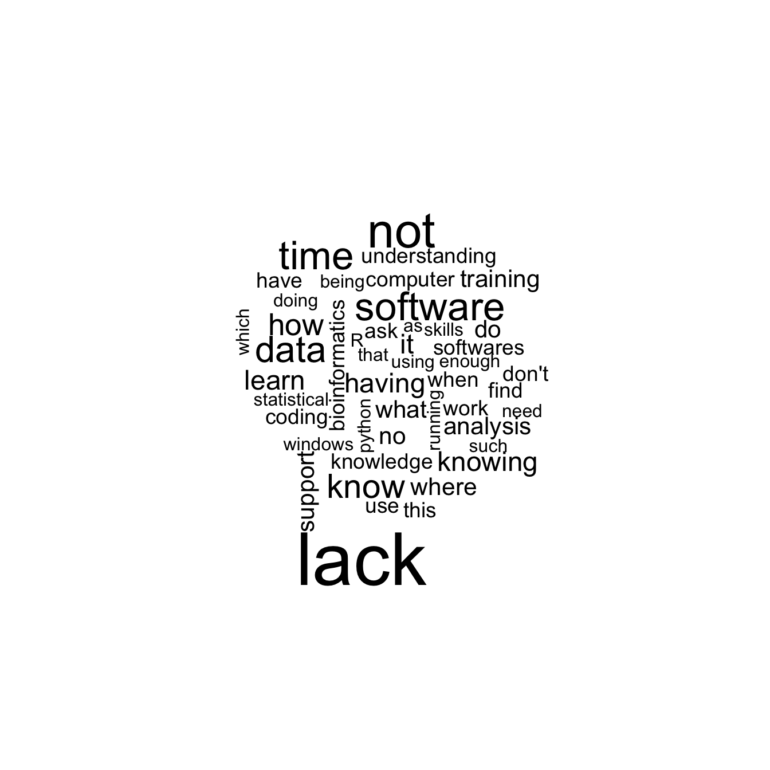
What is your biggest frustration in research computing?
Notes:
Frustrations center around “not knowing what to do” and “do not know whom I can ask”.

Slide 8
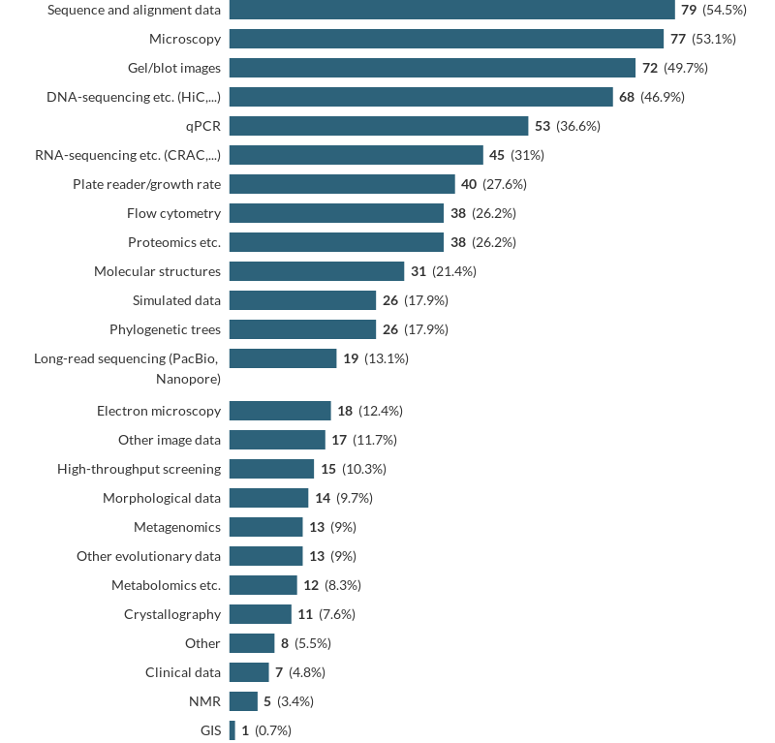
We use many kinds of biological data
Correspondingly diverse software:
MS Excel, SPSS, R, python, MATLAB, ImageJ, ImageStudio, Genome Browsers, Benchling, Snapgene, Pymol, BLAST, multiple sequence alignment, FlowJo, ...

Slide 9
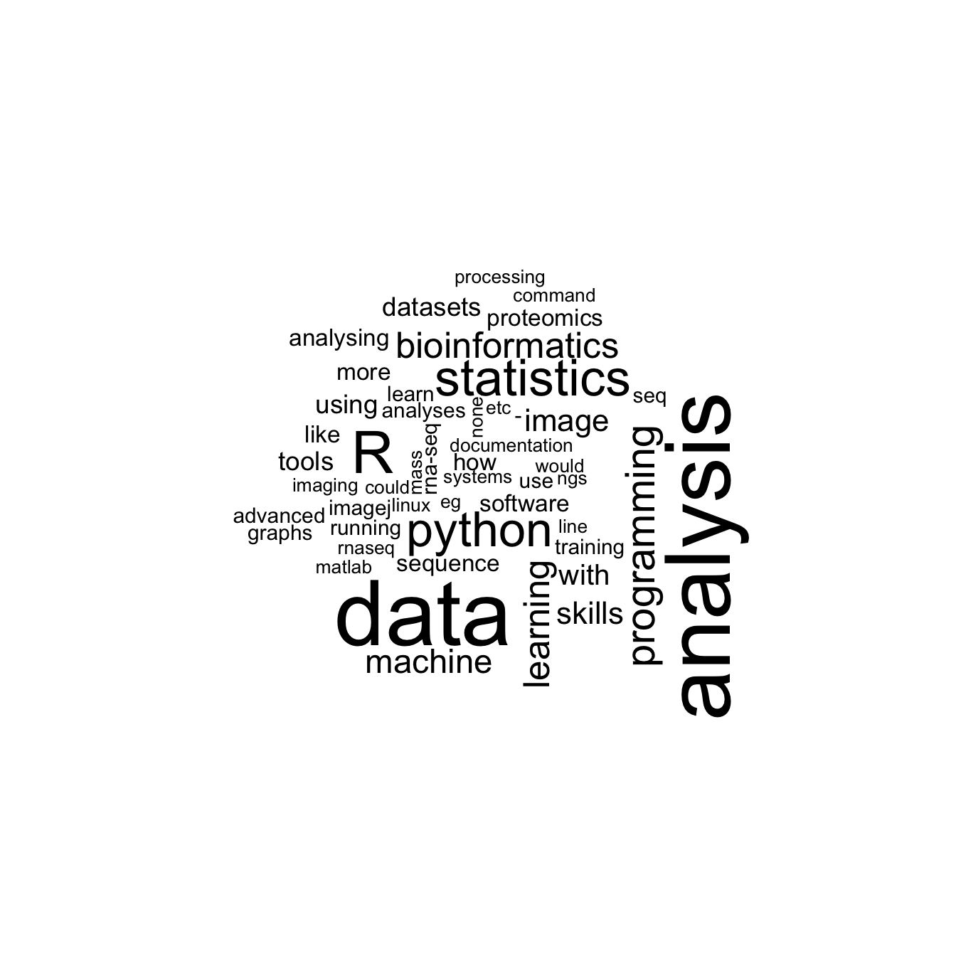
What is your biggest need in computing training?

Slide 10
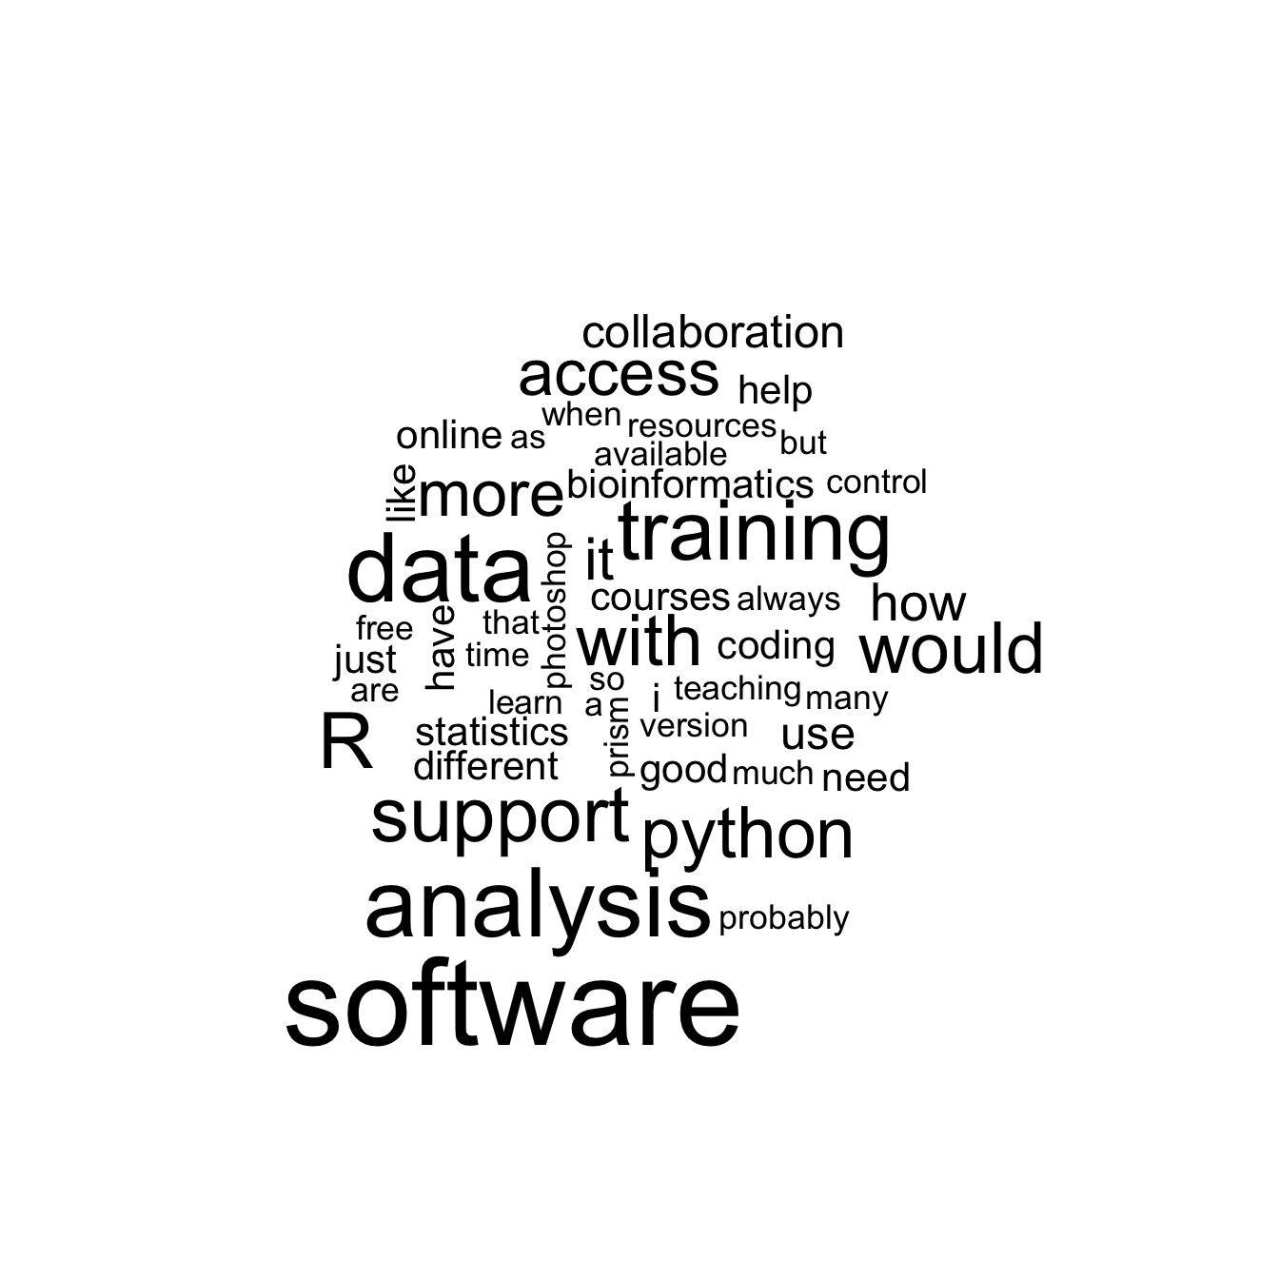
What is your biggest need in computing support?

Slide 11
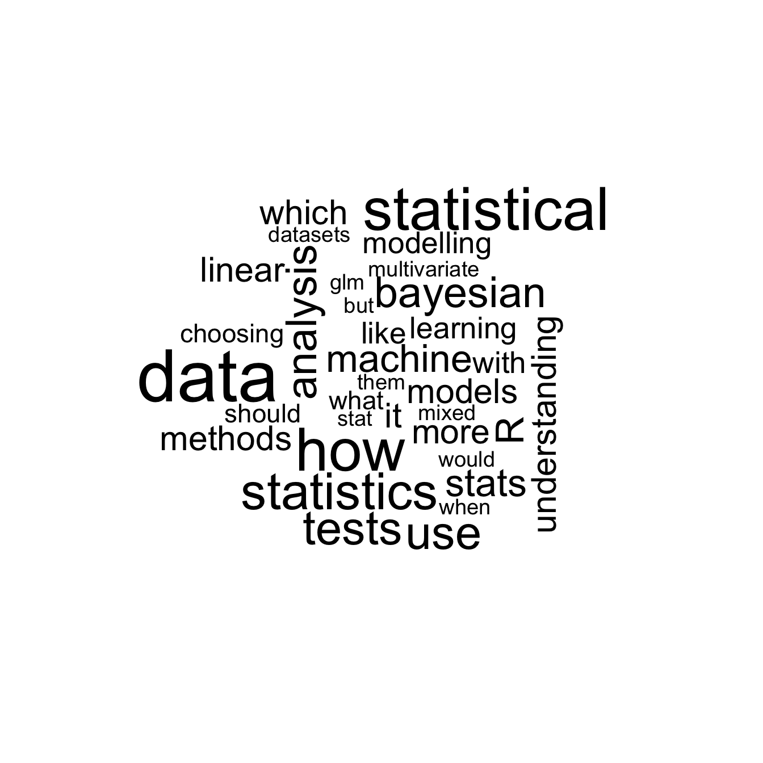
Which statistics methods or topics would you like to learn?

Slide 12

Are you likely to take courses offered within SBS?
In data analysis, bioinformatics, or image analysis:
Would you like more training in statistics?
Address skills needs with Edinburgh Carpentries!

Slide 13

The Carpentries
The Carpentries teaches foundational coding, and data science skills to researchers worldwide. https://carpentries.org/
Started in North America (by UoE alum), promoted in the UK by Software Sustainability Institute, spread across the world.
Based on a community of instructors, maintainers and other contributors.
Open source. Volunteers. Small group of employed staff.
Notes:
The Carpentries is an international collaboration to teach researchers the software development skills essential to their work. It was founded in 1998 by Greg Wilson, a former employee of EPCC, and arose from the growing awareness that something should be done to link domain specific knowledge-bases with software development and computational training.
The Carpentries model is based on a community of certified instructors who teach at the workshops, and contributors who maintain the lessons materials.
The instructors come from a range of backgrounds and are often researchers with a sound experience of research software development and a clear sense of the pitfalls. They get a certification via an extensive online course or a two-day face-to-face intensive one. Instructors are volunteers, who offer to teach at workshops for free and sometimes during their work leave.
The lessons materials are all available under CC-BY licence and maintained by the community itself.
Openness of the community, reusability of the materials and scalability of the model are the real peculiarity of this training organisation.

Slide 14
Format
Defined curriculum (Software, Data, other).
Choose lessons.
Setup workshop: typically 2 days, 2 or more instructors, helpers!
Learners bring their own machine; hands-on (code along) challenges and group work.
Evaluation: surveys, post-its.
Notes:
Carpentries training courses are highly-interactive two-day workshops.
Software, Data Carpentry -- see later slides.
The lessons materials are all available under CC-BY licence and maintained by the community itself.

Slide 15

Software Carpentry
Software focused example.
Day1
AM - Unix Shell
PM - Git
Day2
AM - Python
PM - Python
Make
R
Matlab
SQL
Notes:
Lessons can be reshuffled according to needs.

Slide 16

Data Carpentry
Data focused example.
Cleaning, analysing, visualising.
Domain specific lessons.
Ecology, Social Sciences, Genomics, Geosciences, Humanities.
Spreadsheets, OpenRefine, R, SQL
Notes:
Genomics specificity.

Slide 17
Genomics curriculum
Project organization and management | Learn how to structure your metadata, organize and document your genomics data and bioinformatics workflow, and access data on the NCBI sequence read archive (SRA) database.
Introduction to the command line | Learn to navigate your file system, create, copy, move, and remove files and directories, and automate repetitive tasks using scripts and wildcards.
Data wrangling and processing | Use command-line tools to perform quality control, align reads to a reference genome, and identify and visualize between-sample variation.
Introduction to cloud computing for genomics | Learn how to work with Amazon AWS cloud computing and how to transfer data between your local computer and cloud resources.
Notes:
Genomics specificity.
Run a workshop on EDDIE.

Slide 18

Edinburgh Carpentries - EdCarp
Notes:
Edinburgh Carpentries is an ongoing computational training initiative, offering Carpentries based workshops across the University of Edinburgh and other research institutions in the area. It started its activity in 2018 with support from the SSI, the Computing Office of the School of Physics and Astronomy (SoPA), the Research Data Service and the Digital Research Service. During its first year of activity, EdCarp has trained over 350 students and staff members thanks to the commitment of a large pool of local organisers, instructors and helpers. The courses are very popular and get oversubscribed in hours when the registrations are launched. Python, R, Unix Shell (Bash), Git, OpenRefine, SQL and Genomics Analysis are the lessons offered so far, some of which vary depending on the scientific field.

Slide 19

Edinburgh Carpentries
Local Carpentries community
Paying member – institutional support
Organising and Steering committee
A community of instructors and helpers
Notes:
EdCarp is the local carpentries initiative and community based at UoE but involving other institutions such as the Heriot Watt and the National Libraries of Scotland
It gets institutional support (to pay the membership and staff time)
It’s governed with two recently formed committees (organising and steering)

Slide 20
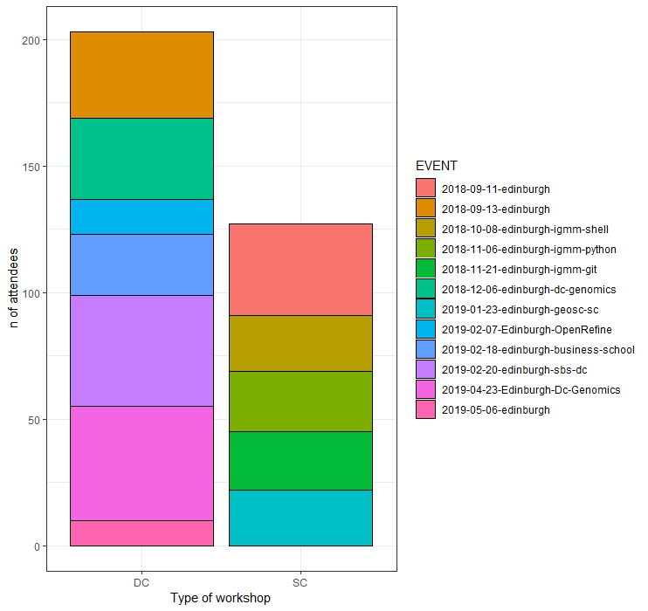
Edinburgh Carpentries (Sept 2018-May 2019)
12 workshops took place to May 2019
6 Software Carpentries organised (+1)
7 Data Carpentries organised (+2)
372 sign up
330 attendees (students + staff)
Notes:
THIS NEEDS UPDATED WITH: https://docs.google.com/spreadsheets/d/1slrJ_I4JCh7ncB09Pd-ryeH2vZNrTigItykIw76zzS4/edit#gid=0

Slide 21
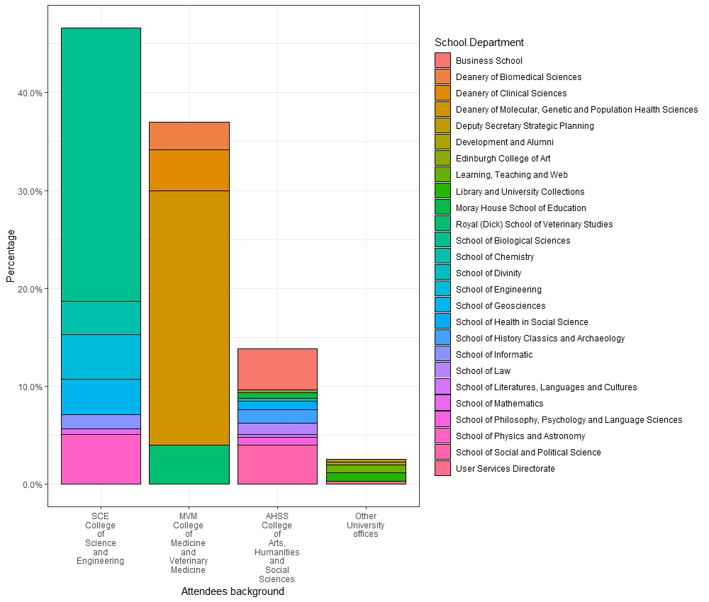
Edinburgh Carpentries (Sept 2018-May 2019)
The most represented Schools are those of Biological Sciences (28%) and the Deanery of Molecular, Genetic and Population Health Sciences (26%)
The college more represented is that of SCE (College of Science and Engineer: 46.6%). MVM (College of Medicine and Veterinary medicine: 37%). AHSS (College of Arts Humanities and Social Sciences: 14%)

Slide 22
Future plans
The activity so far with Edinburgh Carpentries has been possible thanks to the support of SSI and the engagement of a community of organisers, instructors, helpers and attendees.
From June SSI support is reduced, so there will be a need for a new form of support and leadership.
Organisational committee.

Slide 23
2020 EdCarp Programme
SWC workshop at King’s Buildings, 4 sessions, 21/01 – 18/01
SWC Workshop at Geosciences, 29-30/01
Data Carpentry Geospatial, TBC
Data Carpentry at Biology, 4 sessions, 7-20/04
Data Carpentry for Genomics, TBC
Data Carpentry for Social Sciences, 4 sessions, 12/02 – 4/03
Data Carpentry for Digital Humanities, 14-15/05
New organising committee
Now engaging:
cross-college, IAD, Bayes centre/DDI, doctoral programs

Slide 24
Why should you engage?
Effective teaching of skills that are needed
It’s a nice community and atmosphere.
Opportunity to teach and develop materials.
Way of sharing workloads.
Notes:
Inclusivity.
Join projects developing new materials (R for transcriptomics, ML-AI, text mining)
Help other with their training needs and get help from others.

Slide 25
How to engage
edcarp@ed.ac.uk
edinburghcarpentries.slack.com
github.com/edcarp
webpage: edcarp.github.io
signup! eepurl.com/gl4MsX
Notes:
?

Slide 26
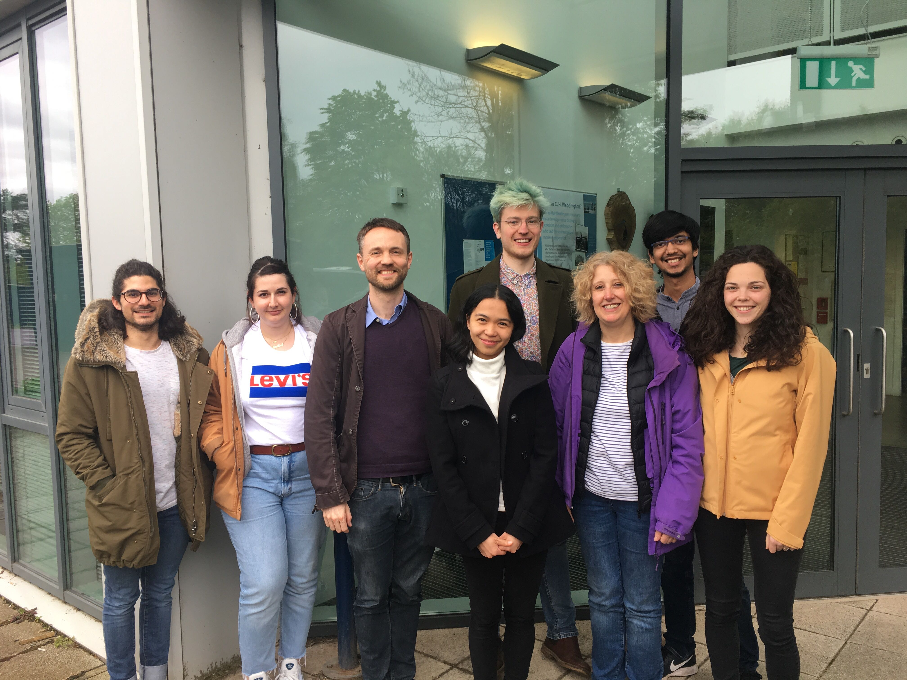


Thank you! Sign up here: http://eepurl.com/gl4MsX
Edinburgh Carpentries
https://edcarp.github.io/
Giacomo Peru
Sean McGeever
Jen Daub
The whole community!
The Carpentries
https://carpentries.org/
Software Sustainability Institute
https://www.software.ac.uk/
SBS Bioinformatics committee
Sara Buonomo
@ewjwallace
https://ewallace.github.io/

