Slide 1

The Politics of Open:
The State of Play in the U.S.
Heather Joseph
Executive Director, SPARC
Repository Fringe Conference
Edinburgh, Scotland
August 3, 2017

Slide 2

SPARC’s goal is to make open the default in research and education.

Slide 3
Policy is a (powerful) lever to use to accomplish this goal.

Slide 4

http://coablog.ashevillenc.gov/wp-content/uploads/2017/02/open-data-graphic.jpg

Slide 5
U.S. Information Policy Precedents
Freedom of Information Act (1966)
Copyright Act (17 U.S.C. 105) (1976)
Paperwork Reduction Act (1980)
Electronic FOIA Amendments (1996)
OMB Circular No. A-130, “Management of Federal Information Resources,” (1996)
Paperwork Elimination Act of (1998)
Notes:
.

Slide 6
OMB Circular A-130
“Open and unrestricted access to public information at no more than the cost of dissemination”
“…Government information is a valuable national resource, and… the economic benefits to society are maximized when government information is available in a timely and equitable manner to all.”

Slide 7

The NIH “Public Access” Policy

Slide 9
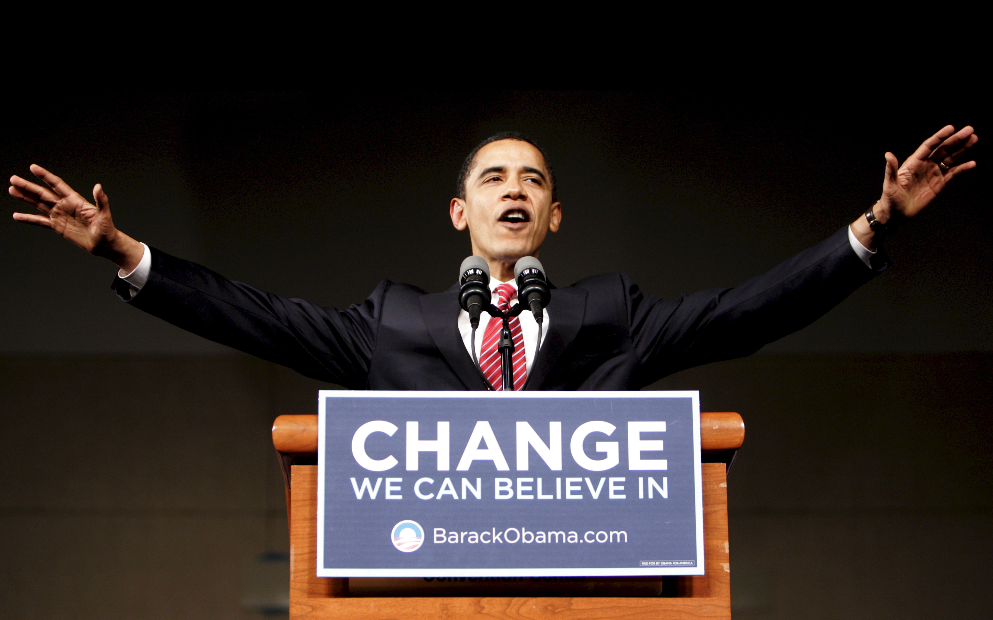

Slide 10
Set the expectation, from day one, that “open” was a key priority.

Slide 11
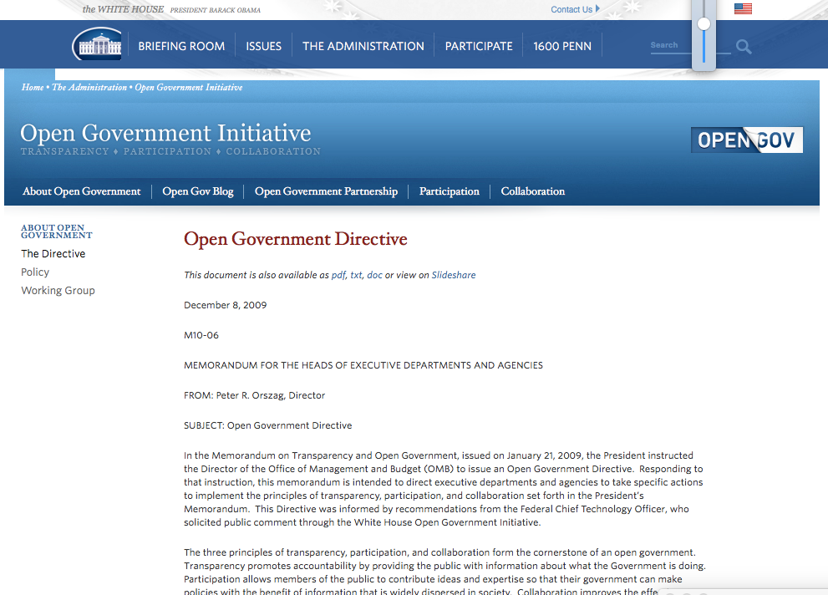
Open Government Directive

Slide 12
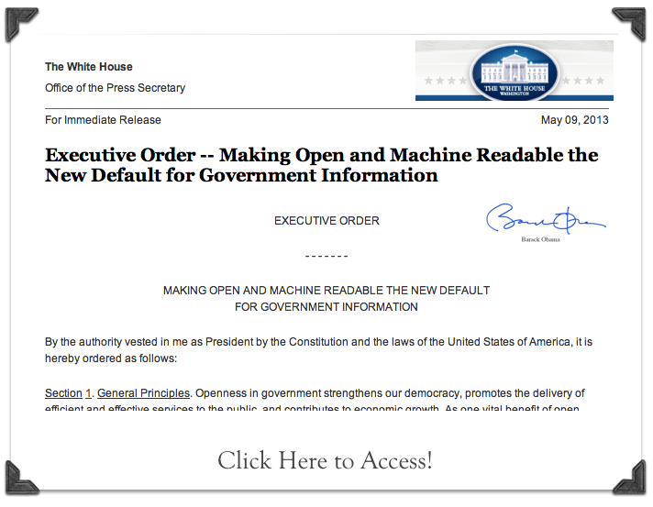

Slide 13
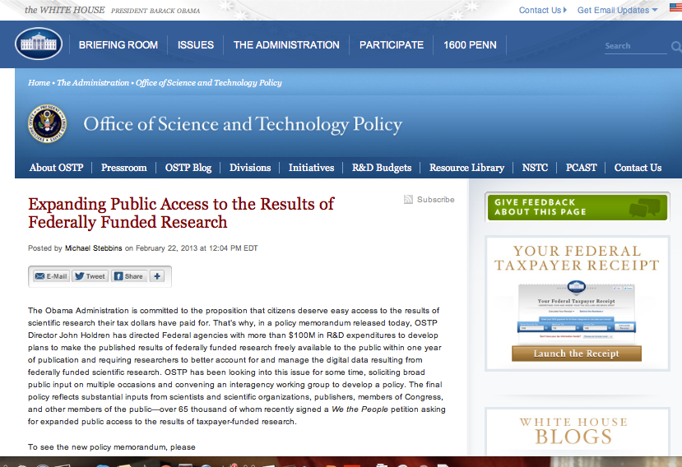
Notes:
Required

Slide 16

Notes:
Required

Slide 17
Open considered a foundational enabling strategy for discovery, better health, innovation, economic growth, job creation…everything.

Slide 18
Until…

Slide 20


Slide 26
Real sense that that an empirical, data-driven, fact-based operating mode is endangered.

Slide 27
So...how are we responding?

Slide 28
1. Play active, pragmatic defense.

Slide 29
1. Play active, pragmatic defense.

Slide 30
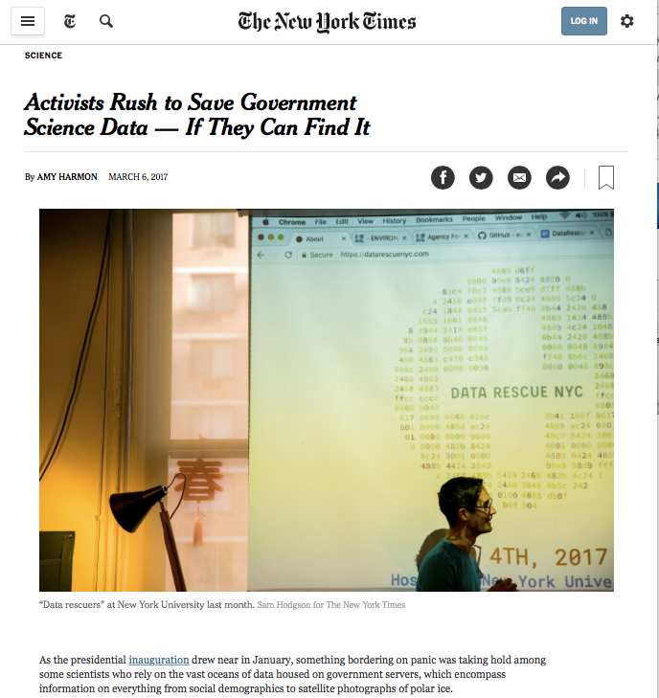

Slide 31


Slide 32
2. Understand what the new priorities are for this Administration: “open and transparent” is out…

Slide 33
…“taxpayers,” “good deals,” and “big wins” are in.

Slide 34
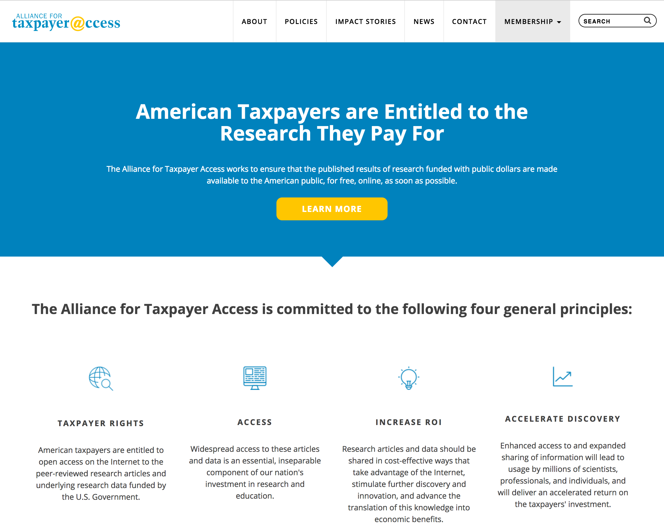

Slide 36
3. Recognize that progress is still possible & position ourselves to drive .

Slide 37
Single-party control of House, Senate and White House presents opportunities to move legislation.

Slide 38

FEDERATION
…exist alongside traditional publishing

Slide 39
FEDERATION
…exist alongside traditional publishing

Slide 40
*As a bonus; Open issues have successfully garnered bipartisan support in Congress…

Slide 41
4. Leverage parallel actions.

Slide 44
Notes:
The Data Coalition is the world’s only trade association dedicated to the transformation of government information into standardized, open data.

Slide 45
5. Build strong(er) cross-sector relationships to leverage success.

Slide 47

Image credit: Tactical Technology Collective (CC BY-SA)

Slide 48
6. Understand that publicly-funded research isn’t the only game in town.

Slide 49
Private Funders/Foundations invest in work that produces huge amounts of data.

Slide 50


Slide 51
Primary Goal:
Position “open” as an enabling strategy to achieve stakeholder goals/missions.
(open in order to…)

Slide 52

Thank You.
Heather Joseph
Executive Director, SPARC
21 Dupont Circle, Washington, DC 20009
heather@sparcopen.org
www.sparcopen.org

