Slide 1
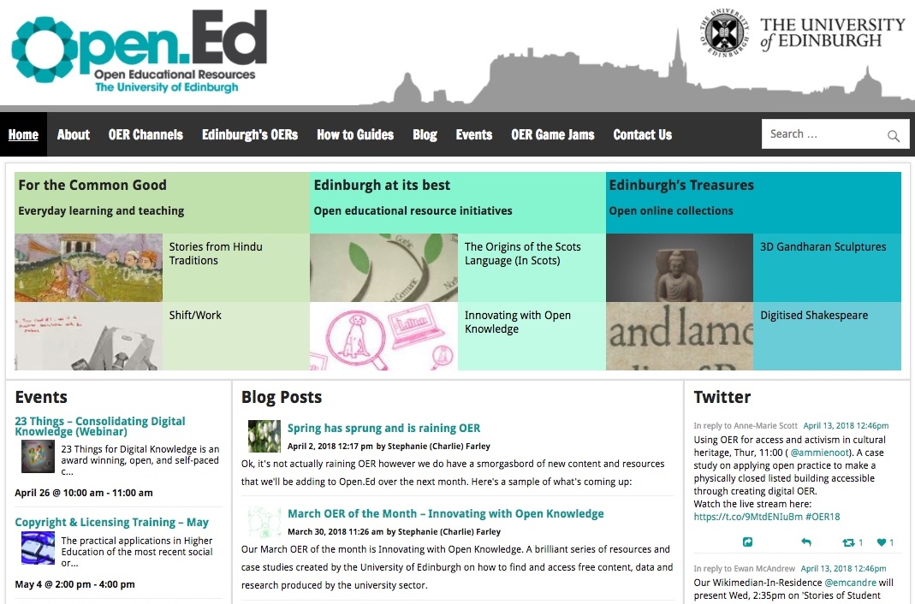

Open.Ed
OER & Open Knowledge at the University of Edinburgh
by
Charlie Farley
&
Lorna M. Campbell
Open.Ed, https://open.ed.ac.uk/

Slide 2
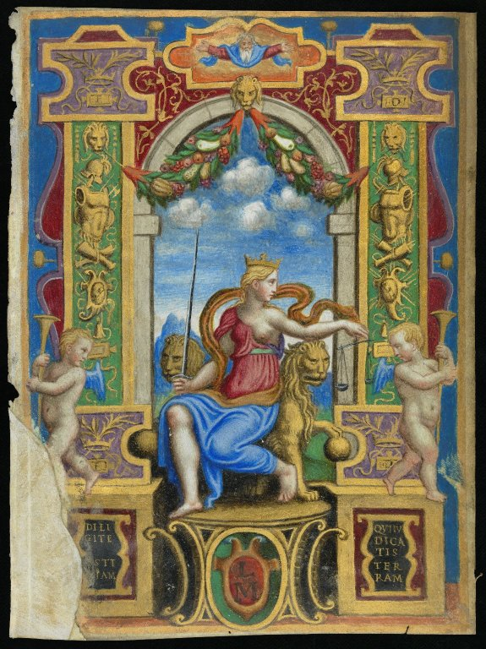
OER Mission, Vision & Policy
Provide the highest quality learning and teaching environment for the greater wellbeing of our students
Make a significant, sustainable and socially responsible contribution to Scotland, the UK and the world.
OER Vision draws on history of the Edinburgh Settlement, excellent education and research collections, traditions of the Enlightenment.
OER Policy encourages staff and students to use, create and publish OERs to enhance the quality of the student experience.
CC BY-NC-SA 2.0, Centre for Research Collections, https://flic.kr/p/snkn7o
Notes:
Open education can encompass many different things. These are just some of the aspects of open education

Slide 3
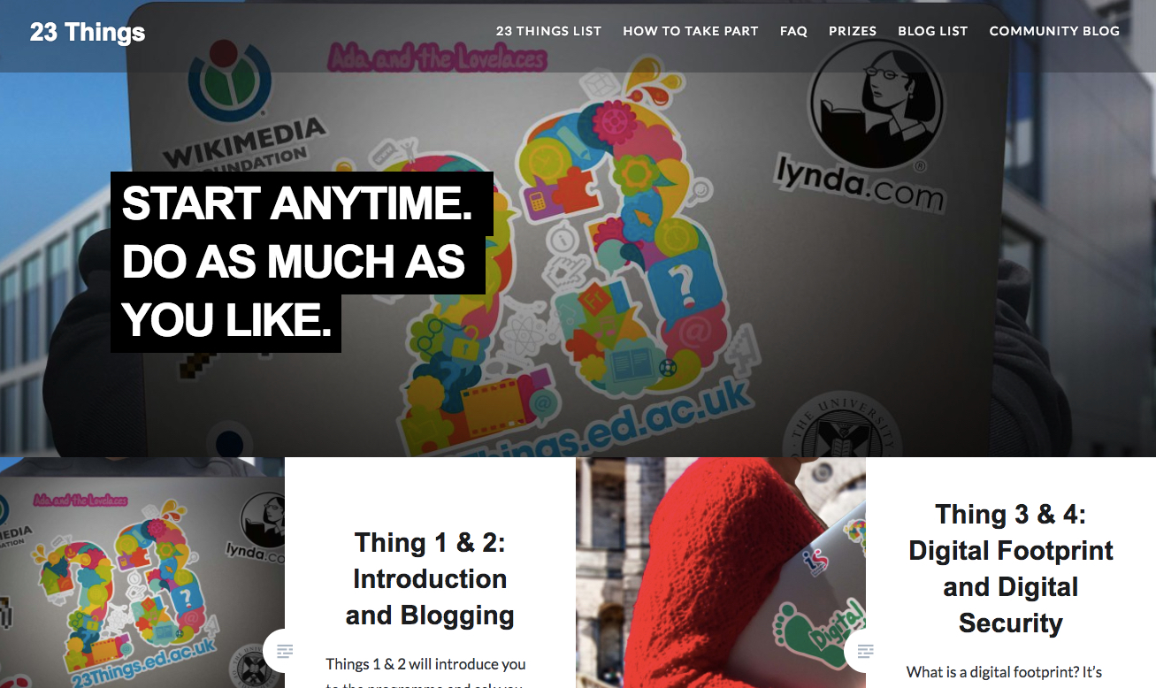
OER for
Digital
Skills
23 Things, https://www.23things.ed.ac.uk/
Notes:
Originally created by the University of Oxford, adapted by the University of Edinburgh. Course won the Credo Digital Award for Information Literacy
Subsequently adapted for use by the Scottish Social Services Council as 23 digital capabilities to support practice and learning in social services.

Slide 4
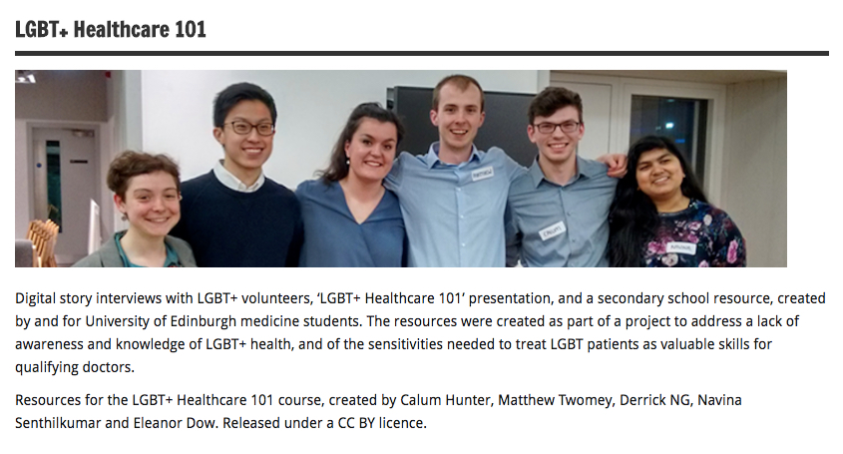
OER for Equality and Diversity
LGBT+ Healthcare 101, http://open.ed.ac.uk/lgbt-healthcare-101/

Slide 5

OER for Knowledge Exchange
Innovating
with
Open Knowledge
Innovating with Open Knowledge, https://openinnovation.is.ed.ac.uk/

Slide 6
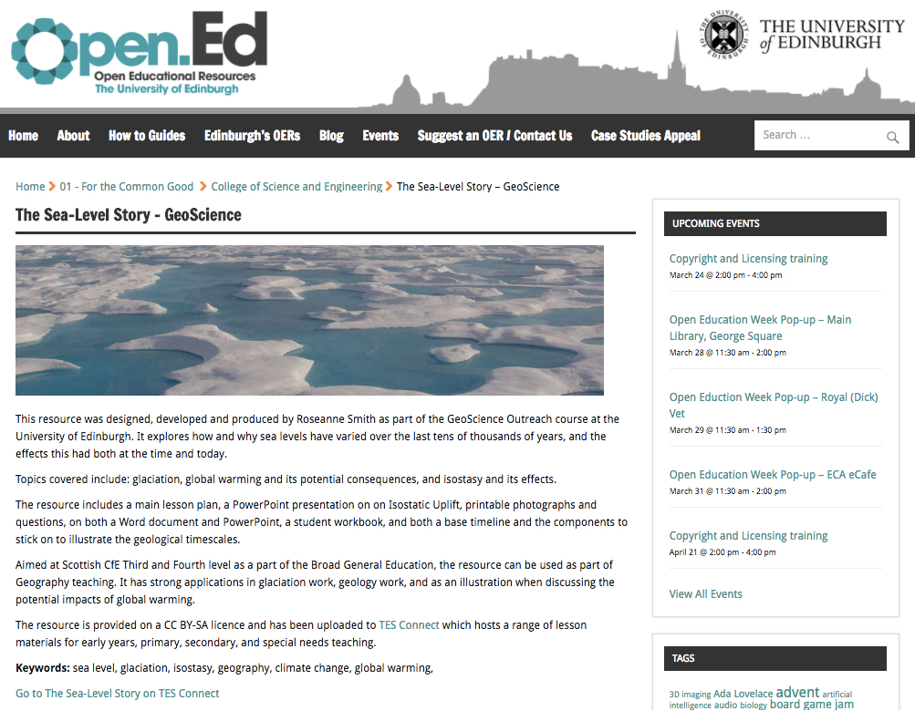
OER
Co-Creation
The Sea-Level Story, http://open.ed.ac.uk/the-sea-level-story-geoscience/

Slide 7
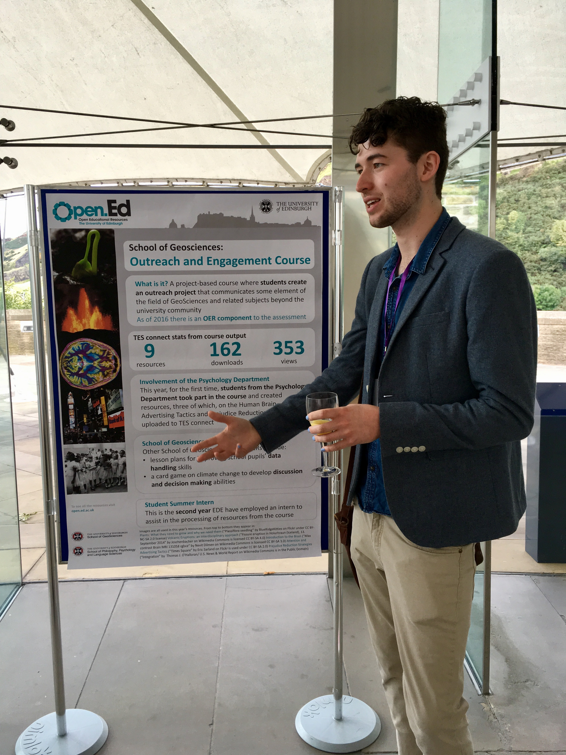
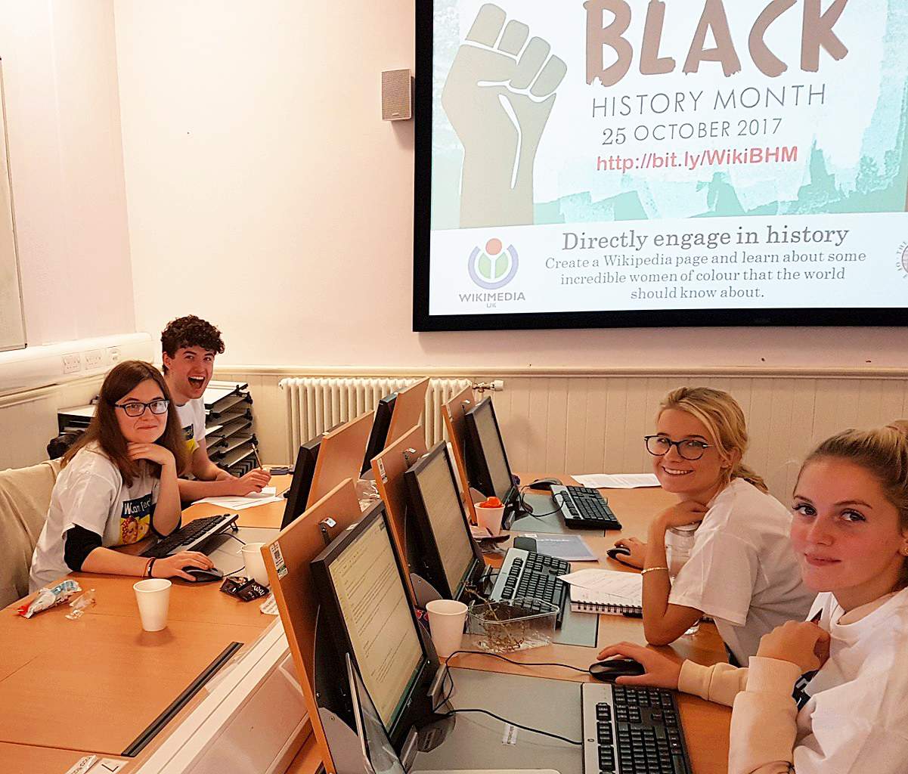
Open Content Curation Student Interns
Tomas Sanders, Open Content Curation Intern, CC BY, Lorna M. Campbell
Black History Month Wikipedia editathon, CC BY-SA 4.0, Stinglehammer,
Wikimedia Commons

Slide 8
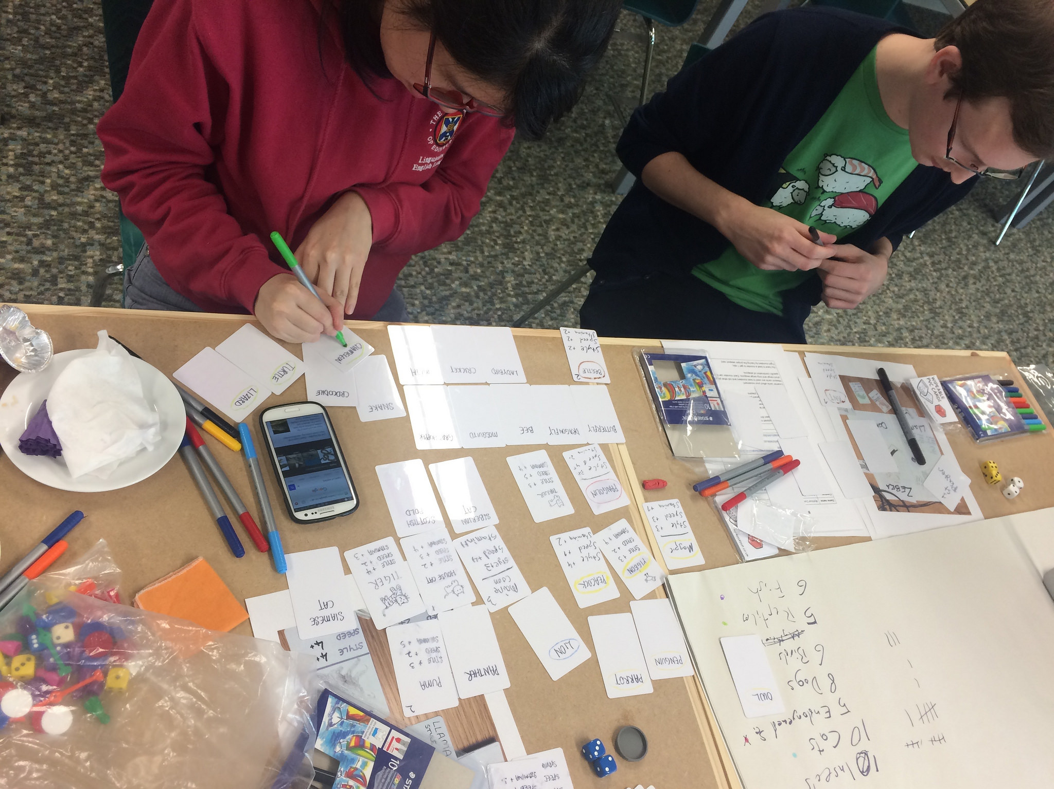
OER for Playful Learning
Board Game Jam, CC BY-SA 2.0 Open.Ed, https://flic.kr/p/R53nGm

Slide 9
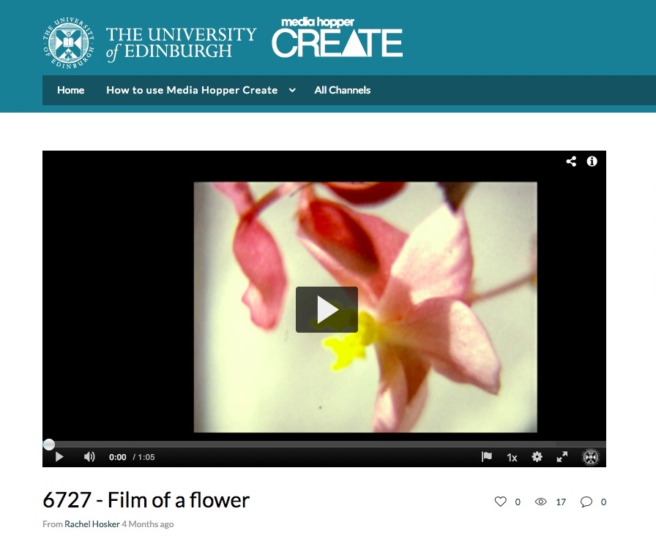
OER for
Creativity
Eric Lucey Film Archive, CC BY, University of Edinburgh,
Media Hopper Create

Slide 10
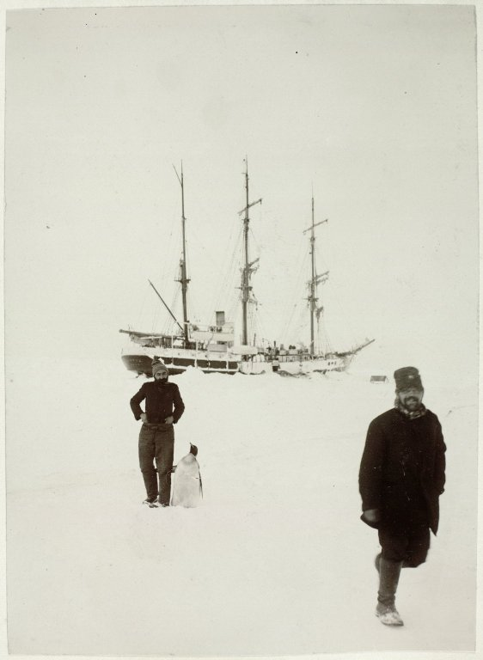
Contact
Charlie Farley
stephanie.farley@ed.ac.uk
@SFarley_Charlie
Open.Ed
open.ed@ed.ac.uk
http://open.ed.ac.uk/
@OpenEdEdinburgh
Lorna M. Campbell
lorna.m.campbell@ed.ac.uk
@LornaMCampbell
CC BY Lorna M. Campbell & Charlie Farley, University of Edinburgh, unless otherwise indicated.
CC BY-NC-SA 2.0, Centre for Research Collections, https://flic.kr/p/fcwCzM

