Slide 1
International collaborations using linked administrative data: Lessons from the MARIC study
Holly Tibble

Slide 2

>30 million people are released from incarceration globally each year
Increased risk of premature mortality
Insufficient statistical power to disaggregate specific cases:
Demographic (young people, ethnic minorities)
Causes (suicide, violence, HIV)
Temporal (first week)

Slide 3
The Mortality After Release from Incarceration Consortium (MARIC): A multi-national individual participant data meta-analysis
Notes:
To address the knowledge gaps identified above, we have created the international Mortality After Release from Incarceration Consortium (MARIC).
MARIC is a multi-disciplinary collaboration of researchers, clinicians and decision-makers
The MARIC study is the world’s largest coordinated effort to examine mortality in this population

Slide 4
29 cohorts
>1.3 million individuals
>9.1 million person-years of follow-up
Notes:
In total we have.. “The combined sample includes 1,337,993 individuals (89% male), with 75,795 deaths recorded over 9,191,393 person-years of follow-up.”

Slide 5
Rohan Borschmann (Melbourne), Holly Tibble (Edinburgh), Matthew J. Spittal (Melbourne), David Preen; (University of Western Australia), Jane Pirkis (Melbourne), Sarah Larney (Sydney), David Rosen (North Carolina), Jesse Young (Melbourne), Alexander Love (Melbourne), Frederick Altice (Connecticut), Ingrid Binswanger (Colorado), Anne Bukten (Oslo), Tony Butler (Sydney), Zheng Chang (Stockholm), Chuan-Yu Chen(Taiwan), Thomas Clausen (Oslo), Peer Brehm Christensen (Southern Denmark), Gabriel J. Culbert (Chicago), Louisa Degenhardt (Sydney), Anja J.E. Dirkzwager(Amsterdam), Kate Dolan(Sydney), Seena Fazel (Oxford), Colin Fischbacher (Edinburgh), Margaret Giles (Joondalup), Lesley Graham (Edinburgh), David Harding (California), Yen-Fang Huang (Taiwan), Florence Huber (French Guiana), Azar Karaminia (Sydney), Claire Keen (Melbourne), Fiona G. Kouyoumdjian (Ontario), Sungwoo Lim (New York), Lars Møller (Denmark), Akm Moniruzzaman (British Columbia), Jeffrey Morenoff; (Michigan), Eamonn O’Moore (London), Lia N. Pizzicato (Philadelphia), Daniel Pratt (Manchester), Scott K. Proescholdbell; (North Carolina), Shabbar I. Ranapurwala; (North Carolina), Meghan E. Shanahan (North Carolina), Jenny Shaw (Manchester), Amanda Slaunwhite (British Columbia), Julian M. Somers (British Columbia),Anne C. Spaulding (Atlanta), Marc F. Stern (Seattle), Kendra M. Viner; (Philadelphia), Nadia Wang (Taiwan), Melissa Willoughby (Melbourne), Bin Zhao (British Columbia), Stuart A. Kinner (Melbourne)
Notes:
There are a whole lot of researchers working together one this – this is just the author list of the primary investigators, let alone the full team from each site

Slide 6
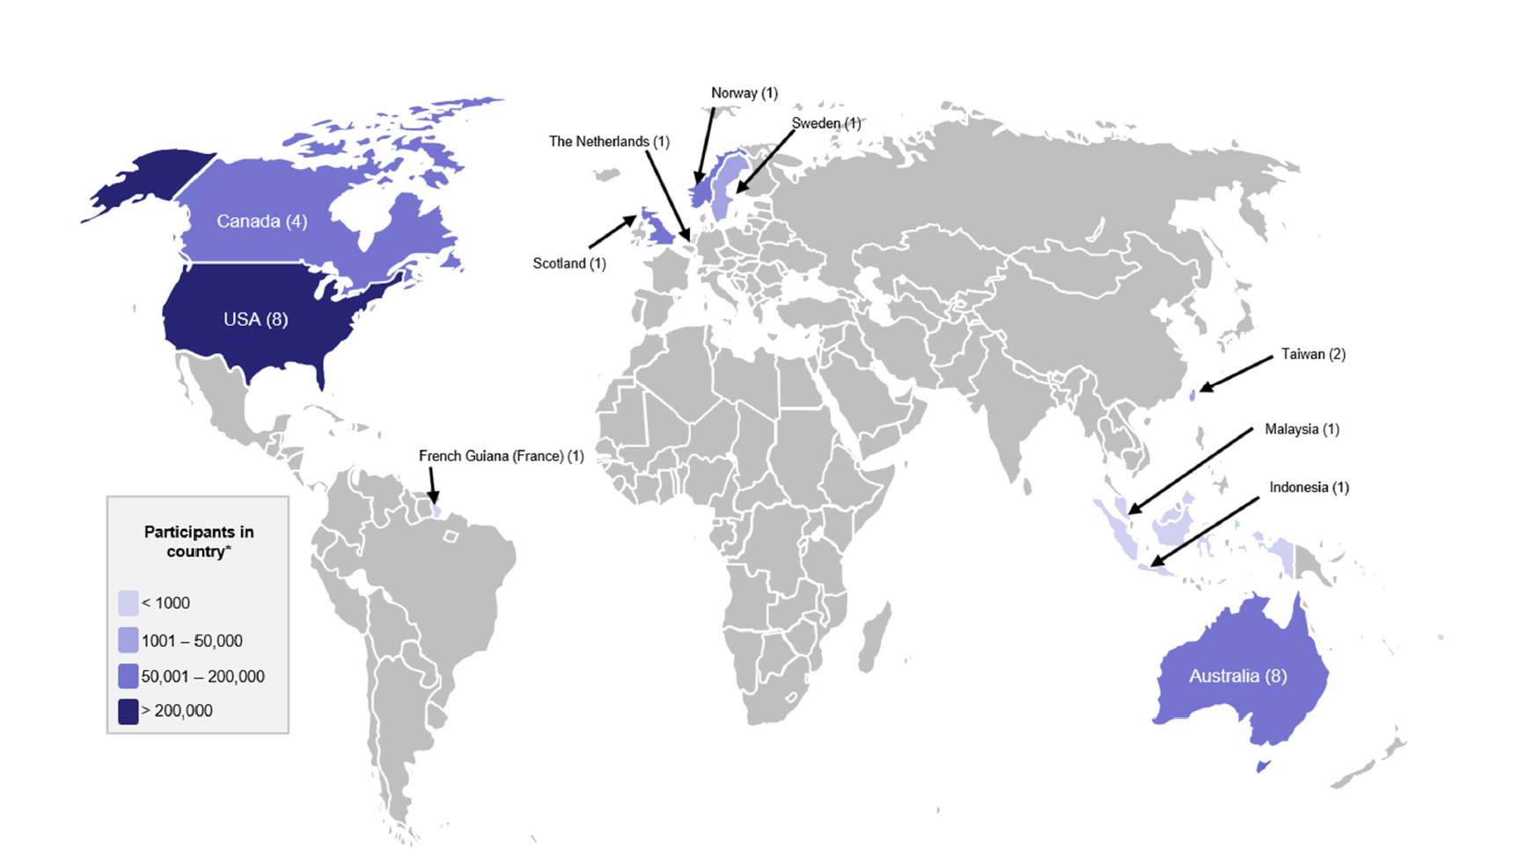
Notes:
Those of you who work in justice health might notice that one major country for incarceration we are missing is Russia

Slide 7
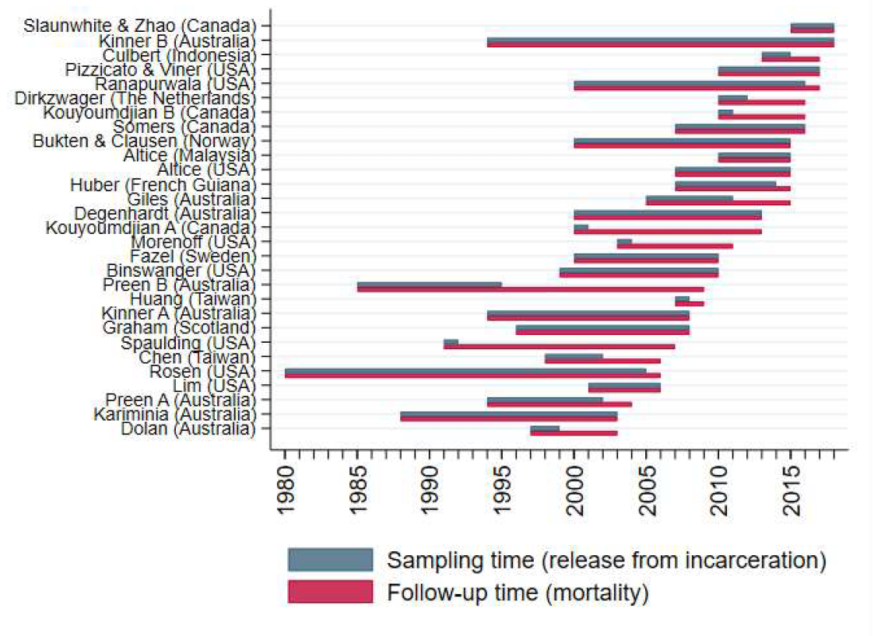

Slide 8
Lessons from MARIC

Slide 9
Problem 1: Data Structures
29 datasets
Different features collected
(e.g. ethnicity)
Different definitions
(e.g. jail vs. prison)
Different feature coding
(e.g. ICD codes)

Slide 10
 | Sex | Ethnicity | Cause of Death
COHORT 1 | {Male, Female, Other} | N.C. | ICD10: Any
COHORT 2 | {Male, Female} | N.C. | ICD10: X60-X84
COHORT 3 | N/A | {Black, White, Other} | {Suicide, Substance Abuse, Other}
COHORT 4 | {Male, Female, Other} | {Asian, Other} | N.C.
Solution:
Comprehensive Data Dictionaries
N.C. = Not Captured

Slide 11

Problem 2: Data Sharing
Using only published data leads to publication bias
Unpublished data has barriers:
Jurisdictional data-sharing regulations
Data ownership
Notes:
Understandably, teams with very recently collected data (which they might not have completed analysis on yet) might not be keen to hand that data over to another team

Slide 12
Cohort 3 Raw Data
Solution:
2-IPDMA
Step 1
Cohort 3 Summary Data
2-Step
Individual Patient Data Meta-Analysis
All Cohorts Summary Data
Step 2
All Cohorts Meta-Analysed Data

Slide 13
Problem 3: Inconsistency in Returned Data

Slide 14
Representation 1
Representation 2
Day | Died | Remaining
0 | 320 | 697,657
1 | 235 | 697,337
2 | 218 | 697,119
3 | 128 | 696,991
4 | 87 | 696,904
5 | 35 | 696,869
Day | Died | Remaining
1 | 320 | 697,657
2 | 235 | 697,337
3 | 218 | 697,119
4 | 128 | 696,991
5 | 87 | 696,904
6 | 35 | 696,869
Is day 1 the day of release or the first day after release?
Notes:
Furthermore, for some people deaths inside prison were considered the end of their incarceration - hard to tell if died inside or outside

Slide 15
Representation 1
Representation 2
Day | Died | Remaining
0 | 320 | 697,657
1 | 235 | 697,337
2 | 218 | 697,119
3 | 128 | 696,991
4 | 87 | 696,904
5 | 35 | 696,869
Day | Died | Remaining
0 | 320 | 697,657
1 | 235 | 697,337
2 | 218 | 697,119
3 | 128 | 696,991
4 | 87 | 696,903
5 | 35 | 696,868
Notes:
In the right hand case, we have one person who was censored, by being REINCARCERATED, which was not captured in some datasets

Slide 16
Explicit inclusion and exclusion criteria (even when the exclusion is just the reverse of the inclusion!)
Feature harmonization/standardization plan
All definitions and assumptions
Expected output example
Sample derivation script in
multiple programming
languages
Solution:
SAPs
Statistical
Analysis
Plans

Slide 17

Conclusions
The MARIC study greatly increases the scope and precision of research on mortality after release from incarceration and brings international attention to this problem.
The IPDMA methodology allows a rigorous and comprehensive analysis of this data to be conducted internationally and collaboratively.
Be specific on details
Be thorough on assumptions
Be prepared with documents

