Slide 1




Using data to improve outcomes for children
Dealing with Data Conference
15 Jan 2020

Slide 2
Dealing with Data Conference
Title: The Data for Children Collaborative with UNICEF –
The Data Opportunities & Challenges when Collaborating across Organisations
Abstract: This new partnership between UNICEF, the University of Edinburgh and the Scottish Government presents some unique opportunities and challenges for a variety of reasons. This talk will take you through the story so far in building up this cross sectoral partnership which looks to deliver impact and insight to childhood issues, locally, nationally and globally, through the use of innovative data and data science.
Understand more about project selection processes, governance frameworks, ethics and child safeguarding, all whilst highlighting the need for extra caution when working with data relating to children.

Slide 3
Agenda
# | Item
1 | Introduction
1 | Project Initiation Processes
2 | Governance Frameworks
3 | Ethics & Child Safeguarding
4 | Summary

Slide 4

1.1 Data for Children Collaborative with UNICEF - Introduction
Using data to improve outcomes for children.
The Data for Children Collaborative with UNICEF is a joint partnership between UNICEF, The Scottish Government and the University of Edinburgh. The Collaborative seeks to improve outcomes for children locally, nationally and globally. It draws on the strengths of all partners to bring insight and solve problems using data and data science.
The Collaborative prioritises and enables data projects linking academics, UNICEF subject matter experts and Scottish Government childhood policy and analyst experts, whilst also fostering partnerships with other organisations. These projects will have a focus on adoption of actionable insights to inform policy and practice.
The Collaborative is funded jointly by the Scottish Government, through the Scottish Funding Council, and the University of Edinburgh for a start-up period of three years.
Increased availability and use of data has highlighted innovative new techniques to solve real-world problems across all sectors. The Collaborative believes that the capabilities and capacity of the partners and wider partnerships can be leveraged to tackle key problems across some of the world’s fundamental childhood issues.
The challenge for the Collaborative is finding the right data for the right problem and gaining access to use it in the right way. With the right support from all partners and other stakeholders, we feel that this is a challenge that can be met, learnt from and shared with others.

Slide 5
1.2 Challenges when Collaborating across Organisations
Three large organisations, each with its own set of policies, governance, ways of working
Dealing with sensitive data relating to children
Global reach of projects, with different data legislations impacting each project
Cross-organisational project teams
Partnering with external organisations, e.g. private sector, adds a layer of complexity

Slide 6
1.3 Data for Children Collaborative – How we work
Impactful
Trusted
Projects propositions will be generated through discussion and consensus from all three partner organisations: UNICEF, the Scottish Government & the University of Edinburgh. Problem statements will be clear and project outputs / insights / actions will be defined from the outset. The child will be at the heart of all decision making regarding project impacts.
The Collaborative will create an Ethical Charter that will outline the responsibilities and practices of any activity relating to the Collaborative, as well as support decision making. The Collaborative will ensure all projects adhere to an ethical protocol throughout the project lifecycle. The Collaborative will comply with all legal and regulatory requirements relating to data protection including privacy, security and usage.
Agile
The Collaborative will operate in a highly flexible and interactive manner across the collaborators and with other delivery partners. The Collaborative will respond to change quickly and work to move constraints as projects progress.
Innovative
Transparent
The Collaborative will deliver projects that involve data driven innovation. These projects can be innovative either in; the data science methodologies used; the data set being used; or new data linkages.
Safe
Each project proposal will go through a prioritisation framework to assess its suitability, deliverability, impact and scalability before progressing to our Advisory Board and Governance Board for approval to proceed.
The Collaborative will prioritise the safeguarding of children above all else. All key stakeholders and project resource will undergo UNICEF approved safeguarding training. The Collaborative will embed a Youth Engagement assessment into its core operating model.

Slide 7
2.1 Prioritisation Framework
Prioritisation Assessment
Subjective scoring of agreed project proposal on 0 – 3 scale against the following criteria:
0 – Reject
1 – Poor
2 – Good
3 – Excellent
Total possible score of 16.2 points
Total Suitability Score /3
Alignment to Collaborative vision
Total Deliverability Score /3 (with x 1.2 weighting)
Data Accessibility
Total Impact Score /3 (with x 1.2 weighting)
Scalability Score /3
Financial Resources / Funding
Data Ethics Challenges
Human Resources
Actionable insights
Timescale v’s Return
SDG alignment
Principal actor / sponsor
Innovative
Delivers leverage
Portfolio /3
Geographic Impact
Diversity
Success Measures Definition
Return on investment
Data Usage
NPF alignment

Slide 8
2.2 Project Initiation Document
The Project Initiation Document considers the follow headings
Project Definition
Background to the Project
Objectives of the Project
Economic Impact of the Project
Project scope and exclusions
Constraints, assumptions and issues
The sponsor / actor and other known interested parties
Data sources
Project Approach
Roles & Responsibilities
Key stakeholders and subject matter experts
Project Team
Business Case
Organisation and Structure
Team / Virtual Team Structure
Governance Model
Roles
Data Strategy
Purpose
Data sourcing methodology
Ethical considerations
Records
Reporting
Responsibilities
Tools
Data Science
Purpose
Methodology
Ethical considerations
Records
Reporting
Responsibilities
Tools
Risk Management
Purpose
Processes, standards and definitions
Tools and techniques
Timing of risk management activities
Risk appetite and tolerance
Reporting and indicators
Escalation
Reviews and assessments
Communications Strategy
Purpose
Communication procedure
Definition of stakeholders
Stakeholder analysis
Information needs for each interested party
Review and feedback
Project Plan
Dependencies
Tolerances
Planning assumptions
Deliverable plan
Schedule
Resource plan
Data Access & Usage plan
Financial budget
Measurements plan
Project completion
Intellectual Property
Background
Title to Project Intellectual Property
Licensing
Ownership of Technical Data
Dispute Resolution
11. Publication
Approval Process
Funding Terms
11. Project Controls
Safeguarding Training
Ethical Review
Ethical Checkpoints
GDPR Review

Slide 9
3.1 Board Governance Structure Proposal
Collaborators and Funders
University of Edinburgh EFI via DDI Governance
UNICEF
Scottish Government via SFC Governance
(Quarterly)
Steering Board
Membership
Chair Stefaan Verhulst – GovLab
UoE Gillean McCluskey – Scottish Acad Lead
UoE Lesley McAra – EFI
Public Sector Mahmood Adil – Clinical & Pub Health
Public Sector Mick Wilson – Scot Gov
UNICEF Mark Hereward – UNICEF
UNICEF Lucinda Rivers- UNICEF
Independent Manolo Perez – TDL
Independent Richard Kenway (Interim) – Ethics
Independent XXX – International Childhood Expert
Delivery Alex Hutchison – Del Director
Strategy
Set jointly
agreed direction
AI-X (University of Edinburgh)
Review expertise available for ethical guidance
Delivery
Director
Delivery Support
Board
Membership
Alex Hutchison – Del Director (Chair) Albert King – Scot Gov
Carol Sinclair – NSS XXX – UNICEF Ethics Rep
Gillean McCluskey – Scottish Acad Lead Jude McCorry – TDL
Kostas Kavoussanakis – EPCC Liz Reilly – Philanthropy Lucinda Rivers – UNICEF Ritchie Somerville – DDI
XXX – UoE Ethics Rep
Practice
Direct
for impact
Support, enable, and empower
(Fortnightly)
Project Working Group A
(Fortnightly)
Project Working Group C
Future projects
Future projects
Future projects
Future projects
Delivery
(Fortnightly)
Project Working Group B
Future projects
Implement
for impact
(Periodically)
Partnership Forums
Data Holders
Reflection
Advise
Other Stakeholders
Reflect and
Inform
Decide
Deliver
Youth Engagement

Slide 10
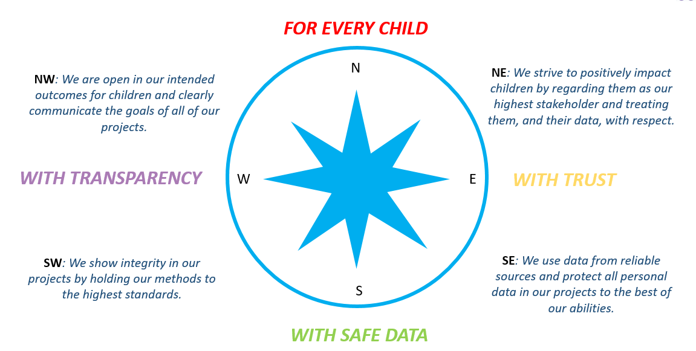
4.1 Safe Data Ecosystem
Ethical Assessment:
Compass
Roadmap
Highway Code
Socio Ethical Questions
Data Protection
Data Management
PID incorporates Data Management Plan, based on UoE templates
UoE online Data Protection Impact Assessment

Slide 11
4.2 Ethical Assessment
Roadmap
Highway Code
Start
(at outset)
Project
Data
On The Road
(periodic review)
Project
Data
Destination
(at results stage)
Project
Data
Results
Results
Results
Detailed guidance notes to support completion of Roadmap

Slide 12
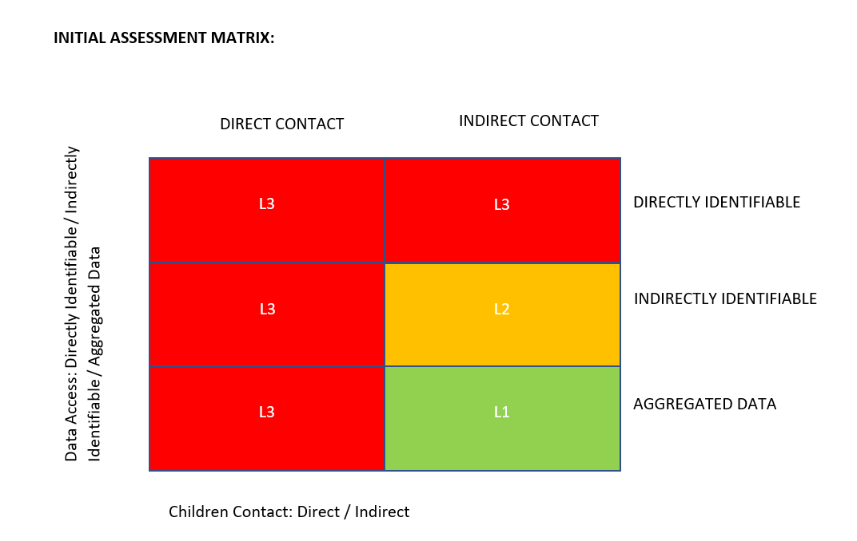
4.3 Safeguarding Training
Developing Safeguarding Training in three tiers to meet training requirements:
L1 “Theory Test” – low risk – safeguarding statement + 15-minute review
L2 “Driving Test” – medium risk – safeguarding statement + 45-minute training session
L3 “Advanced Driving Course” – high risk – full UNICEF safeguarding training

Slide 13
5. Summary
Three large organisations, each with its own set of policies, governance, ways of working
Leverage the strengths of each organisation
Be transparent on which policies will be used to manage data
Make sure all decisions are clearly agreed at the appropriate governance forum
Dealing with sensitive data relating to children
Build a clear framework of project initiation for each project to adhere to
Engage relevant experts in review of any assessments / project documentation
Global reach of projects, with different data legislations impacting each project
Seek local expertise for different requirements
Cross-organisational project teams & external organisations
Build trust via clear ways of working and expectations on stakeholders
Communicate code of conduct to all involved in project and appropriate level of safeguarding training

