Slide 1

Impact and the REF
Tweet
#rfringe17
Catriona Firth
REF Deputy Manager
Repository Fringe
Edinburgh, 3 August 2017

Slide 2
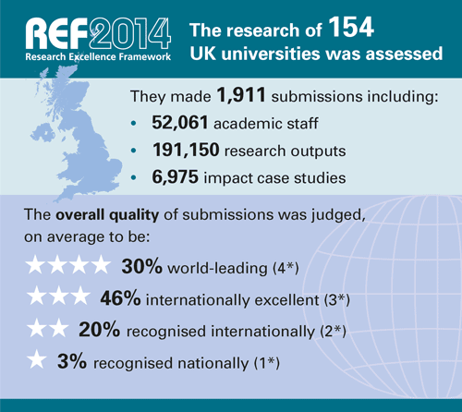
Impact in REF 2014
Assessed for the first time in REF 2014.
‘Impact is any effect on, change or benefit to the economy, society, culture, public policy or services, health, the environment or quality of life, beyond academia’.
Reflected policy aims to maintain and improve the achievements of the HE sector in undertaking ground-breaking research and building on this research to achieve demonstrable benefits to the wider economy and society.

Slide 3
Impact in REF 2014 – assessment
Impact Case Studies
Four-page documents describing impacts that had occurred between January 2008 and July 2013. The submitting university must have produced high-quality research since 1993 that contributed to the impacts. Each submitting unit returned one case study, plus an additional case study for every 10 staff.
Impact Template
This document explained how the submitted unit had enabled impact from its research during the period from 2008 to 2013, and its future strategy for impact.
Assessment Criteria
Impact case studies were assessed in terms of their ‘reach and significance’
Impact templates were assessed in terms of how far the approach and strategy were conducive to achieving impacts.

Slide 4
Impact in REF 2014 – outcomes
6,975 case studies were submitted
On average across all submissions, 44% of impacts were judged outstanding (4*) by over 250 external users of research, working jointly with the academic panel members. A further 40% were judged very considerable (3*).
Cost estimated at £550m

Slide 5
The nature, scale and beneficiaries of research impact. An initial analysis of Research Excellence Framework (REF) 2014 impact case studies. King’s College London and Digital Science. March 2015
Impact in REF 2014 – outcomes

Slide 6
The Stern Review
In November 2015, Lord Nicholas Stern was commissioned by the Minister of Universities and Science to conduct an independent review of the REF.
Key principles
    Lower burden
    Less game-playing
    Less personalisation, more institutionally focused
    Recognition for investment
    Making space for long-term research
    More rounded view of research activity
    Interdisciplinary emphasis
    Broaden impact

Slide 7
The Stern Review - Key points
Staff and outputs
    Submission of all ‘research-active’ staff
    Outputs to be determined at unit of assessment level
    Outputs should not be ‘portable’
    Could impact on number of case studies required for each unit
    Feedback
  Broad support to include ‘all staff with significant responsibility to carry out research’ but questions on how to define ‘significant responsibility’
  Support for weakening link between staff and submitted outputs.
  Concerns about effects of non-portability, its timing in cycle and practical issues of implementation
  Initial proposal
    Institutions to identify staff in scope or opt for 100% submission
    Allow outputs to be counted twice or implement more complex hybrid model

Slide 8
The Stern Review - Key points
    Impact
    Broaden and deepen the definition of impact and provide additional guidance
      Public engagement
      Impact on curricula and/or pedagogy
    Move the impact template to the assessment of environment
    Reduce number of required case studies to min. of one
    Include impact arising from research, research activity or a ‘body of work’
    Quality threshold for underpinning research & standards of rigour
    Resubmission of REF 2014 case studies

Slide 9
The Stern Review - Key points
    Feedback on impact proposals
    Support for alignment with Research Council definitions
    Support for broader basis of research, but challenges in drawing boundaries
    Some concerns about sub-profile based on one case study
    Difficult to separate out rigour from originality and significance
    Support for resubmission of 2014 case studies but questions around ‘additionality’

Slide 10
The Stern Review - Key points
    Institutional-level assessment
    Impact: case studies arising from multi and interdisciplinary and collaborative work
      10-20% of total impact case studies; minimum of one
    Environment: statement to avoid duplication of content across UOAs; give recognition to institutional support
    Feedback
    Impact: unsure of problem to be solved; unclear if right mechanism; questions about relationship between institution and unit of assessment
    Environment: support for principle; concerns about small & specialist; questions about best way to assess; needs to enable sector diversity
    Suggestions
      Impact strategy + flagging case studies (incl. interdisciplinary examples)
      Institutional-level environment section within UOA template
      No separate / lower weighting (5%) for institutional-level environment

Slide 11
Next steps
  Communications in summer/autumn 2017
  REF initial decisions document
  Summary of consultation responses
  Full consultation responses
  Launch of REF2021 website and Twitter account

Slide 12
Thank you for listening
Follow us on Twitter at
#REF2021
info@ref.ac.uk
openaccess@hefce.ac.uk

